Slide 1
Advanced Medical Home (AMH)
Technical Advisory Group (TAG)
Meeting #14:
Implementation Experience: Quality Deep Dive
Revisiting Priority Issues for AMH TAG
October 12, 2021

Slide 2
Agenda
Welcome and Roll Call (5 minutes)
Implementation Experience: Quality Deep Dive (20 minutes)
Revisiting Priority Issues for AMH TAG (30 minutes)
Wrap-Up and Next Steps (5 minutes)
1
2
3
4

Slide 3
AMH TAG Membership Introductions and Roll Call
Name | Organization | Stakeholder
C. Marston Crawford, MD, MBA | Pediatrician Coastal Children's Clinic – New Bern, Coastal Children's | Provider (Independent)
David Rinehart, MD | President-Elect of NC Family Physicians North Carolina Academy of Family Physicians | Provider (Independent)
Rick Bunio, MD | Executive Clinical Director, Cherokee Indian Hospital | Provider
Gregory Adams, MD | Member of CCPN Board of Managers Community Care Physician Network (CCPN) | Provider (CIN)
Ruth Krystopolski, MBA | Senior Vice President of Population Health Atrium Health | Provider (CIN)
Amy Russell, MD | Medical Director Mission Health Partners | Provider (CIN)
Kristen Dubay, MPP | Director Carolina Medical Home Network | Provider (CIN)
Joy Key, MBA | Director of Provider Services Emtiro Health | Provider (CIN)
Tara Kinard, RN, MSN, MBA, CCM, CENP | Associate Chief Nursing Officer Duke Population Health Management Office | Provider (CIN)
George Cheely, MD, MBA | Chief Medical Officer AmeriHealth Caritas North Carolina, Inc. | Health Plan
Michael Ogden, MD | Chief Medical Officer Blue Cross and Blue Shield of North Carolina | Health Plan
Michelle Bucknor, MD, MBA | Chief Medical Officer UnitedHealthcare of North Carolina, Inc. | Health Plan
Eugenie Komives, MD | Chief Medical Officer WellCare of North Carolina, Inc. | Health Plan
William Lawrence, MD | Chief Medical Officer Carolina Complete Health, Inc. | Health Plan
Jason Foltz, DO | Medical Director, ECU Physicians MCAC Quality Committee Member | MCAC Quality Committee Member
Keith McCoy, MD | Deputy CMO for Behavioral Health and I/DD Community Systems, Chief Medical Office for Behavioral Health and IDD | DHHS

Slide 4
Welcome and Roll Call (5 minutes)
Implementation Experience: Quality Deep Dive (20 minutes)
Revisiting Priority Issues for AMH TAG (30 minutes)
Wrap-Up and Next Steps (5 minutes)
1
2
3
4

Slide 5
AMH Monitoring & Evaluation To Date
Certification & Contracting Process
Program Design
AMH TAG
Data Sharing
Program Oversight & Evaluation
Quality

Slide 6
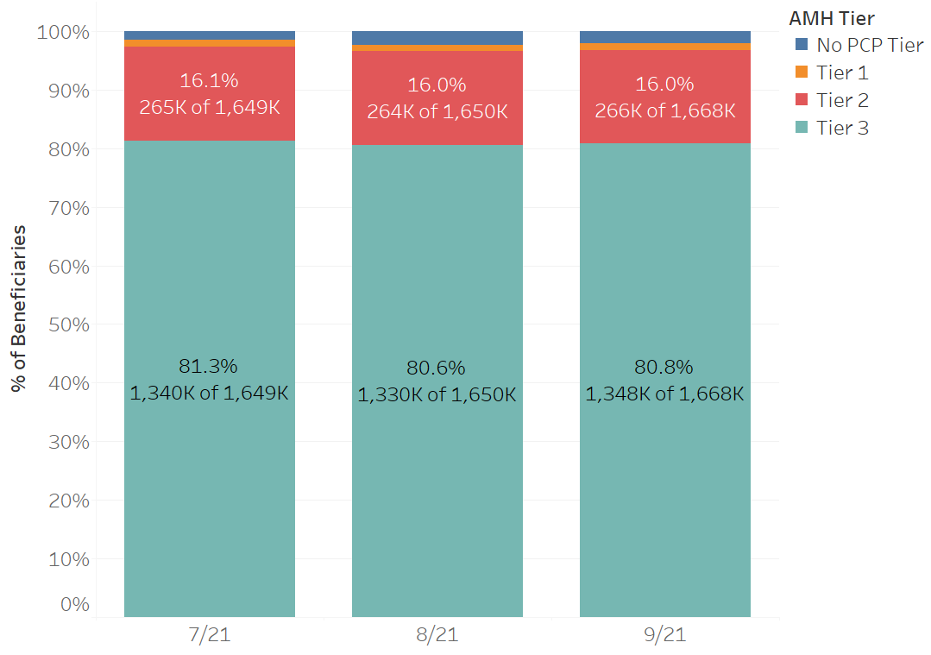
Managed Care Beneficiaries by AMH Tier
80%+ of members are assigned to an AMH Tier 3 practice

Slide 7
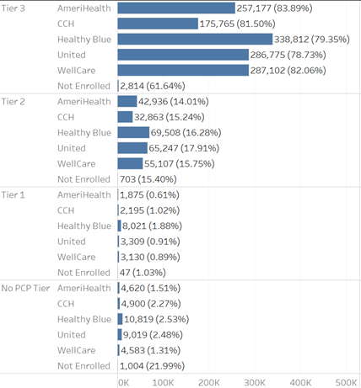
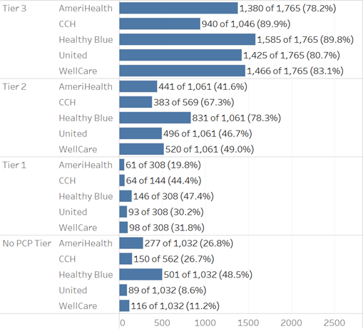
Member Enrollment and PCP Contracting by Plan by State-Assigned AMH Tier
Through September 13, 2021
Contracted PCPs by State Tier (% of All PCPs of that Tier)*
Beneficiary Count by State Tier (% of Plan Beneficiaries)
~80% of members are assigned to an AMH Tier 3 practice.
PHPs have higher rates of contracting with AMH Tier 3s over other types of PCPs
Source: https://internaldashboards.ncdhhs.gov/t/Medicaid/views/MemberXPHPXPCP_16201744538180/BeneficiaryandPracticeCountbyPlanbyState-AssignedAMHTier?:showAppBanner=false&:display_count=n&:showVizHome=n&:origin=viz_share_link
*Only reflects contracting in regions 3, 4, and 5 for CCH

Slide 8
AMH Glidepath Payments Summary
 | April | May | June | Total
Practice Count (as % of all Tier 3 AMHs) | 1,099 (62.4%) | 1,187 (67.4%) | 1,303 (74.0%) | 1,338 (76.1%)
Total $ Spent | $9,596,769.55 | $11,280,524.11 | $11,503,315.91 | $32,380,609.57
Beneficiaries Count (as % of all Beneficiaries Assigned to Tier 3 AMH) | 1,127,723 (69.1%) | 1,270,896 (77.8%) | 1,306,981 (80.0%) | 1,385,940 (84.9%)
.

Slide 9
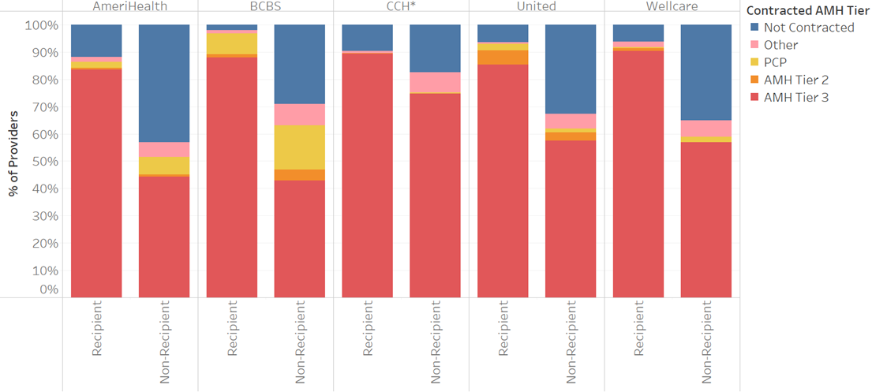
Contracting at the State Tier by PHP: Glidepath Recipient vs Non
1,338 Glidepath Practices, 440 Tier 3 Non-Glidepath Recipients
AMH Tier 3s w/Glidepath were more likely to contract with more Plans as a Tier 3.
*Only reflects contracting in regions 3, 4, and 5 for CCH

Slide 10
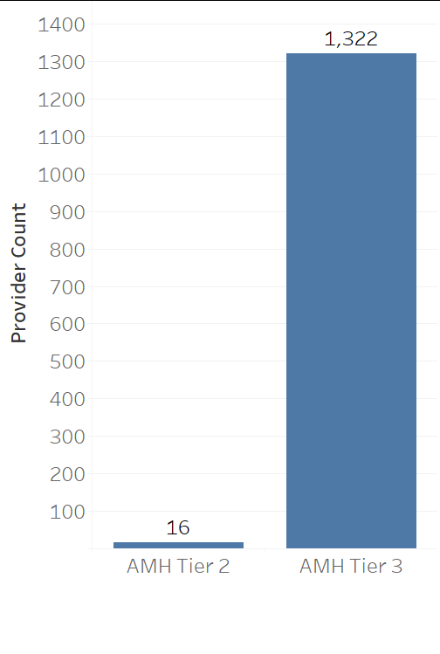
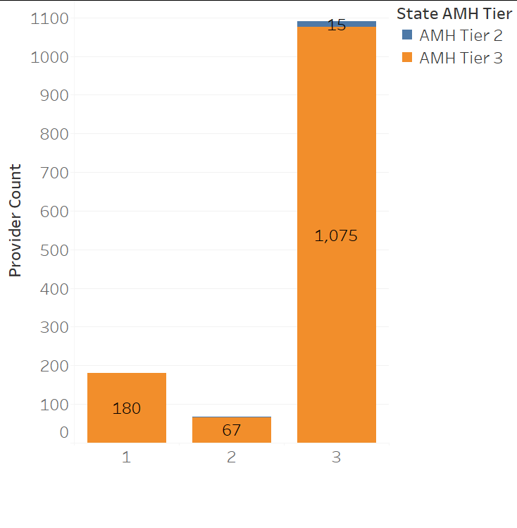
AMH Glidepath Recipients—Maintaining Tier 3 Contracts
AMH Tier as of 8/27/2021
Months Provider Received Payments
16 practices (1%)
downgraded to Tier 2
.
Notes:
At time of payments practices were required to be an AMH3
16 practices downgraded from Tier 3 to Tier 2 (confirmed in NCTracks)

Slide 11
.
AMHs & Clinically Integrated Networks (CIN)
Through September 11, 2021
CINs Affiliated with AMHs ​ | Number of AMHs/Sites​ | Member Count​ | Proportion of Beneficiaries​
CIN 1 | 716​ | 733,060​ | 45%​
CIN 2 | 181​ | 176,101​ | 11%​
CIN 3 | 138​ | 115,939​ | 7%​
CIN 4 | 128​ | 110,415​ | 7%​
CIN 5 | 80​ | 99,632​ | 6%​
CIN 6 | 66​ | 77,005​ | 5%​
CIN 7 | 81​ | 62,781​ | 4%​
CIN 8 | 71​ | 52,504​ | 3%​
CIN 9 | 26​ | 47,187​ | 3%​
CIN 10 | 35​ | 30,362​ | 2%​
CIN 11 | 5​ | 26,034​ | 2%​
CIN 12 | 10​ | 20,816​ | 1%​
CIN 13 | 22​ | 13,791​ | 1%​
CIN 14 | 15​ | 11,445​ | 1%​
CIN 15 | 20​ | 10,747​ | 1%​
CIN 16 | 14​ | 6,627​ | 0%​
CIN 17 | 1​ | 6,595​ | 0%​
CIN 18 | 13​ | 5,237​ | 0%​
CIN 19 | 3​ | 5,000​ | 0%​
CIN 20 | 1​ | 3,527​ | 0%​
CIN 21 | 1​ | 2,012​ | 0%​
CIN 22 | 1​ | 1,718​ | 0%​
CIN 23 | 1​ | 59​ | 0%​
CIN 24 | 8​ | 1,654​ | 0%​
CIN 25 | 127​ | 12,548​ | 1%​
​ | 1,764​ | 1,632,796​ | ​
76% of members are in 5 CINs
70% of practices are in 5 CINs
CIN affiliation is collected from PHPs through the BCM029, a weekly contracting and data integration report. CIN data on BCM029 is not complete. In addition, many AMHs are affiliated with different CINs across different PHPs.

Slide 12
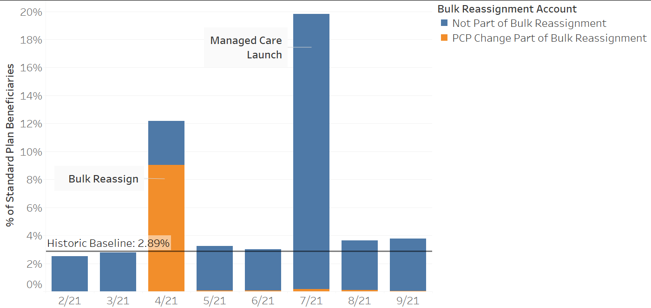
Proportion of Standard Plan Beneficiaries Reassigned each Month
Most members (80%+) kept their PCP after MCL. Most reassignments occurred during the bulk reassignment period and at MCL.
Any PCP reassignments show up at the start of the following month. Reassignments on 7/21 include auto-assignments and plan-originated reassignments. Baseline reflects average reassignments on 2/21, 3/21, 5/21, and 6/21.
Notes:
Not all PCP changes occurred in 4/21, which is why we see some

Slide 13
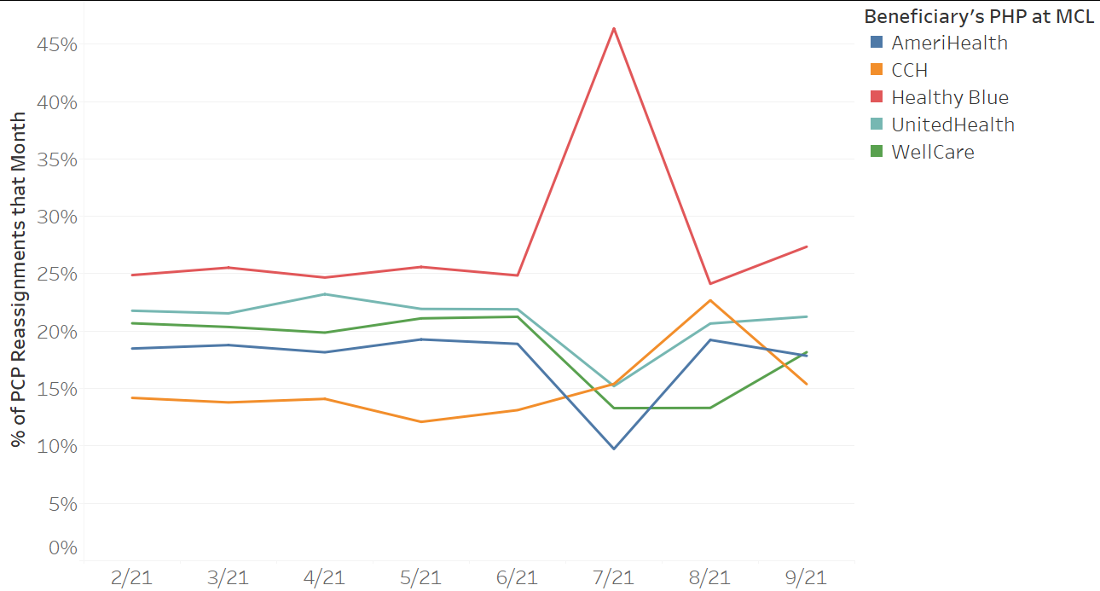
Proportion of PCP Reassignments each Month by Plan
Pre-MCL the proportion of reassignments associated with members who would be assigned to each Plan is consistent. When plans control assignments starting 7/21, we see some variations.
.

Slide 14
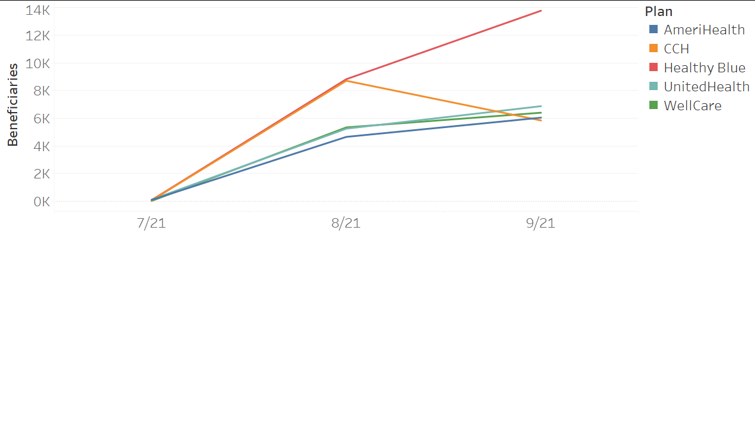
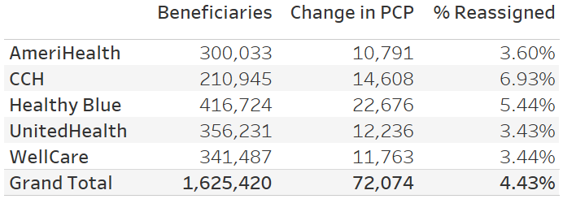
PCP Assignment Changes by Plan After Managed Care Launch
Source: https://internaldashboards.ncdhhs.gov/t/Medicaid/views/KPI9-AssignmentChangesEachWeekWorkbookDRAFT/BeneficiaryReassignmentafterMCL?:showAppBanner=false&:display_count=n&:showVizHome=n&:origin=viz_share_link
.

Slide 15
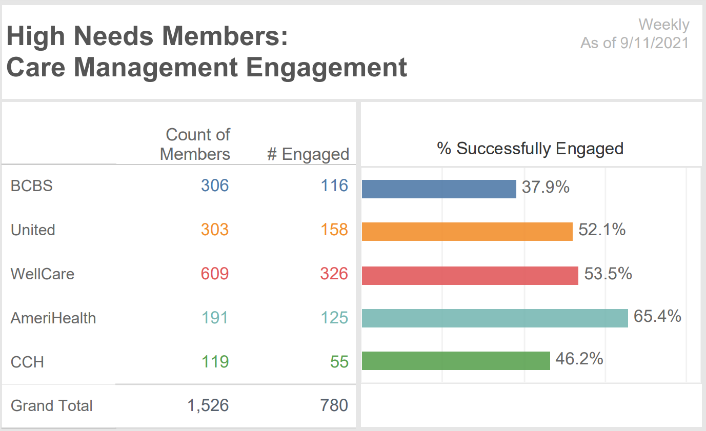
High Need Beneficiaries Transitions (Care Management)
All High Need Members were engaged by PHP care managers initially for warm hand-off as needed to AMH Tier 3
Through final weekly submission of High Need Beneficiary at Cross Over PHP report, 9/11/2021
Source - https://internaldashboards.ncdhhs.gov/t/Medicaid/views/1_KPI_SummaryPage/LandingPage?:showAppBanner=false&:display_count=n&:showVizHome=n&:origin=viz_share_link

Slide 16
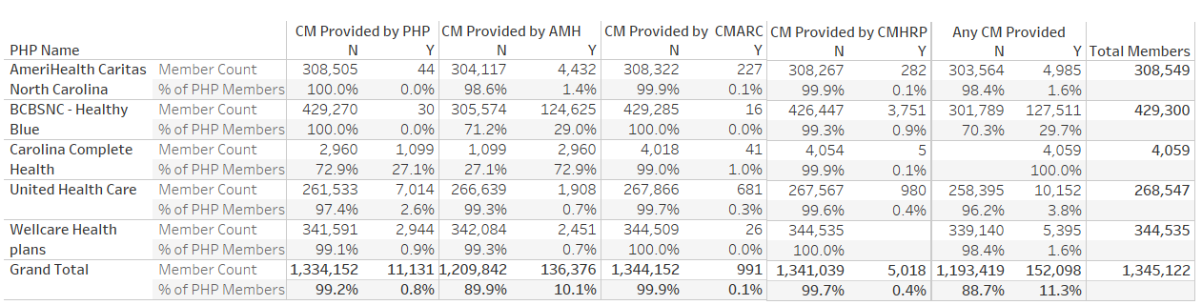
Early Care Management Analysis
Through 7/31/2021
Under Development
Data shown in this slide is based on reporting provided by the PHPs, and we are not yet confident in the accuracy.
The report is intended to capture total beneficiaries enrolled with the PHP, and not all plans complied with this as seen by total member count, so the rates of CM are not accurate. There are also issues with duplicate members reported. We are working with the plans to improve data quality.

Slide 17
AMH Quality Measure Attribution
Certification & Contracting Process
Program Design
AMH TAG
Data Sharing
Program Oversight & Evaluation
Quality

Slide 18
Quality Initiatives within the AMH Program
  The Department requires Standard Plans to monitor the performance of AMHs in all tiers to ensure delivery of high-quality care.
Advanced Medical Home Measure Set
NQF# | Measure Name |  | Steward | Frequency*
Pediatric Measures
NA | Child and Adolescent Well-Care Visits (WCV) | Child and Adolescent Well-Care Visits (WCV) | NCQA | Annually
0038 | Childhood Immunization Status (Combo 10) (CIS) | Childhood Immunization Status (Combo 10) (CIS) | NCQA | Annually
1407 | Immunizations for Adolescents (Combo 2) (IMA) | Immunizations for Adolescents (Combo 2) (IMA) | NCQA | Annually
NA | Well-Child Visits in the First 30 Months of Life (W30) | Well-Child Visits in the First 30 Months of Life (W30) | NCQA | Annually
Adult Measures
0032 | Cervical Cancer Screening (CCS) | Cervical Cancer Screening (CCS) | NCQA | Annually
0033 | Chlamydia Screening in Women (CHL) | Chlamydia Screening in Women (CHL) | NCQA | Annually
0018 | Controlling High Blood Pressure (CBP) | Controlling High Blood Pressure (CBP) | NCQA | Annually
0059 | Comprehensive Diabetes Care: Hemoglobin A1c (HbA1c) Poor Control (>9.0%) (HPC) | Comprehensive Diabetes Care: Hemoglobin A1c (HbA1c) Poor Control (>9.0%) | NCQA | Annually
1768 | Plan All-Cause Readmissions (PCR) [Observed versus expected ratio] | Plan All-Cause Readmissions (PCR) [Observed versus expected ratio] | NCQA | Annually
0418/ 0418e | Screening for Depression and Follow-up Plan (DSF) | Screening for Depression and Follow-up Plan (CDF) | CMS | Annually
NA | Total Cost of Care | Total Cost of Care |  | Annually
All practices will be eligible to earn negotiated Performance Incentive Payments based on the set of measures in the AMH measure set, which were selected for their relevance to primary care and care coordination.
CY2022 = First Measurement Period
CY2019 = Baseline Statewide Rates
*Monthly gap measure reports are also required.
Notes:
The AMH measure set is a subset of the standard plan measures we just presented, were thoughtfully selected as actionable at the practice level and what is relevant at the primary care level for improved care and outcomes. Read slide.
So from this AMH measure set, with opportunities for AMH performance incentives to improve quality and quality of care at the AMH level, we have the next layer for driving quality improvement through the Performance Improvement projects at the Health Plan level and how we will collectively support providers and beneficiaries in target areas of improvement, which I’ll hand it over to Beth McDermott to introduce.

Slide 19
AMH Quality Measure Attribution
Process for attributing beneficiaries to AMHs for quality measurement, VBP with PHPs to AMHs, and performance incentives.
The Department seeks to ensure that quality measurement for a given AMHs’ assigned member panel achieves the following goals:
  1) Provides incentives for the AMH to proactively conduct outreach to their prospectively-assigned members to engage them in care and improve the quality of their care;
  2) Ensures AMH performance incentive payments reflect all of the care they provide or are expected to provide; and
  3)Aligns with the Department’s goal that AMHs are accountable for all assigned members.

Slide 20



AMH Quality Measure Attribution
Performance Incentive Structure by AMH Tier
  PHPs required to offer performance incentive payments to Tier 3 practices; not required, rather encouraged for Tiers 1 and 2.
    Performance Incentive Payments for selected AMH measures
Beneficiaries select PCP(AMH) or auto-assigned* upon enrollment
  AMHs prospectively-assigned beneficiaries at beginning of measurement period (calendar year)
PHPs reconcile AMH's prospective panel at end of measurement year
  Has beneficiary been attributed to the provider for 6+ months?
  Has beneficiary met technical requirements of the measure(s)?
    Continuous enrollment and allowable gap in coverage criteria
* Auto-assignment process reflects existing or expected care relationships: Prior assignment, claims, family AMH assignment, geographic proximity, special medical needs, language/cultural preference

Slide 21
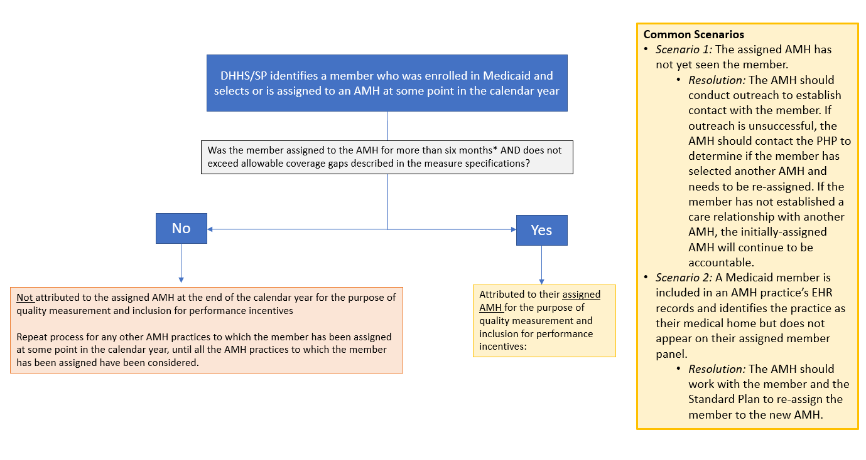
AMH Quality Measure Attribution
For TAG feedback:
Does the assignment period to the AMH reflect the appropriate timeframe for accountability?
What other considerations are there with attribution for performance incentives to AMHs that are not represented in this model?

Slide 22
Welcome and Roll Call (5 minutes)
Implementation Experience: Quality Deep Dive (20 minutes)
Revisiting Priority Issues for AMH TAG (30 minutes)
Wrap-Up and Next Steps (5 minutes)
1
2
3
4

Slide 23
Reminder: Issues Originally Identified for AMH TAG (4/1/2019)
The AMH TAG will help North Carolina Medicaid make informed policy
decisions on the development of the program in the following areas:
Certification & Contracting Process
Program Design
AMH TAG
Data Sharing
Program Oversight & Evaluation
Quality
Source: Meeting #1: Kick-Off on April 1, 2019

Slide 24
Certification and Contracting
Key Issues for AMH TAG
At TAG Kick-Off (April 2019)
“What further market education and guidance should DHHS consider issuing?”
Key Developments
Release of Notice of AMH Policy Changes (11/16/20) regarding Oversight within AMH Tier 3, AMH Tier 3 Payment, and Changes to Care Management Reporting Requirements in AMH Tier 3¹
Release of AMH Manual 2.1 (April 2021)²
Now (2021-22)
Is the design vision of reducing audit/monitoring burden across PHPs and AMH Tier 3s being met? If not, what are the options to improve alignment?
How much did AMH contracting diverge from Tier certification with DHHS? Should DHHS have a second attestation process?
What are the options to further align AMH with NCQA population health standards?
Sources: 1) Notice of AMH Policy Changes (11/16/20); 2) AMH Manual 2.1 (April 2021)

Slide 25
Data Sharing
Key Issues for AMH TAG
At TAG Kick-Off (April 2019)
“How should DHHS approach standardization of data flows between PHPs and CINs and between PHPs and individual AMH practices?”
“How should DHHS require practices to capture care management encounters?”
Key Developments
Release of AMH Data Specification Guidance Requirements for Sharing Beneficiary Assignment and Pharmacy Lock-In Data (1/21/21), Encounters and Historical Claims Data (4/5/21), and Patient Risk List (4/6/21)¹
Now (2021-22)
What barriers exist to sharing cost data between PHPs and AMHs? How can DHHS support this priority?
What is working well or could be improved in the implementation of the AMH Data Specification Guidance and reporting structure?
What data would be most beneficial for the State to share that it is not sharing currently?
Source: 1) AMH Data Specification Guidance web page

Slide 26
Quality
Key Issues for AMH TAG
Now (2021-22)
Could quality measure reporting requirements for practices be aligned across PHPs to improve practices’ internal quality improvement activities? If so, what does that look like at the practice level?
How are PHPs approaching measurement and data sharing at the practice level in Managed Care Year 1 and on what timeframes?
How is the AMH program measuring and promoting equity?
At TAG Kick-Off (April 2019)
“How could DHHS set policies to align measurement approaches across PHPs?”
“How should DHHS approach hybrid measure reporting and reporting of measures that require clinical data within the AMH program?”
Key Developments
Release of North Carolina’s Medicaid Quality Measurement Technical Specifications Manual for SPs and TPs (3/5/21)¹
Source: 1) North Carolina’s Medicaid Quality Measurement Technical Specifications Manual for Standard Plans and BH I/DD Tailored Plans, Version 1.3 (3/5/21)

Slide 27
Program Oversight and Evaluation
Key Issues for AMH TAG
Key Developments
Release of Patient Risk List standardized tool to aid in Care Management Reporting (4/6/21)¹
Now (2021-22)
What does the reporting tell us about the care management available at AMH Tier 3 practices? Does it adhere to the “community based” vision?
How have workforce patterns and services changed with Managed Care (plan level, practice level, CIN level staff)?
For AMH Tier 3 practices working with CINs, how are the roles and responsibilities for care management working?
At TAG Kick-Off (April 2019)
“How can DHHS track and evaluate provider-based care management?”
Source: 1) Requirements for Sharing Patient Risk List to Support AMHs (4/6/21)

Slide 28
Program Design
Key Issues for AMH TAG
Key Developments
Implementation of Healthy Opportunities Pilots (ongoing)¹
Implementation of Tailored Care Management (ongoing)²
DHHS partnership with AHEC for training and support (ongoing)³
Release of VBP Strategy for Standard Plans and Providers (1/8/20)⁴
Now (2021-22)
How can DHHS ramp up VBP incentives for practice level population health, quality, and awareness of total cost of care?
How could DHHS consider aligning its VBP strategy with other NC payers?
What are early successes, gaps, and needs in training and practice support?
How does ongoing work on Healthy Opportunities Pilots and InCK help shape iteration of the entire AMH Program?
At TAG Kick-Off (April 2019)
“What is the role of AMH practices in the Healthy Opportunities Pilots and Tailored Care Management?”
“How should DHHS approach ongoing training and practice support?”
“How can DHHS ramp up VBP incentives for practice level population health, quality, and awareness of total cost of care?”
“How could DHHS consider aligning its VBP strategy with other NC payers?”
Sources: 1) Healthy Opportunities Pilots web page; 2) Tailored Care Management web page; 3) NC AHEC AMH Practice Support web page; 4) North Carolina’s Value-Based Payment Strategy for Standard Plans and Providers in Medicaid Managed Care (1/8/20)

Slide 29
For Discussion:
Discussion Questions
What should be the highest priority issues for the TAG:
  In the short-term (next 1-3 months)?
  In the medium-term (between now and end of first year of Managed Care in July 2022)?

Slide 30
Welcome and Roll Call (5 minutes)
Implementation Experience: Quality Deep Dive (20 minutes)
Revisiting Priority Issues for AMH TAG (30 minutes)
Wrap-Up and Next Steps (5 minutes)
1
2
3
4

