Slide 1

Hurricane Helene: Mental Health Response Updates
NC Department of Health and Human Services
Candice Sanford
Program Lead-DMHDDSUS Helene Recovery
Division of Mental Health, Developmental Disabilities and Substance Use Services

Slide 2
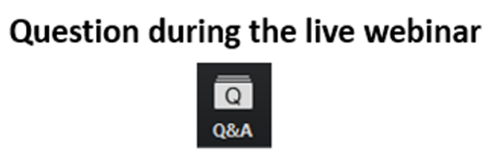
Logistics
for Today’s
Webinar

Slide 3

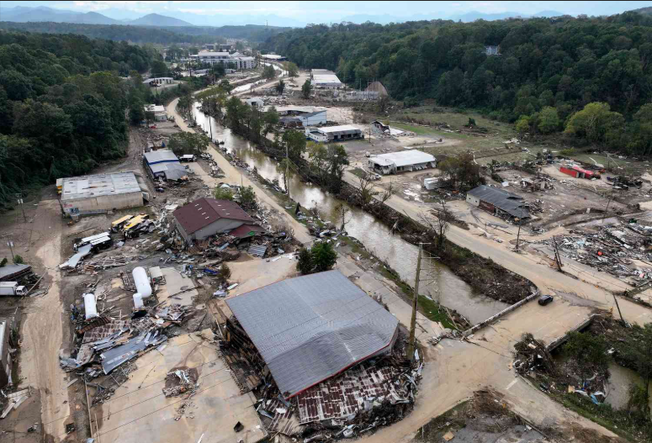
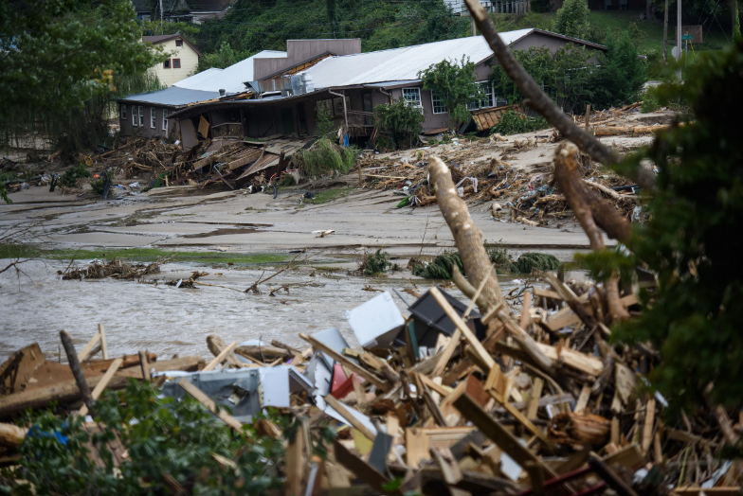
Hurricane Helene Impact and Response :
9/23/2024
Helene Makes Landfall in NC
9/28/2024
Presidential Major Disaster Declaration/FEMA CCP Funding Approved
10/10/2024
NCGA passes Helene Relief package
9/23/2025
1-year Anniversary of Helene
1/2/2025
GROW NC Established
9/26/2024
NCEM activates State Emergency Operations Center
Hurricane Helene: Key Impacts in North Carolina
Western NC saw record-breaking flooding, with some areas receiving over 20 inches of rain
Federal Disaster Declaration issued for 27 counties and the Eastern Band of Cherokee Indians
NC State Emergency Operations Center activated from September to December 2024
Final death toll: 95 lives lost (estimated to be higher)

Slide 4
Behavorial Health Impacts
🧠 Immediate Psychological Responses
Increased anxiety, fear, and uncertainty
Acute stress reactions (e.g., hypervigilance, sleep disturbances)
Grief and mourning, especially after loss of life or property
💔 Long-Term Mental Health Effects
Elevated risk of Post-Traumatic Stress Disorder (PTSD)
Onset or worsening of depression and generalized anxiety disorders.
Substance use or relapse in recovery due to coping challenges
Suicidal ideation or increased suicide risk in vulnerable groups.
Millions of people in North Carolina were directly or indirectly impacted, with widespread emotional distress reported across communities.
Common psychological reactions included:
Insomnia, irritability, and social withdrawal
Increased use of alcohol and tobacco
Feelings of grief, hopelessness, and anxiety about the future
Post-Traumatic Stress Disorder (PTSD) affected an estimated 30–40% of individuals exposed to Hurricane Helene.

Slide 5
Behavorial Health Impacts
‍👩‍👧‍👦 Impacts on Specific Populations
Children may exhibit behavioral regression, nightmares, or separation anxiety
Older adults may experience isolation, cognitive decline, or exacerbated chronic conditions
First responders and healthcare workers often face burnout, compassion fatigue, or moral injury
Individuals with pre-existing mental health conditions may experience destabilization or loss of access to care
🏥 Barriers to Behavioral Health Support
Disruption of mental health services and medication access
Limited availability of culturally competent care
Stigma around seeking psychological help, especially in rural or underserved areas
Financial strain and housing instability affecting treatment continuity
First responders and emergency personnel faced high levels of emotional fatigue and moral injury.
Children and families experienced disrupted routines and emotional trauma, with schools and caregivers encouraged to provide trauma-informed support.
Individuals with preexisting mental health conditions were at heightened risk due to disrupted care and medication access.

Slide 6



Behavorial Health Impacts
‍🌱 Protective Factors and Recovery Supports
Community cohesion and peer support networks
Access to trauma-informed care and crisis counseling
Early intervention and psychoeducation
Resilience-building programs and spiritual or cultural practices
🆘 Support Resources Activated
Disaster Distress Helpline: 1-800-985-5990, 24/7 crisis counseling for disaster survivors
988 Suicide & Crisis Lifeline: Available via call, text, or chat for emotional support
Hope4NC Helpline: 1-855-587-3463, Free, confidential support for North Carolinians
Peer Warmline: 1-855-733-7762, Staffed by individuals in recovery offering lived-experience support

Slide 7
Who Are Priority Populations?
Priority Populations are groups disproportionately affected by disasters due to physical, social, or economic vulnerabilities such as:
Children and infants
Older adults
People with disabilities
Individuals with chronic health or mental health conditions
Low-income or unhoused individuals
Non-English speakers or culturally isolated groups
Priority populations are ranked based on:
Exposure level (proximity to hazard)
Vulnerability (physical, mental, social)
Access to resources (transportation, healthcare, shelter)
Recovery capacity (support networks, financial stability)
Tools for Identifying:
Community health assessments
GIS mapping of vulnerable zones
Collaboration with local agencies and NGOs
Real-time data from shelters and hospitals
Surveys and outreach programs

Slide 8

Why Identify Priority Populations?
We identify priority populations after a disaster to ensure that the most vulnerable individuals receive timely and appropriate support. These groups, such as children, older adults, people with disabilities, and those with limited resources often face greater barriers to recovery and are at higher risk of harm.
By recognizing who is most affected, emergency responders and public health officials can allocate resources more effectively, reduce disparities, and promote a more equitable and resilient recovery for the entire community.

Slide 9
Strategies for Building Resiliency Post-Disaster
🏘️ Community-Level Resilience
Strengthen Local Networks: Foster partnerships among nonprofits, faith groups, and local governments to coordinate recovery and preparedness.
Invest in Infrastructure: Rebuild with climate-resilient materials and designs to withstand future disasters.
Support Economic Recovery: Provide grants and technical assistance to small businesses and local industries.
Promote Mental Health Access: Expand trauma-informed care and behavioral health services across affected regions.
Engage in Inclusive Planning: Ensure marginalized communities have a voice in recovery and resilience strategies.
💪 Individual Resilience
Access to Case Management: Connect survivors with personalized recovery plans and resources.
Financial Literacy & Preparedness: Offer workshops on budgeting, insurance, and emergency savings.
Mental Health & Wellness: Normalize seeking help and provide culturally competent counseling.
Preparedness Education: Equip individuals with tools and knowledge for future emergencies (e.g., go-kits, evacuation plans).

Slide 10

Building Resilience
‍GROWNC serves as the central hub for coordinating long-term recovery efforts following Hurricane Helene across Western North Carolina.
Rooted in community resilience and collaboration, GROWNC brings together local agencies, nonprofits, behavioral health providers, and volunteers to support survivors, rebuild infrastructure, and restore hope.
From housing assistance to emotional wellness, GROWNC is committed to guiding WNC communities through recovery with compassion, equity, and strength.
Home Page | Governor's Recovery Office for Western NC
" In the wake of Hurricane Helene, we have set clear priorities to ensure a swift and effective recovery for western North Carolina, focusing on rebuilding safe housing, restoring our infrastructure, and revitalizing our economy and communities. "

Slide 11
Building Resilience- GROWNC Core Programs
‍Disaster Case Management: Personalized support for survivors navigating housing, health, and financial recovery. Hotline available: 844-746-2326.
Housing Recovery: Temporary housing solutions for displaced residents. Rapid construction of resilient permanent housing.
Infrastructure Restoration: Rebuilding roads, bridges, and utilities. Clearing debris and restoring parks, trails, and waterways.
Economic Revitalization: Support for small businesses through grants and infrastructure repair.
Investment in workforce development and community resilience.
Community Development Block Grants (CDBG): Pursuing federal funding through HUD to support long-term rebuilding.
Small Business Infrastructure Grant Program: Up to $1 million per local government to repair public infrastructure affecting business access.
Tourism Recovery Initiative: “Rediscover the Unforgettable” campaign to boost tourism in affected mountain towns.

Slide 12

Hope4NC Program Objectives
Extensive Outreach: Engage with a wide audience affected by Hurricane Helene through direct, face-to-face outreach at shelters, homes, and various locations.
Emotional Assessment and Referral: Evaluate the emotional well-being of survivors and facilitate referrals to appropriate behavioral health services.
Resource Connection: Identify and address tangible needs, connecting survivors with community resources and disaster relief services.
Emotional Support and Counseling: Offer emotional support, educational resources and crisis counseling to aide in strengthening connections with families and community support systems.
Community Training and Education: Provide training and education to community partners on disaster reactions, effective interventions, and the scope of crisis outreach services.
Partnership Development: Foster partnerships with local disaster organizations to enhance support and resources.
Promote Resilience and Recovery: Collaborate with local stakeholders to encourage community resilience and recovery.
Data Collection and Evaluation: Gather and analyze data to ensure the delivery of high-quality services and validate program efforts.
Legacy Building: Establish a lasting legacy of enhanced coping skills, educational and resource materials, and strengthened community connections.
Notes:
In North Carolina, Hope4NC is the Crisis Counseling Program activated during an event
CCP supports short-term interventions to assist disaster survivors in understanding their current situation and reactions, mitigating stress, promoting the use or development of coping strategies, providing emotional support, and encouraging links with other individuals and agencies who may help in their recovery process.
It is anonymous. Therefore, there are no case files, records, or diagnoses of individuals using services

Slide 13
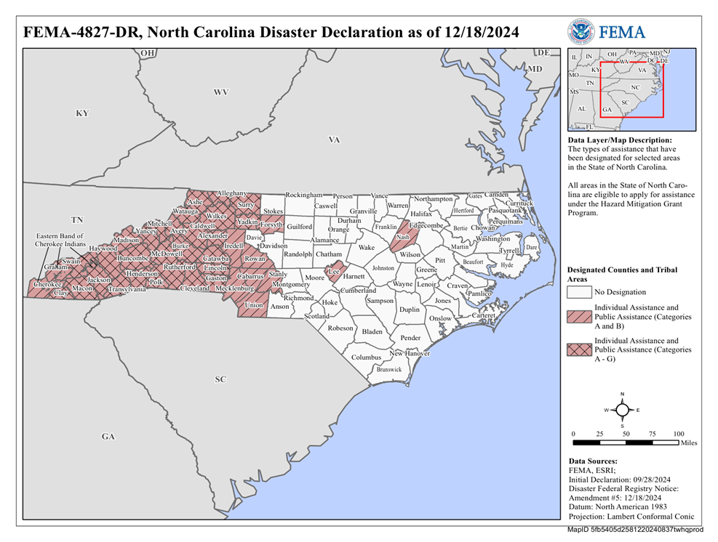
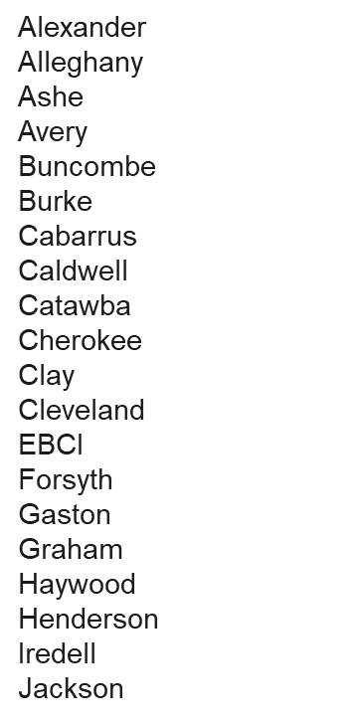
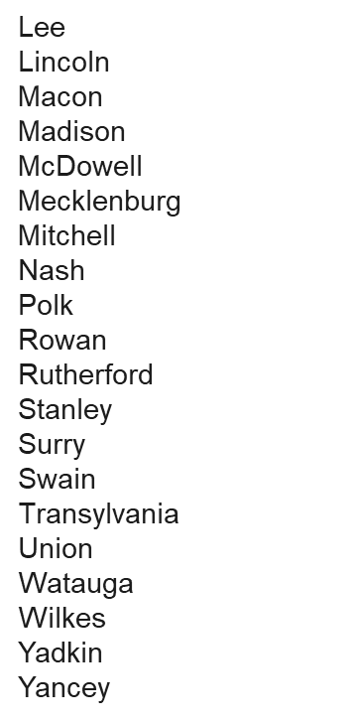
Hope4NC Target Population
The Hope4NC CCP program services the following counties & tribes in North Carolina impacted by Hurricane Helene:
Notes:
In North Carolina, Hope4NC is the Crisis Counseling Program activated during an event
CCP supports short-term interventions to assist disaster survivors in understanding their current situation and reactions, mitigating stress, promoting the use or development of coping strategies, providing emotional support, and encouraging links with other individuals and agencies who may help in their recovery process.
It is anonymous. Therefore, there are no case files, records, or diagnoses of individuals using services

Slide 14
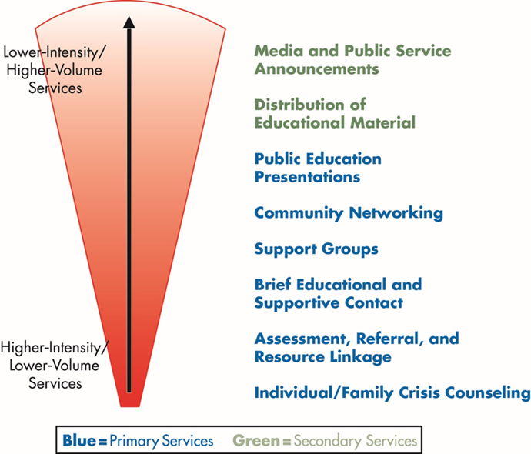
Hope4NC Program Services
Hope4NC CCP offers a variety of programs and services, including crisis counseling, disaster preparedness education and community support.
Primary Services
Assessment, Referral and Resource Linkage
Brief Educational & Supportive Contact
Community Networking
Individual / Family Crisis Counseling
Public Education Presentation
Support Groups
Secondary Services
Distribution of Educational Materials
Media and Public Service Announcements
Notes:
In North Carolina, Hope4NC is the Crisis Counseling Program activated during an event
CCP supports short-term interventions to assist disaster survivors in understanding their current situation and reactions, mitigating stress, promoting the use or development of coping strategies, providing emotional support, and encouraging links with other individuals and agencies who may help in their recovery process.
It is anonymous. Therefore, there are no case files, records, or diagnoses of individuals using services

Slide 15




Hope4NC Contact Information
NC Division of Mental Health, Developmental Disabilities, and Substance Use Services (DMHDDSUS) Vaya Health, Partners Health Management and the 988/REAL Crisis Call Center all work together as integral partners in the Hope4NC initiative, providing coordinated behavioral health support across North Carolina.
For more information email hope4nc@dhhs.nc.gov or visit the Hope4NC website and download our flyer to share.
Notes:
In North Carolina, Hope4NC is the Crisis Counseling Program activated during an event
CCP supports short-term interventions to assist disaster survivors in understanding their current situation and reactions, mitigating stress, promoting the use or development of coping strategies, providing emotional support, and encouraging links with other individuals and agencies who may help in their recovery process.
It is anonymous. Therefore, there are no case files, records, or diagnoses of individuals using services

Slide 16
Hurricane Helene Recovery Funding

Slide 17
Hurricane Helene Legislative Funds:
Overall NCGA Appropriations: $1.42billion
DMHDDSUS NC General Assembly Allocation: $16.5 million
Services for Underserved Populations
Substance Use Services
Engagement and Outreach
Counseling for Deaf/Hard of Hearing (individual, family, group)
Homeless Veterans: housing, employment, MH/SUD care
Enhanced Behavioral Health Services at FQHCs & BH Centers (children, uninsured, Latino, migrant families)
Disaster supply distribution for special populations
3 Additional Mobile OTP Clinics (rural counties, prisons, LTC settings)
NARCAN and Overdose prevention distribution throughout affected areas (~6,250 doses)
Additional funds for Peer support staffing
Funding for WNC Listening Program

Slide 18
Hurricane Helene Legislative Funds:
Key DMHDDSUS Initiatives (cont.)
Disaster Relief and Housing
Resilience and Recovery
Rental assistance & housing supports for local non profits
Supply distribution including: phones, food, clothing
Public Awareness and Education
Training for first responders, public health, LME-MCOs and providers
Summer Recovery Camps for children & families
Distribution of Educational Materials (English & Spanish)
Development of additional community education materials
Crisis Response
Co-Responder Model (Haywood & Cherokee)
Additional MORES Teams(Jackson, Macon Swain & Haywood)

Slide 19

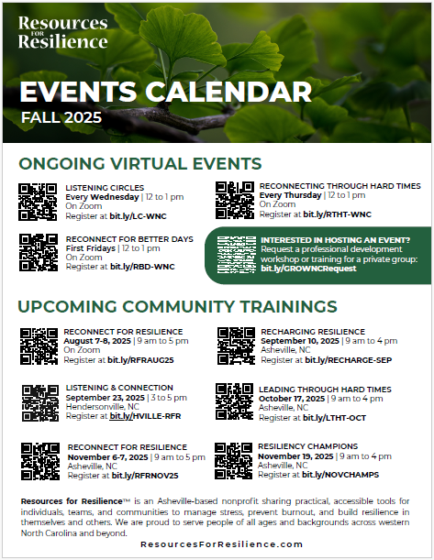
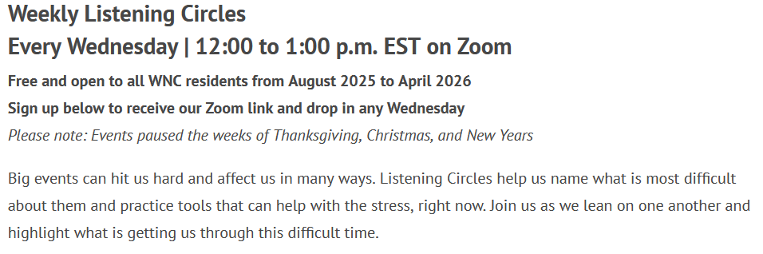

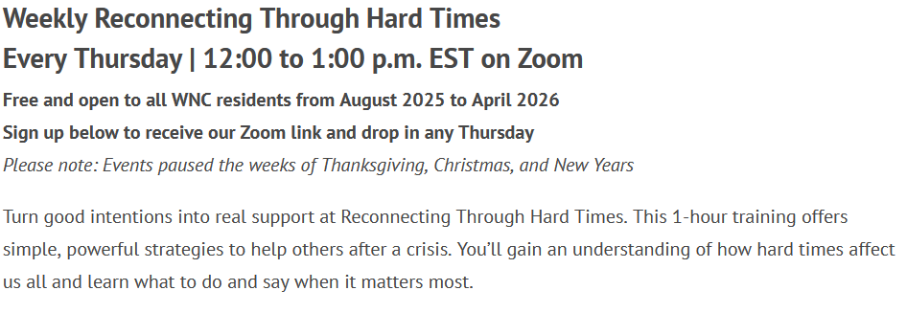

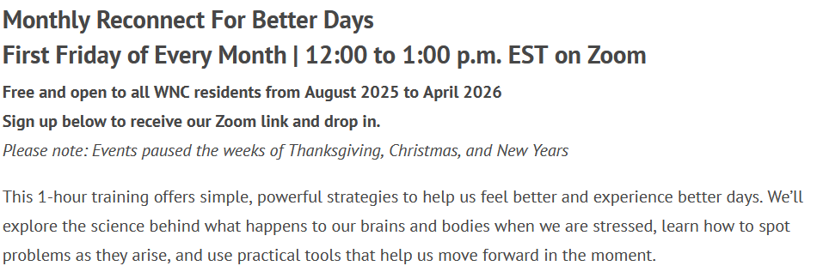
Initiative Highlight: Resources for Resilience
For more info:
https://bit.ly/GROWNCOfferings

Slide 20



Future Considerations:
Challenges
Lessons Learned
Overwhelmed Behavioral Health System
Delayed Service Coordination
Challenges with BH Response Coordination
Stigma and Cultural Considerations
First Responder and Helper Burnout
Provision of Services
Integration of MH into emergency Planning
Expansion of Disaster Crisis Response Capacity
Proactive Cross-Agency Coordination
Knowledge of Federal and State Funding Processes
Trainings for First Responders and MH Professionals
Utilize Existing Resources (HOPE4NC hotline)

Slide 21




Resilient by Design
Rise Again
Restore Energy and Purpose Beyond Burnout and Compassion Fatigue
Empowering helping professionals to recover from burnout, ease compassion fatigue, and reconnect with their sense of purpose and health.
Mary Lynn Barrett LCSW, MPH
everydayresilienceservices@gmail.com
Notes:
slide 1
Welcome to Restore Energy and Purpose Beyond Burnout and Compassion Fatigue.
I’m Mary Lynn Barrett owner of Everyday Resilience Services. I am a mental health clinician with 25 years of experience working as a clinical provider in health care settings, faculty in family practice residency program and in private practice.
worked in Resiliency education for 15 years
developed curriculum and taught nationally and internationally.
I taught the information and tools you will learn today to physicians, teachers, social workers, case managers, mid level staff, managers, administrators of hospital systems, child care workers, professors, clergy, children,
school teachers in Honduras, psychology students in Rwanda, Novices in Tanzania
Enough about me.
I’m here today to share with you all some information about burnout and compassion fatigue and, more importantly, some strategies that are helpful in preventing and addressing the symptoms they create.
You will leave this session with several different tools that you can use right away to address any symptoms of burn out and compassion fatigue you might be experiencing and to start to reconnect with your passion and motivation for the work that you do.

Slide 22




RESILIENCE
Resilient Zone
Thinking Brain
Dominant
Shut Down
Offline Brain
Amped up
Offline
Brain
Fatigue, numbing,
disconnection, low energy,
low motivation
resilient zone
in flow, flexible thinking
problem solving
Distracted, frustrated
angry, worried thoughts,
annoyed,
Levine, Miller-Karas, Resources for Resilience
everydayresilienceservicees.com
Notes:
It is characterized by:
Emotional exhaustion – feeling drained and depleted of emotional resources
Depersonalization – developing a cynical attitude toward work and those served
Reduced personal accomplishment – feeling ineffective and lacking achievement
Important Notes:
Burnout is work-related, not a medical condition
It affects performance, motivation, and overall well-being
explain f/f/freeze and how affects energy

Slide 23

RESILIENT ZONE
Resilience
Improved Relationships
Enhanced Productivity
Levine, Miller-Karas, Resources for Resilience
everydayresilienceservicees.com
Notes:
Why just telling yourself to feel better doesn’t work
How Brain works- rigid vs flexible thinking-open lines of communication- information able to register or encode when thinking brain is online (who’s driving the bus)
How this relates to burnout and compassion fatigue (CF)
Idea of lines of communication not being open when we are stressed…need to open these lines to communicate to the brain that we are safe….

Slide 24





THE BRAIN UNDER STRESS
everydayresilienceservicees.com

Slide 25

SIGNALING SAFETY
How to Speak the Language of Sensation
See Hear Smell Touch Taste
Attention to Positive or Neutral Sensory Information Turns off Stress Response
everydayresilienceservicees.com
Notes:
Balance Sensations
Deeper Breath
Slower heart rate
Relaxed muscles
Calmer voice Grounded
Release Sensations
that occur when no longer stuck in amped-up or shut-down
Heat or warmth
Vibration or tingling
Trembling
Burping or Yawning
Tears (wetness around the eyes)
***Make sure to practice with a current work stressor or a memory of something stressful at work that you haven’t been able to shake loose
Rate on 1-10 before and after, make sure to have baseline body scan for comparison

Slide 26




ORIENTING TO PRESENT MOMENT
5-4-3-2-1
5 Things you See
4 Things you Feel
3 Things you Hear
2 Things you Smell
1 Thing you Taste
Notice Your
Heart Rate
Notice Your
Breathing
Notice Your
Muscles Relaxing
everydayresilienceservicees.com

Slide 27

INTENSE INPUT
Push on Wall
Pull Up on Chair
Using Arms and Legs
Use Hands Under Seat
Pull or Push with arms
Push with Feet
Notice Your
Heart Rate
Notice Your
Breathing
Notice Your
Muscles
Relaxing
everydayresilienceservicees.com

Slide 28
THINKING SHIFT HAPPENS
Perception Changes
Problem Solving Improves
Thoughts can Shift
Thoughts can Register
We can Ask for Help
We can be Compassionate for Self and Others
Emotions can be Diffused with Logic
everydayresilienceservicees.com

Slide 29
Questions?

