Slide 1
November-December 2016
DMA Provider Services
Medicaid and NCHC Providers

Slide 2
Purpose and Agenda
  Purpose
To provide answers and clarification regarding OPR and CCNC/CA billing guidance for Medicaid and NCHC services
  Agenda
  Outline of Changes
  CCNC/CA Program Changes
  Top 10 FAQs
  Claims Examples
  Resources

Slide 3
Outline of Changes
EFFECTIVE DATE | CHANGE
November 1, 2016 | OPR Requirement Implementation Claim pends if any NPI on claim cannot be validated Claim denies if a required ordering, referring, or operating NPI is omitted from the claim. See September 2016 OPR Special Bulletin Service Facility NPI requirement not implemented Incident-to Billing obsolete CCNC/CA PCP NPI no longer required in the “referring provider” field for claims adjudication CCNC/CA overrides no longer required
February 6, 2017 | Rendering Provider Service Location requirement Claims pend if the address where the service is rendered is not listed on the individual rendering provider’s record in NC Tracks The above requirement has been rescinded: https://ncdma.s3.amazonaws.com/s3fs-public/documents/files/SPECIAL_BULLETIN_Provider_Service_Location_2017_03.pdf Provider Affiliation requirement Claim pends if the individual provider is not affiliated with the billing NPI on the claim
Effective immediately, rendering providers are not required to enroll all of their site locations in NCTracks.

Slide 4
CCNC/CA Program Changes
Effective 11/1/16, CCNC Referrals and
CCNC Overrides are not required.
Effective 5/1/17, providers will not have the option to make CCNC Referrals nor CCNC Override Requests via NC Tracks.
CCNC/CA PCP’s NPI---- is no longer required for claims adjudication in NCTracks
CCNC/CA PCPs---------- are not required to enter referrals in NCTracks
CCNC/CA Overrides----- no longer required
Clarifying points:
After 11.01.2016, claims should not deny for CCNC/CA editing related to EOB 00270 or EOB 00286.
The CCNC/CA PCP Agreement mandates direct patient care, care coordination, and documentation in patient’s Medical Record
For patient care coordination purposes, providers and suppliers should contact the CCNC/CA PCP of record if a CCNC/CA enrollee presents….
  Based on medical necessity, providers/suppliers do not need permission from the CCNC/CA PCP of record when deciding whether to treat.
DSS agencies or CCNC/CA PCP offices where a patient presents can facilitate enrollment with a CCNC/CA PCP

Slide 5
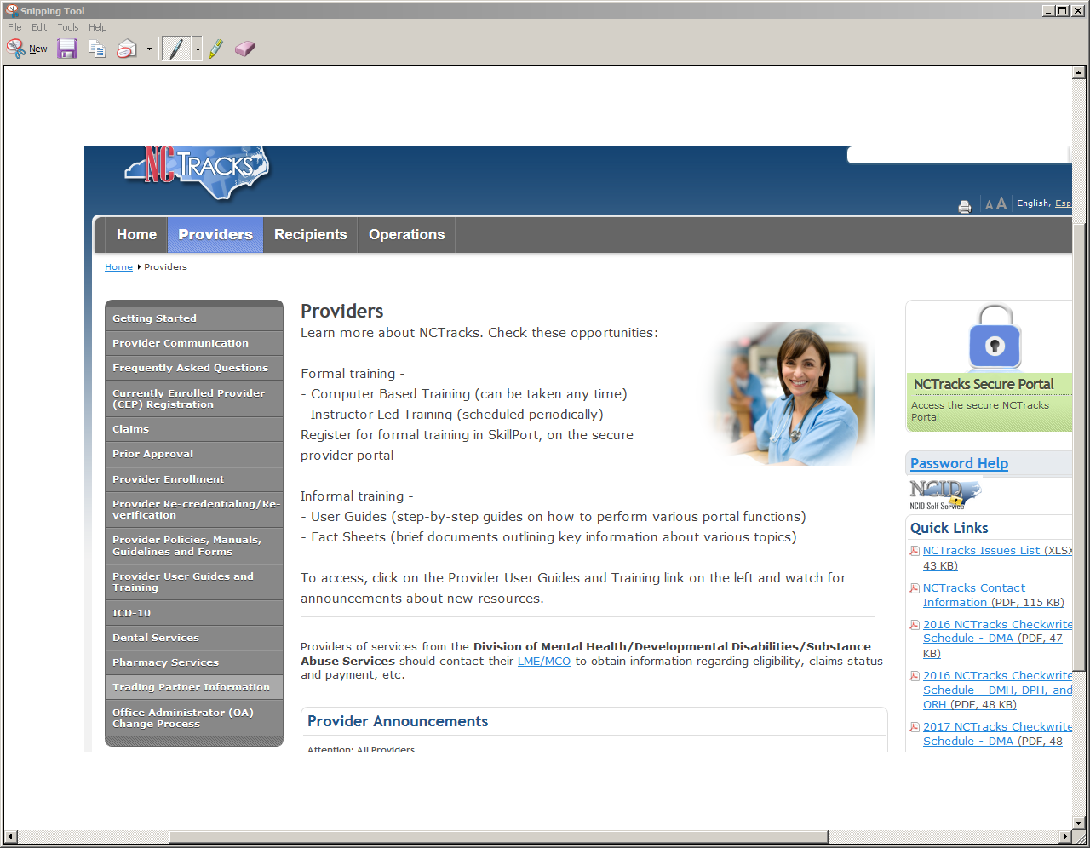
Frequently Asked Questions (FAQs)
www.nctracks.nc.gov

Slide 6
Frequently Asked Questions (FAQs)
  TOP 10 FAQs:
  Individual OPR Provider Enrolled After Claim Denied?
    Pended claims automatically recycle every week
    For denials - Resubmit claim when OPR provider is enrolled
    Effective dates of enrollment will be validated
  How Does OPR Affect Prescribing Providers?
    Prescribing providers must be enrolled
    Exceptions for some Residents and Interns
  Which Health Plans Must Comply with OPR?
    OPR is a federal mandate applicable to NC Medicaid and NCHC
    Only certain claims/services need referring or ordering NPI#.
  What Happens if NPI Entered Incorrectly on Claim?
    Claim will suspend if NPI cannot be validated
    Can correct with a new day claim

Slide 7
Frequently Asked Questions (FAQs)
When Required, How is the Ordering NPI and Referring NPI Entered on the Professional Claim in NCTracks?
  NCTracks – claim field location not one in the same
  Ordering NPI goes under ‘Services’ Tab’
  Referring NPI goes under ‘Provider Information’ and ‘Services’ Tab
How does OPR Affect Radiology Services?
  Radiology global codes and/or technical component (TC) apply
  Modifier 26 exempts the claim from OPR editing
Locating the Ordering and Referring NPIs for CAP Services?
  See Service Authorization Form from Case Management & Lead agencies or contact these entities
  Case Management/Lead Agencies – See Administrative Memo

Slide 8
Frequently Asked Questions (FAQs)
For CCNC/CA, Do I Now Use the Individual PCP’s NPI for Claims?
  CCNC/CA referral authorizations are different from OPR referring provider
  Billing Providers do not need the individual PCP’s NPI on claims
Why are Providers Still Calling Me for CCNC/CA Referrals?
  Care coordination practices and service referrals are still binding
  Clinical Coverage Policy compliance
  Services prior to Nov. 1 still require CCNC/CA payment authorizations
I Have Providers Seeing Patients at Numerous Locations. Should I Add Them to the Provider’s Record?
  All service addresses must be on a rendering/attending provider’s record
  Taking no action to add the locations will cause claim suspensions

Slide 9
Claims Examples
A Medicaid beneficiary visits her established medical home for a well exam. NCTracks on-line eligibility verification confirms that the beneficiary has been assigned to a CCNC/CA medical home where she is not established.
  The patient is seen by a Nurse Practitioner who is not enrolled with Medicaid. The Nurse Practitioner orders labs, which are sent to an independent lab for processing.

Slide 10
Claims Examples
What happens to the claim?
The medical home claim will deny because the attending provider NPI of the Nurse Practitioner is not active.
The claim from the practice does not need the CCNC/CA NPI of the PCP listed on the Medicaid file. If that organizational NPI is included on the claim, the claim will deny.
The independent lab’s claim will require the individual NPI of the clinician who ordered the lab. Because the Nurse Practitioner is not enrolled, the claim will pend for 90 days.
What about the CCNC/CA referral?
Because the patient is established and has never seen the PCP listed on the Medicaid file, the practice does not need to coordinate care with the PCP on the Medicaid eligibility search result
The practice should be proactive in assisting to correct the PCP and should document any service referrals for specialty care in the medical record.

Slide 11
Claims Examples
2) A Medicaid beneficiary has received inpatient care. Upon discharge, her hospitalist orders an evaluation for personal care services (PCS -- hands-on assistance with bathing, dressing, mobility, toileting, or eating).
The beneficiary is enrolled with a CCNC/CA primary care provider.
What is required on the claim?.
What are the CCNCCA service referral requirements?

Slide 12
Claims Examples
Assessment
Per clinical coverage policy 3L (PCS), the hospitalist may order the assessment through the hospital’s discharge planning office for a maximum of 60 days.
The ordering individual provider’s NPI is not required on the claim.
If the PCS provider adds the ordering NPI of the hospitalist to the claim, it would be subject to OPR editing..
Re-assessment
At re-assessment, the CCNC/CA primary care provider must order any continuation of service.
An ordering NPI is not required on the claim to meet the OPR requirement.
If the PCS provider adds the ordering NPI of the PCP to the claim, it would be subject to OPR editing...

Slide 13
Claims Examples
CCNC/CA Service Referral Requirements
The discharge planner should refer the patient back to their PCP for care following the hospital stay.
The discharge planner should also contact with the PCP to inform them of the patient’s inpatient care, and the need for PCS services.
The PCS provider must obtain the order for continued services after 60 days through the CCNC/CA PCP.
The ordering and referring field of the professional claim may be left blank.
  CCNC/CA payment authorization is not required.
  If the organization NPI of the CCNC/CA provider is used, the claim will deny.
Notes:
CCNC/CA Service Referral Requirements
The discharge planner should refer the patient back to their PCP for care following the hospital stay.
The discharge planner should also contact with the PCP to inform them of the patient’s inpatient care, and the need for PCS services.
The PCS provider must obtain the order for continued services after 60 days through the CCNC/CA PCP.
The ordering and referring field of the professional claim may be left blank.
CCNC/CA payment authorization is not required.
If the organization NPI of the CCNC/CA provider is used, the claim will deny.

Slide 14
Claims Examples
3) On November 16, 2016, a physician assistant, who is not enrolled with Medicaid, writes an order for Durable Medical Equipment.
The beneficiary takes the order to a DME supplier that is enrolled in Medicaid.

Slide 15
Claims Examples
What happens to the claim?
The DME claim requires the individual NPI of the ordering provider per the September 2016 OPR Special Bulletin.
Because the ordering provider is not enrolled with Medicaid, the claim will pend for 90 days.
The DME provider is responsible for notifying the ordering provider of the need to enroll.
Once the ordering provider is enrolled, the DME provider may resubmit their claim or wait for the pended claim to adjudicate..
Is there another option?
The DME supplier may use the NCTracks Provider Practitioner Search feature to confirm the participation of the ordering provider prior to filling the order.
If the ordering provider is not found, inform the beneficiary and return the order to be completed by an active NC Medicaid provider.

Slide 16
Claims Examples
4) A Medicaid beneficiary injures their hand after normal office hours and visits the local urgent care center. The urgent care center uses their in house equipment to perform an x-ray and refers the patient to an orthopedist. The orthopedist determines that surgery is needed and orders a CT scan to clarify the extent of the injury and best placement of pins. The CT scan occurs at an outpatient hospital imaging center.
How will the radiology claims process?
What are the CCNCCA service referral requirements?

Slide 17
Claims Examples
X-Ray
The urgent care center bills a global charge on a professional claim for the radiology service as the equipment and reading of the x-ray occurred at the same location.
Global billing of radiology procedures on a professional claim require an individual ordering NPI.
The urgent care uses the individual ordering NPI of the provider who ordered the radiology service.
CT Scan
The local imaging center uses the TC modifier on their professional claim. A TC modifier requires an ordering NPI, which would be the individual NPI of the orthopedist who ordered the scan.
The radiologist reading the scan bills a professional claim with a 26 modifier. The 26 modifier bypasses OPR editing. The radiologist may leave the ordering field blank.

Slide 18
Claims Examples
CCNC Referral Requirement
Urgent Care Center
  The urgent care center should contact the beneficiary’s PCP to inform them of the services rendered after hours, the suspected nature of the injury, and the secondary referral made to an orthopedist.
  Documentation of the contact should be in the medical record.
  CCNC/CA payment authorization is not required.
Orthopedist
  The orthopedic specialist should contact the beneficiary’s PCP to obtain a service referral for the duration of the specialty care.
  Documentation of the contact should be in the medical record of both the primary care and specialty office.
  CCNC/CA payment authorization is not required.

Slide 19
Resources
Where to find help?
  NCTracks Enrolled Practitioner Search
    https://www.nctracks.nc.gov/content/public/providers.html
  OPR Frequently Asked Questions
    https://www.nctracks.nc.gov/content/public/providers/faq-main-page/faqs-for-OPR-providers.html
  Monthly Medicaid Bulletins and Special Bulletins
    https://dma.ncdhhs.gov/providers/medicaid-bulletins

