Slide 1
NCTracks ICD-10 Overview
Chip Pate
Senior Technical Analyst
Division of Medical Assistance
September 18, 2015

Slide 2
NCTracks ICD-10 Implementation Timeline
2011 |  |  |  |  | 2012 |  |  | 2013 |  |  |  | 2014 |  |  |  | 2015 |  |  |  | 2016
QTR1 | QTR2 | QTR3 | QTR4 | QTR1 | QTR2 | QTR3 | QTR4 | QTR1 | QTR2 | QTR3 | QTR4 | QTR1 | QTR2 | QTR3 | QTR4 | QTR1 | QTR2 | QTR3 | QTR4 | QTR1
 |  | Intial Assessment
 |  |  |  |  |  | Business Rules and Code Remediation
 |  |  |  |  |  |  |  |  |  | System Design
 |  |  |  |  |  |  |  |  |  |  |  | System Remediation and Testing
 |  |  |  |  |  |  |  |  |  |  |  |  |  |  | UAT, Provider/TP Testing, Training
 |  |  |  |  |  |  |  |  |  |  |  |  |  |  |  |  |  |  | Support
 |  |  |  |  |  | Provider Communications
Systems
Transactions
Notes:
As you can see, we’ve been working on ICD-10 for NCTracks since before go-live.

Slide 3
ICD-10 Provider Readiness Survey 4 Results
16% of respondents have not started ICD-10 implementation
Most common reasons for not yet completing ICD-10 preparations
  Other priorities / competing projects
  Not enough staffing / resources
  Do not know enough about it
18% have not received ICD-10 information from Billing Vendor
19% do not know if practice management software is compliant
25% are uncertain if they will be ready for ICD-10 by October 1
This is a call to action:
  Take advantage of available resources to learn about ICD-10
  Make ICD-10 preparedness a priority - it is an investment in future business
  Talk to your billing vendor and practice management software company
Notes:
Thanks to those of you who participated in the survey to measure the progress that has been made in preparing for ICD-10.

Slide 4
ICD-10 Provider & Trading Partner Testing
CSC completed testing of ICD-10 changes in NCTracks in late 2014 and DHHS concluded User Acceptance Testing in April 2015
A Test Group of providers and trading partners was selected by DHHS to represent the variety of NCTracks submitters
The group submitted ICD-10 test claim transactions to NCTracks
  Tests included both batch electronic transactions as well as claims keyed into the portal
  After each test was executed, a remittance advice was sent with disposition of claims
  The group confirmed testing results and provided feedback to NCTracks
  Five test cycles were run to allow re-testing of any anomalies found
Testing ran from May through August
Primary error found involves use of ICD Qualifier on batch electronic transactions
Lessons learned are being shared with all providers
The actual system code that will process ICD-10 claims has been in production since the first weekend of August with no significant defects.
Notes:
The provider and trading partner testing represented claims from a variety of provider types.
Lessons learned are being shared with all providers

Slide 5
ICD-10 Considerations for NCTracks
NCTracks Provider Portal screens will be changing to allow both ICD-9 and ICD-10
ICD-9 codes and ICD-10 codes cannot be billed on the same claim
  Claims that span the October 1, 2015 transition date should be split to allow proper billing of codes (ICD-9 versus ICD-10) based on dates of service
  A batch may include both ICD-9 and ICD-10 claims
Prior Approvals that span October 1, 2015 do not need to be split
  PA Requests submitted to NCTracks on or after October 1 will use ICD-10 codes
  DPH is exception (Sickle Cell and EHDI) – must be split if PA spans October 1
Like ICD-9, not all ICD-10 codes will be covered in NCTracks.
  CSC and DHHS worked together to map the appropriate ICD-10 codes
  See the slide on ICD-10 Provider Education for more information on determining appropriate codes to bill.
Notes:
Most PAs – except DPH – do not use diagnosis code when matching PA to claim
Retro PAs for DOS before October 1 will use ICD-9 codes

Slide 6
ICD-10 Provider Education
NCTracks ICD-10 training focused on system changes
  30 minute Webinar Sessions will be held in August, September, and October
NCTracks ICD-10 Crosswalk - ncmmis.ncdhhs.gov/icdxwalk.asp
  ICD-9 to ICD-10 crosswalk of codes covered by NCTracks
NCTracks ICD-10 Webpage and Email Listserv
Clinical Coverage Policy Updates
  Will be posted to the NC DHHS website - http://www.ncdhhs.gov/dma/mp/index.htm
  Should be consulted before billing for ICD-10 on October 1
For basic ICD-10 training, see the CMS ICD-10 Provider Resources: http://www.cms.gov/Medicare/Coding/ICD10/ProviderResources.html
Notes:
NCTracks continues to engage providers in a variety of ways to help them understand the changes coming with ICD-10.
Providers are encouraged to take advantage of basic ICD-10 training available from CMS – especially for physician practices – to make sure that staff are prepared for the transition in October. Training is also available from other sources.

Slide 7
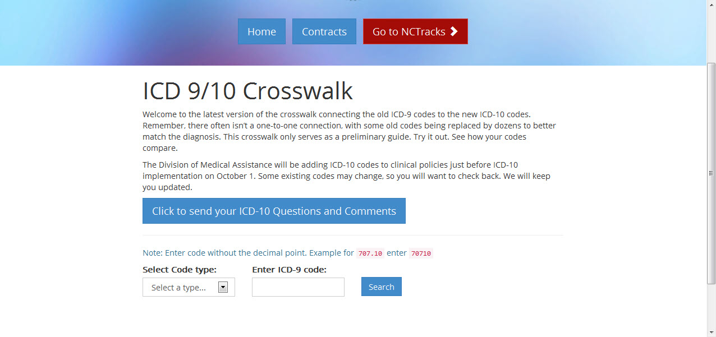
NCTracks ICD-10 Crosswalk
Systems
Transactions
http://ncmmis.ncdhhs.gov/icdxwalk.asp

Slide 8
ICD-10 Resources Available to Providers
Centers for Medicare and Medicaid Services (CMS)
  http://www.cms.gov/Medicare/Coding/ICD10/index.html - Overall Info and Medicare
  http://www.medicaid.gov/medicaid-chip-program-information/by-topics/data-and-systems/icd-coding/icd.html - Medicaid
North Carolina Healthcare Information & Communications Alliance, Inc. (NCHICA) www.nchica.org
Workgroup for Electronic Data Interchange (WEDI) www.wedi.org
American Health Information Management Association (AHIMA) http://www.ahima.org/topics/icd10
Healthcare Information and Management Systems Society (HIMSS) http://www.himss.org/library/icd-10-transition
NCTracks ICD-10 Page - Announcements, FAQs https://www.nctracks.nc.gov/content/public/providers/ICD10.html
  Send ICD-10 questions to ICD-10 Inbox at NCTracks-Questioner@dhhs.nc.gov
Notes:
The links to information published by entities other than the NC DHHS are provided to illustrate the breadth of resources available regarding ICD-10. The State of North Carolina, its agencies, and agents are not responsible for the content.

Slide 9
ICD-10 Frequently Asked Questions
Will ICD-10 replace Current Procedural Terminology (CPT) coding?
No. The transition to ICD-10 does not affect CPT coding for outpatient procedures and physician services. Like ICD-9 procedure codes, ICD-10-PCS codes are for hospital inpatient procedures only.
Will there be annual updates for ICD-9 and ICD-10 from October 1 2015?
Like ICD-9 codes are now, ICD-10 codes will be updated every year. ICD-9 codes will not continue to be updated after October 1, 2015.
How long will we have to keep using ICD-9 codes?
Given the timely filing period of 12 months and adjustment period of 18 months, you may still be using ICD-9 codes (for services rendered before October 1, 2015) for up to 2.5 years or more.
Also see the ICD-10 FAQ page on the NCTracks Provider Portal at
https://www.nctracks.nc.gov/content/public/providers/ICD10/faqs-for-ICD-10.html

Slide 10

Questions
  .

