Slide 1
Agenda
Medical Care Advisory Committee
Quality Subcommittee
September 24, 2020

Slide 2
AGENDA
Call to Order/Roll Call
Quick Updates on New Members and Introduction of Dr. Shannon Dowler, CMO for NC Medicaid
SP Measure Set and Telehealth
Keeping Kids Well
Voting on New Members
Questions/Feedback
Adjourn
Notes:
Composition specifics
wide variety of physicians on the Medical Care Advisory Committee (MCAC) so that the needs of general and subspecialty practices are addressed and met by the new system of care
request that DHHS confirm that sufficient expertise regarding the provision of mental health, I/DD, and substance abuse services is represented on MCAC. Furthermore, we ask that the Department prioritize this expertise as an essential perspective in its plan for continued stakeholder engagement.

Slide 3
New Members
Crystal Tillman, DNP, RN, CPNP, PMHNP-BC, FRE: Co-Chair
Dr. Benjamin Simmons III, MD: Primary Care
Dr. Charles McCormick, MD, MPH: ED/BH
Lisa Macon Harrison: Local Health Department

Slide 4
Questions/Feedback

Slide 5
NC Department of Health and Human Services
Keeping Kids Well
Presentation
Jaimica Wilkins, MBA, CPHQ, ICP
Senior Program Manager – Quality Management
September 24, 2020

Slide 6
Summary
COVID-19 has led to a measurable decrease in pediatric preventive care, especially for African-American and Latinx populations.
Parents are not certain if vaccines are required with virtual education.
Parents are apprehensive to take children in for visits due to COVID-19 or experience barriers visiting their pediatrician or family physician.
Under-utilization of well-child visits are missed opportunities to identify physical, developmental, and behavioral concerns – many of which can be managed or treated.
Missed vaccinations can eventually lead to community outbreaks of preventable disease during a busy COVID19 and influenza season.
North Carolina now requires a meningococcal vaccine for kids 17 years and older.

Slide 7
Opportunity
CCNC, NC AHEC and NC DHHS can help address this important public health concern.
Can accelerate a rebound of pediatric well-care among Medicaid beneficiaries younger than 19 years of age to the pre-COVID-19 level.
NC DHHS has engaged stakeholders through an Advisory Group supporting a statewide campaign to address the problem.
NC AHEC and CCNC developed a strategic and coordinated approach to improving well-child and immunization rates through provider and patient interventions. Our collective work will contribute toward preparing kids for school and for a life-time of optimal health.

Slide 8
Proportion of Population¹ with Overdue Well Child Visits 0-2 by Race
¹Sub-population denominators are for ages 1-5 whereas well visit data are for 0-2
This version does not include the “unknown” category

Slide 9
Proportion of Population¹ with Overdue Well Child Visits 0-2 by Ethnicity
¹Sub-population denominators are for ages 1-5 whereas well visit data are for 0-2
This version does not include the “unknown” category

Slide 10
Proportion of Population¹ with Overdue Well Child Visits 0-2 by Gender
¹Sub-population denominators are for ages 1-5 whereas well visit data are for 0-2
This version does not include the “unknown” category

Slide 11
Proportion of Population¹ with Overdue Well Child Visits 3-6 by Race
¹Sub-population denominators are for ages 1-5 whereas well visit data are for 3-6
This version does not include the “unknown” category

Slide 12
Proportion of Population¹ with Overdue Well Child Visits 3-6 by Ethnicity
¹Sub-population denominators are for ages 1-5 whereas well visit data are for 3-6
This version does not include the “unknown” category

Slide 13
Proportion of Population¹ with Overdue Well Child Visits 3-6 by Gender
¹Sub-population denominators are for ages 1-5 whereas well visit data are for 3-6
This version does not include the “unknown” category

Slide 14
Weekly Proportion of Population¹ Receiving Childhood Immunizations² by Race
¹Sub-population denominators are for ages 1-5
²A higher value is favorable
This version does not include the “unknown” category

Slide 15
Weekly Proportion of Population¹ Receiving Childhood Immunizations² by Ethnicity
¹Sub-population denominators are for ages 1-5
²A higher value is favorable
This version does not include the “unknown” category

Slide 16
Weekly Proportion of Population¹ Receiving Childhood Immunizations² by Gender
¹Sub-population denominators are for ages 1-5
²A higher value is favorable
This version does not include the “unknown” category
Notes:
-

Slide 17
Targeted Practices
All practices that provide primary care to children:
Pediatrics
Family Medicine
School-based clinics
Local Health Departments
FQHCS and RHCs

Slide 18
Project Highlights
Project started August 3rd and will run through the fall.
Media campaign targeted to patients and the public by DHB with information available in English and Spanish.
CCNC care management programs will reach families with tailored messaging to Latinx and African-American families.
Local Health Departments will deploy care managers to do active outreach to children in care management who are missing immunizations and well visits.
Practices with >500 care alerts for pediatric patients are included in the 1:1 practice support work. This comprises 300 independent and health system practice locations across North Carolina.
Practice support provides 1:1 coaching support comprising recommended best practices or interventions, standardized workflows, clinical workflow redesign, educational tip sheets and toolkits.
NCDHHS is leading an advisory group to gather feedback into outreach and communications, provide mass communications outreach to membership, and partner on delivery of webinar content and speakers.

Slide 19
Interventions
Use the EHR to generate a list of children who are behind on well child care.
Utilize the Internet and social media to reach parents and families.
Utilize your staff and physical space to promote well child visits & immunizations.
Partner with local school systems to get the message out about well child care and immunizations.
Remind families across your catchment area of the importance of well child care and immunizations via local news outlets.
Run a WCV/Immunization Promotion Month.
Incorporate well child care into your acute care visits.
Develop workflow to document immunizations that were received elsewhere.
Implement group visits for well child care (Post-COVID-19 pandemic).

Slide 20
Partnerships in the works..
Reach Out and Read (ROR): A non-profit that provides families at routine check-ups with books, knowledge, and tools they need to make reading a part of their daily routine
Pharmaceutical companies: preliminary discussions around using modalities such as drone support to get supplies and eventually vaccines to extremely rural areas of NC
Health Systems: Partnerships on community events- Immunizations and Well Child Visits

Slide 21
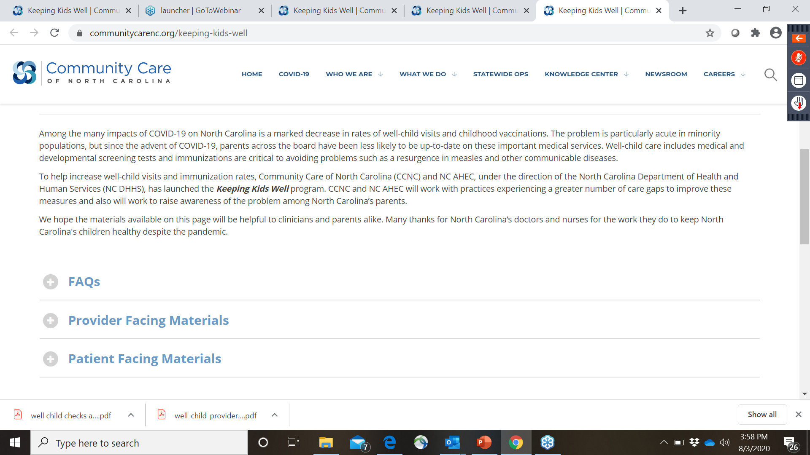
Keeping Kids Well Website Includes Resources for Practices

Slide 22
Questions & Feedback

