Slide 1
Medical Care Advisory Committee
Quality Subcommittee
January 21, 2021

Slide 2
Agenda
Call to order/Roll Call
Annual Quality Management Activities and Team Overview
Quality Strategy Update and QAPI/PIP Alignment
Annual Quality Report
CAHPS/ECHO results
LME-MCO/Provider Survey update
Keeping Kids Well Campaign
Teleheatlh Evaluation—Updated Data
July Readiness Plans (PHPs) and 2021 Governance Calendar
Public Comment/Closing remarks

Slide 3
Medicaid Quality Management Overview
Kelly Crosbie, MSW, LCSW
Director of Quality and Population Health

Slide 4
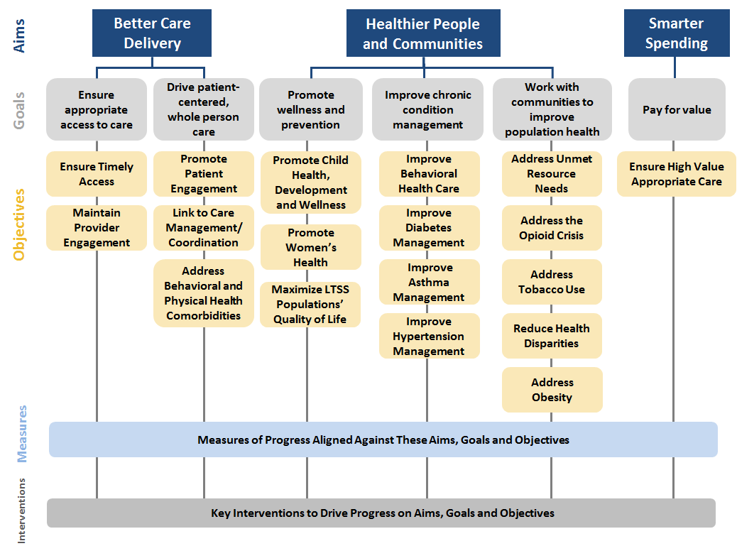
North Carolina Medicaid Quality Framework
The Quality Framework defines and drives the overall vision for advancing the quality of care provided to Medicaid beneficiaries in North Carolina.
Source: North Carolina Medicaid Managed Care Quality Strategy

Slide 5
Summary of Medicaid’s Quality Management Program
1
Quality Measure Reporting—claims-based, survey (member & provider), clinical data collection
2
Quality Baselining, Benchmarking, and Performance Target Development
3
Disparities Reporting and Tracking and Performance Target Development
4
Quality Assessment and Performance Improvement Programs (QAPIs)
  Standard Plans, Tailored Plans, LME-MCOs, Primary Care Care Management Programs (CCNC, Tribal Option) are required to do annual performance improvement projects
  DHB has contracted with AHEC so support statewide alignment on Qi/PIPs
5
Value-Based Payment/Provider Incentives
DHB will use financial incentive for measure performance over time with Health Plans (Year 3)
Health Plans (PHPs) will use measures in value-based arrangements with Providers
6
External Quality Assurance Validation
  The External Quality Review Organization (EQRO) will validate Health Plans measure reporting and validate PHP contract compliance.
  Health Plans must achieve NCQA accreditation by Year 3
7
Evaluation
  1115 waiver, SUD waiver, Healthy Opportunities Pilots
  Care Management programs
  Network Access Monitoring

Slide 6
Medicaid Quality: Public Reporting of Performance
Annual Quality Report—DHHS will share plan-level rates for the quality measures, to facilitate comparison among plans.
Quality Rating Scale (QRS)—Member-Facing Plan Report Cards
Health Equity Report—DHHS will assess disparities in care and outcomes and publish a report summarizing areas or care in which disparities have improved, persisted, or developed.
Provider Survey Results—DHHS, in partnership with a third party, will field a survey to providers assessing their satisfaction with the PHP(s) with which they have contracted. The Department will publish overall satisfaction rates and other findings from this survey.
Member Survey Results—DHHS, in partnership with a third party, will field surveys to assess patient experience in receiving care.
Network Accessibility Reports-- DHHS, in partnership with a third party, will evaluate network adequacy—a combination of provider availability, realized member utilization, and patient perception of availability.
Accreditation Progress and Results—DHHS will publish PHP progress toward receiving this accreditation and will report the accreditor’s findings for each PHP during its accreditation process.
Evaluation Results—DHHS will publish results of monitoring and eval with our external evaluation vendor as well as results of other targeted evaluation (telehealth).
EQRO Reports—DHS will publish results of annual evaluation of PHP performance from our external quality review organization.

Slide 7
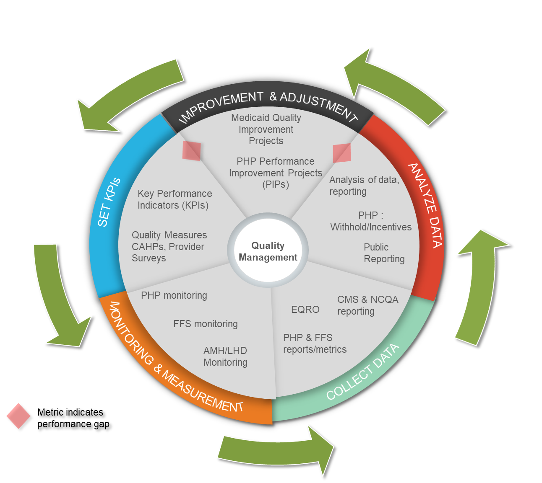
Quality and Population Health Team
Medicaid Quality Management
  Quality Strategy
  Statewide Quality Improvement
  EQRO/Accreditation
  Provider Supports (AHEC)
Program Evaluation
  Quality Measures/Targets
  Provider & Member Surveys
  Public-facing quality reports
  Evaluations
Population Health
  Advanced Medical Homes
  CMARC/CMHRP
  Tailored Care Management
  LTSS Care Management
  Transitions of Care

Slide 8
MCAC Quality Subcommittee
Quality Strategy Update
PIP Alignment- Year 1
Jaimica Wilkins, MBA, CPHQ, ICP
Senior Program Manager, Quality and Population Health, Division of Health Benefits
January 21, 2021

Slide 9
Updated Quality Strategy Release and Submission Timeline
January 2021
Finalize Draft Updated Quality Strategy; begin committee review
February-March 2021
Public Comment Process
April 2021
Final Updated Quality Strategy submitted to CMS

Slide 10
Performance Improvement Project Standardization Summary
Alignment of Performance Improvement Projects (PIPs) statewide for all Prepaid Health Plans (PHPs)
3 PIPs standardized in Contract Year 1
  1 Clinical Adult PIP
  1 Clinical Child PIP
  1 Clinical Maternal Health PIP
PIPs support Quality Strategy Aims, Goals and Objectives

Slide 11
Performance Improvement Projects
Performance Improvement Projects (PIPs) (42 C.F.R. § 438.330)
  The PHP shall develop a Performance Improvement Project (PIP) that is:
    Designed to achieve significant improvement in health outcomes as part of the annual PHP Quality Assessment and Improvement program review; and
    Includes measurement of performance using quality indicators as part of the annual PHP Quality Assessment and Performance Improvement program review.
  Each PIP shall include both the planning and initiation of activities for increasing or sustaining improvement and implementation of interventions to achieve improvement in the access to and quality of care.
  The PHP shall conduct at least one (1) non-clinical Performance Improvement Project (PIP) on an annual basis that is aligned to the aims, goals, objectives and interventions outlined within the Department’s Quality Strategy
  The PHP shall be required to develop and execute two (2) clinical performance improvement projects annually that must be related to the following areas:
    Pregnancy Intendedness;
    Tobacco Cessation;
    Diabetes Prevention;
    Birth Outcomes;
    Early Childhood health and development;
    Hypertension;
    Behavioral Health Integration
  If the PHP performs below seventy-five percent (75%) for overall CMS 416 rates, the PHP shall submit one Performance Improvement Project on EPSDT screening and community outreach plans in addition to the three (3) required clinical and non-clinical performance improvement projects annually.

Slide 12
Quality Aims, Goals, Objectives
Childhood Immunization Status- Aim 2, Goal 3, Objective 3.1 & 3.2
Comprehensive Diabetes Care- Aim 2, Goal 4, Objective 4.2
Prenatal and Postpartum Care – Aim 2, Goal 3, Objective 3.2
Aims | Goals | Objectives
Aim 1: Better Care Delivery. Make health care more person-centered, coordinated and accessible. | Goal 1: Ensure appropriate access to care | Objective 1.1: Ensure timely access to care
 |  | Objective 1.2: Maintain Medicaid provider engagement
 | Goal 2: Drive patient-centered, whole person care | Objective 2.1: Promote patient engagement in care
 |  | Objective 2.2: Link patients to appropriate care management and care coordination services
 |  | Objective 2.3: Address behavioral and physical health comorbidities
Aim 2: Healthier People, Healthier Communities. Improve the health of North Carolinians through prevention, better treatment of chronic conditions, and better behavioral health care, working collaboratively with community partners. | Goal 3: Promote wellness and prevention | Objective 3.1: Promote child health, development, and wellness
 |  | Objective 3.2: Promote women’s health
 |  | Objective 3.3: Maximize long term services and supports (LTSS) populations’ quality of life
 | Goal 4: Improve chronic condition management | Objective 4.1: Improve behavioral health care
 |  | Objective 4.2: Improve diabetes management
 |  | Objective 4.3: Improve asthma management
 |  | Objective 4.4: Improve hypertension management
 | Goal 5: Work with communities to improve population health | Objective 5.1: Address unmet resource needs
 |  | Objective 5.2: Address the opioid crisis
 |  | Objective 5.3: Address tobacco use
 |  | Objective 5.4: Reduce health disparities
 |  | Objective 5.5: Address obesity
Aim 3: Smarter Spending Pay for value rather than volume, incentivize innovation and ensure appropriate care. | Goal 6: Pay for value | Objective 6.1: Ensure high-value, appropriate care
Notes:
Composition specifics
wide variety of physicians on the Medical Care Advisory Committee (MCAC) so that the needs of general and subspecialty practices are addressed and met by the new system of care
request that DHHS confirm that sufficient expertise regarding the provision of mental health, I/DD, and substance abuse services is represented on MCAC. Furthermore, we ask that the Department prioritize this expertise as an essential perspective in its plan for continued stakeholder engagement.

Slide 13
Childhood Immunization Status- CIS (Combo 10)
Description:
The percentage of children 2 years of age who had four diphtheria, tetanus and acellular pertussis (DTaP); three polio (IPV); one measles, mumps and rubella (MMR); three haemophilus influenza type B (HiB); three hepatitis B (HepB), one chicken pox (VZV); four pneumococcal conjugate (PCV); one hepatitis A (HepA); two or three rotavirus (RV); and two influenza (flu) vaccines by their second birthday. The measure calculates a rate for each vaccine and nine separate combination rates.
Exclusions:
Exclude children who had a contraindication for a specific vaccine from the denominator for all antigen rates and the combination rates. The denominator for all rates must be the same.
Exclude contraindicated children only if administrative data do not indicate that the contraindicated immunization was rendered in its entirety.
  Denominator The eligible population.
  Numerators For MMR, hepatitis B, VZV and hepatitis A, count any of the following:
    Evidence of the antigen or combination vaccine, or
    Documented history of the illness, or
    A seropositive test result for each antigen.
Notes:
c. agendas of upcoming meetings, posted far enough in advance to permit public
participation on issues that arise on the agenda,
d. information about accessing attendance/participation in monthly and quarterly
MCAC meetings, including options that make the meetings accessible to those
who cannot travel,
e. information about the public participation aspect of the MCAC meetings so that
the public will know how to prepare for efficient and effective participation in
those meetings,
f. access to documents that will be important in the meeting discussions, made
available prior to meetings, so that the public can have a more full and
meaningful understanding of what is transpiring in the meetings; and
g. timely posting of meeting minutes, so that the public can follow up in an
effective and efficient way on issues discussed in the meetings
-explains how a stakeholder can be considered for MCAC membership,
including sufficient detail to allow a stakeholder to apply for a membership,
b. identifies the term start and ending dates for all current MCAC members, and
c. states the ongoing responsibilities of and expectations upon MCAC members,
including attendance, participation on subcommittees if needed, and reasonable
responsiveness to community stakeholders
Please consider making these and other amendments to the plan in order
to create stakeholder participation in oversight and to strengthen
the oversight function of the ombudsman:
a. Provide that the ombudsman will communicate with the MCAC regarding
trends in PHP performance and enrollee concerns on a regular basis,
b. Provide that the ombudsman will provide proactive feedback to DHHS
regarding positive PHP/enrollee trends as well, so that they can be
acknowledged and leveraged for increased system effectiveness,
c. Provide for the ombudsman to copy the MCAC when it provides feedback to
DHHS, and that MCAC will make the copy available to the public on the website,
and
d. Provide the MCAC with periodic summaries of:
i. trends identified by the ombudsman, both positive and negative, in PHP
performance and enrollee concerns (and other areas, as may be added in this
role) to the MCAC regarding,
ii. feedback provided to DHHS by the ombudsman, and
iii. Updates
Commenters
Hospital (1) was faith division

Slide 14
Comprehensive Diabetes Care: HbA1C Poor Control (>9.0%)
Description:
The most recent HbA1c level (performed during the measurement year) is >9.0% or is missing, or was not done during the measurement year, as documented through laboratory data or medical record review.
Note: A lower rate indicates better performance for this indicator (i.e., low rates of poor control indicate better care).

Slide 15
Prenatal and Postpartum Care
Description:
The percentage of deliveries of live births between November 6 of the year prior to the measurement year and November 5 of the measurement year. For these women, the measure assesses the following facets of prenatal and postpartum care:
Rate 1: Timeliness of Prenatal Care. The percentage of deliveries that received a prenatal care visit as a member of the organization in the first trimester or within 42 days of enrollment in the organization.
Rate 2: Postpartum Care. The percentage of deliveries that had a postpartum visit on or between 21 and 56 days after delivery.
Exclusions:
From the denominator: Non-live births

Slide 16

Questions?

Slide 17
NC Medicaid Annual Quality Report
Taylor Zublena, Program Manager, Quality Measurement, Division of Health Benefits
January 21, 2021

Slide 18
NC Medicaid Annual Quality Report- DRAFT
Annual Report assessing 2016-2019 performance on quality measures related to aims and goals of the Quality Strategy
  1)Better Care Delivery, 2)Healthier People and Communities, and 3) Smarter Spending
  Measures are aligned with key DHHS initiatives
    Opioid Action Plan
    Early Childhood Action Plan
    Perinatal Health Strategic Plan
    Healthy North Carolina 2020 and 2030
Future annual reports will include measures stratified by Health Plans and Plan population.
  Key objective is to reduce health disparities and promote health equity
  Goals set to close performance gaps and improve over time

Slide 19
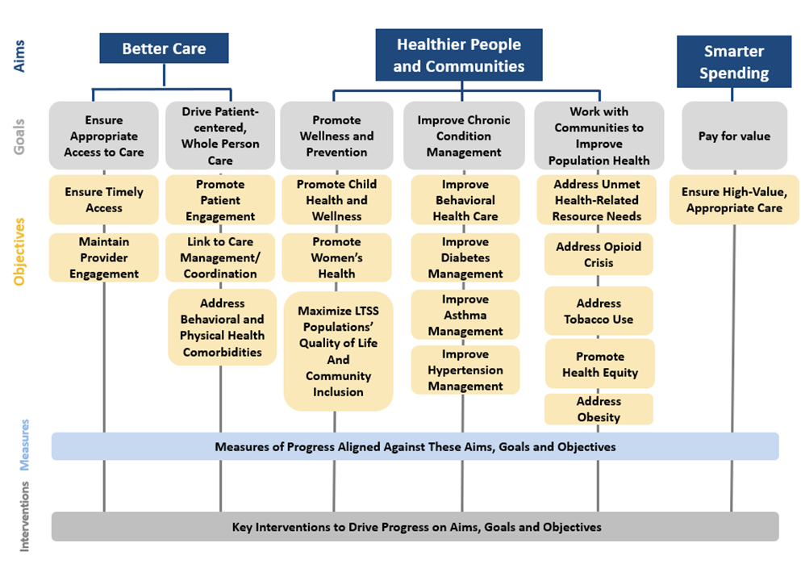
Overview of the Quality Framework

Slide 20
Summary of NC Medicaid Quality Performance 2019

Slide 21
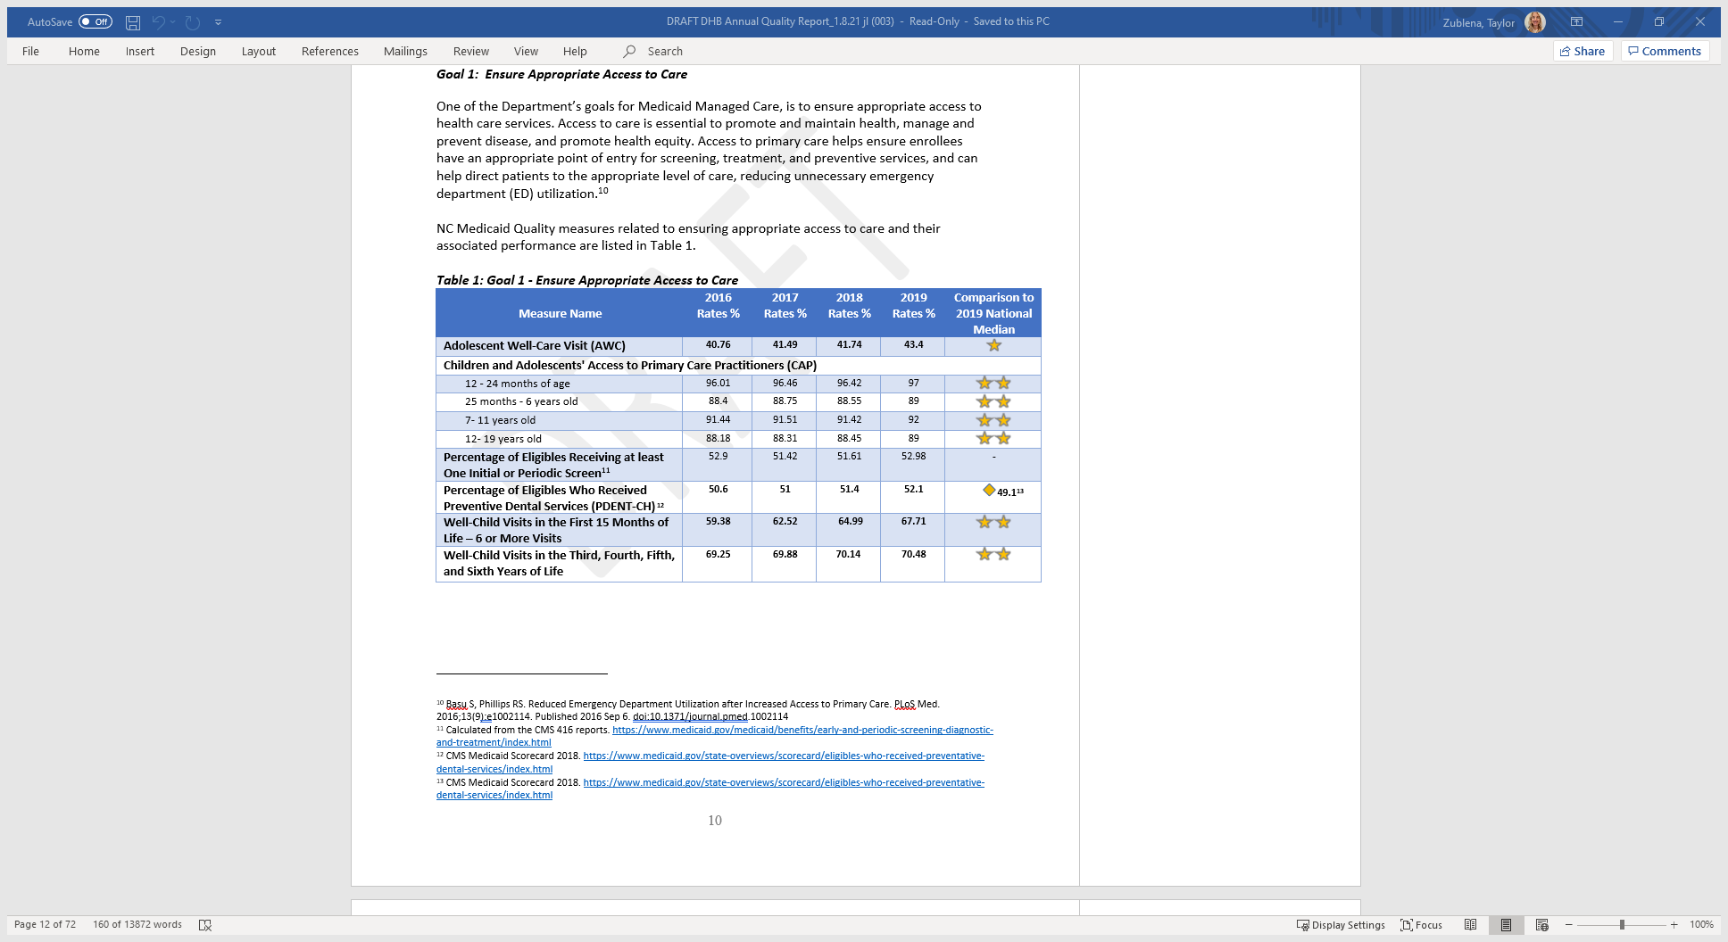
Aim 1: Better Care. Make health care more person-centered, coordinated and accessible
Calculated from the CMS 416 reports. https://www.medicaid.gov/medicaid/benefits/early-and-periodic-screening-diagnostic-and-treatment/index.html
CMS Medicaid Scorecard 2018. https://www.medicaid.gov/state-overviews/scorecard/eligibles-who-received-preventative-dental-services/index.html
CMS Medicaid Scorecard 2018. https://www.medicaid.gov/state-overviews/scorecard/eligibles-who-received-preventative-dental-services/index.html

Slide 22
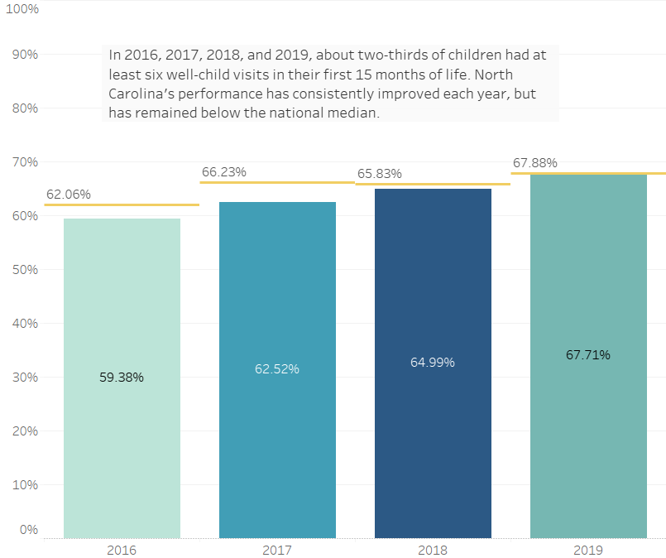
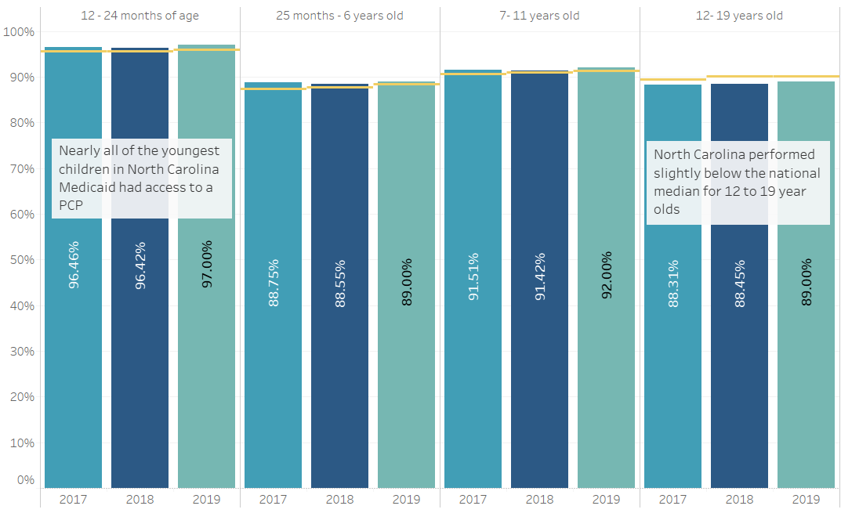
Aim 1: Better Care
Children and Adolescents’ Access to Primary Care – this chart illustrates the percent of children and adolescents that had at least one visit with a primary care practitioner (PCP) for 2017, 2018, and 2019.
Well-Child Visits in First 15 Months of Life (6+ Visits) – This chart illustrates, for 2016 through 2019, the proportion of children in NC Medicaid that had at least six well-child visits during their first 15 months of life.

Slide 23
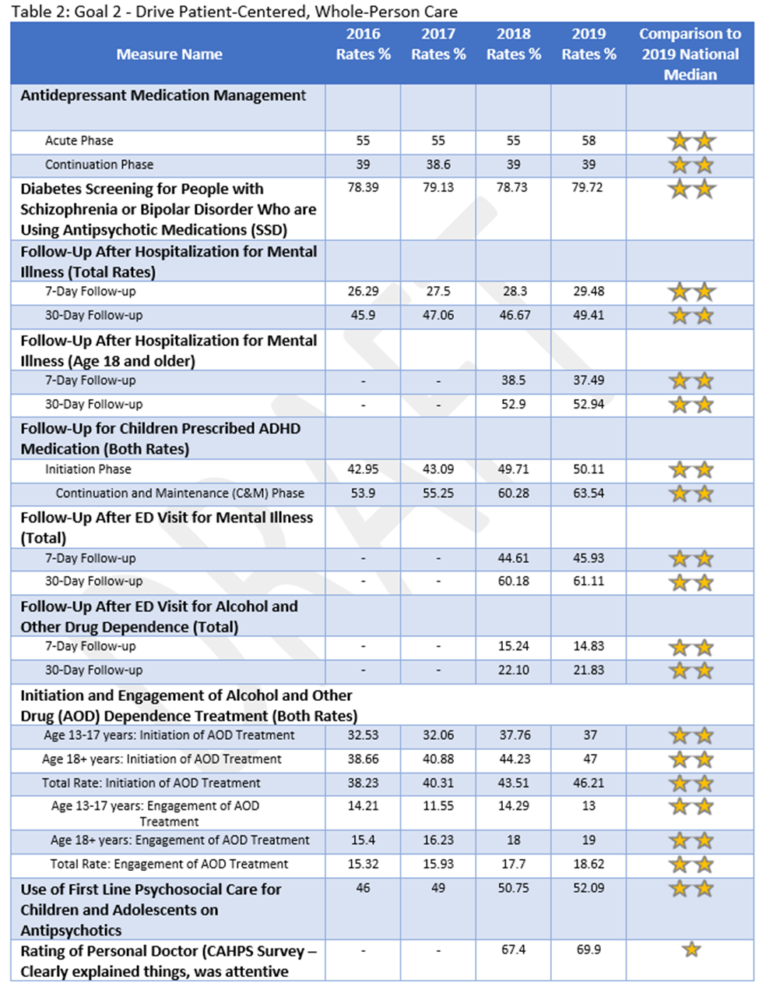
Aim 1. Better Care. Goal 2: Drive Patient-Centered, Whole Person Care

Slide 24
Aim 1. Better Care. Goal 2: Drive Patient-Centered, Whole Person Care

Slide 25
Aim 1. Better Care. Goal 2: Drive Patient-Centered, Whole Person Care

Slide 26
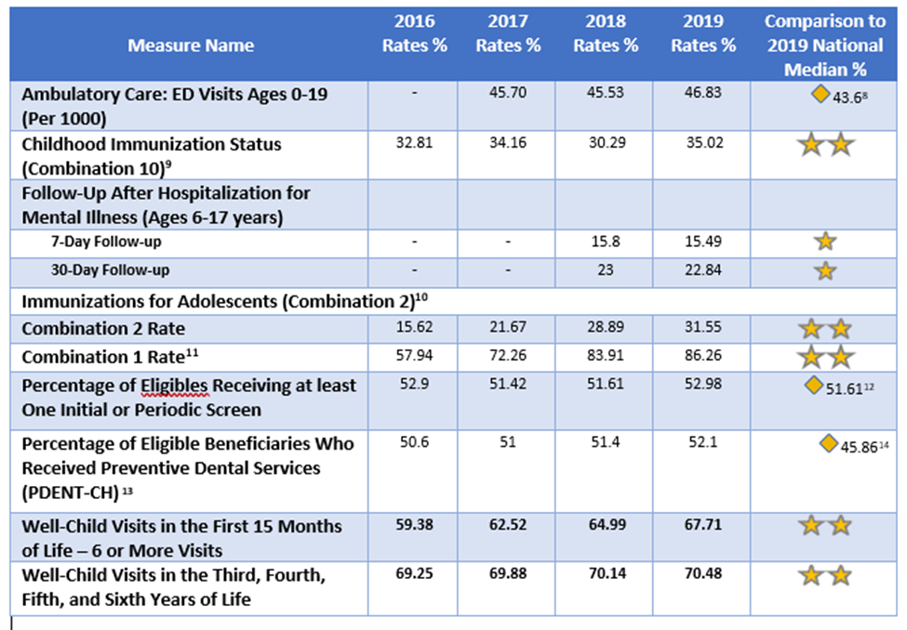
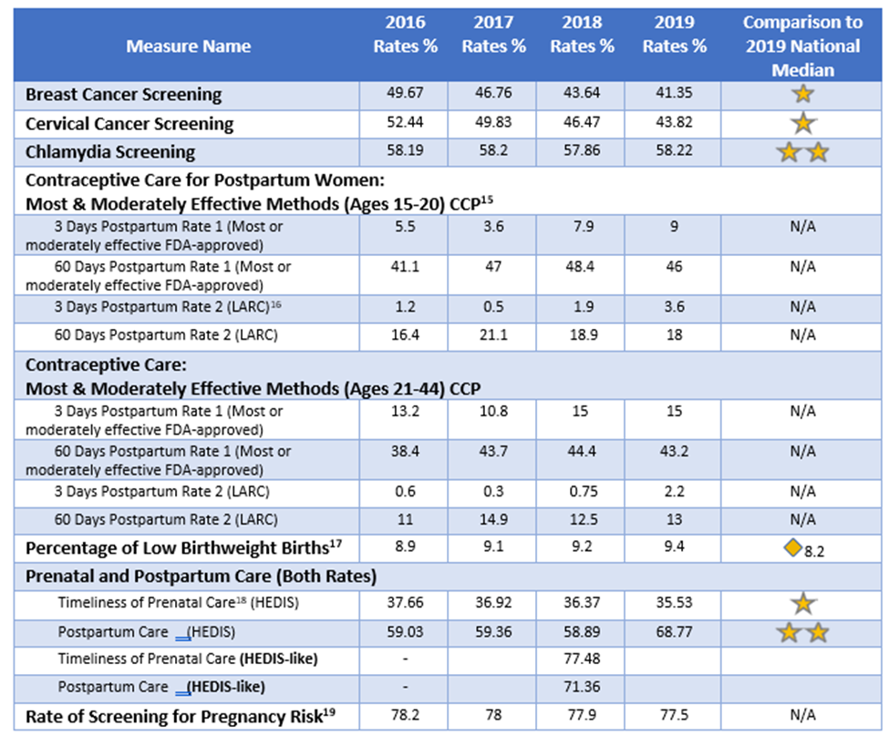
Aim 2: Healthier People and Communities. Improve the health of North Carolinians through prevention, better treatment of chronic conditions and better behavioral health care, working collaboratively with community partners.
Goal 3A-Promote Wellness and Prevention- Children’s Health Goal 3B- Promote Wellness and Prevention- Women’s Health

Slide 27
Aim 2: Healthier People and Communities. Goal 4: Improve Chronic Condition Management.
HbA1c Reporting
HbA1c results provide the most direct insight into diabetes control and will be important in assessing and monitoring the quality of diabetes care in NC Medicaid. Recognizing that providers face challenges in reporting this measure, the Department will work with providers and PHPs to implement a consistent reporting process.
NC Medicaid BRFSS Results - https://schs.dph.ncdhhs.gov/data/brfss/medicaid/

Slide 28
Aim 2: Healthier People and Communities. Goal 4: Improve Chronic Condition Management.

Slide 29
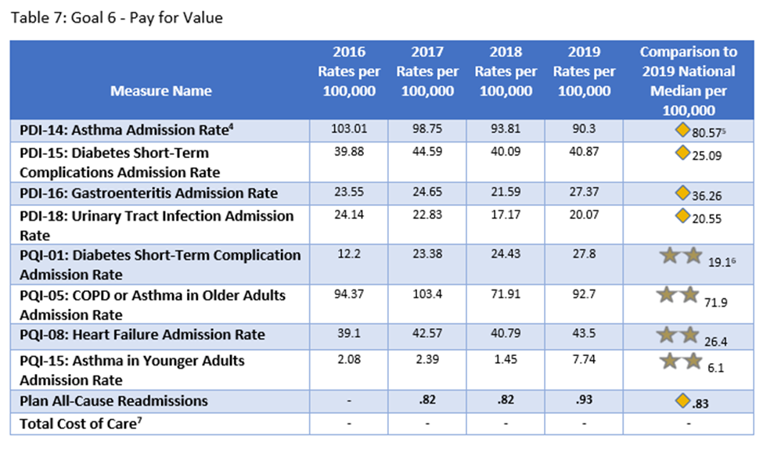
Aim 3: Smarter Spending. Pay for value rather than volume, incentivize innovation and ensure appropriate care
⁴ The rates presented for PDI-14, PDI-15, PDI-16, PDI-18, PQI-01, PQI-05, PQI-08, and PQI-15 represent potentially avoidable hospitalizations per 100,000 population.
⁵ Instead of the stars used for HEDIS measures, PDI and PQI national comparisons are reported as hospitalizations per 100,000 population.
⁶ National Medians for PQI-01, PQI-05, PQI-08, PQI-15 and Plan All-Cause Readmissions were drawn from CMS Adult Health Care Quality Measures for 2018 (2019 medians not yet published) https://www.medicaid.gov/medicaid/quality-of-care/performance-measurement/adult-and-child-health-care-quality-measures/adult-health-care-quality-measures/index.html
⁷ DHB is still finalizing its approach to measuring Total Cost of Care. This rate will be available in future reports.

Slide 30
Continuous Quality Improvement in NC Medicaid
NC Medicaid Managed Care Quality Strategy updated annually
Monitor accountability for measures and quality improvement for Health Plans (PHPs and PCCM)
Feedback from MCAC-Quality Subgroup and NC Medicaid internal QHO committee
NC will publicly report performance as feasible and appropriate in promoting transparent, high-quality care as well as stakeholder engagement through:
  NC Medicaid Annual Quality Report
  Health Equity Report
  Provider Survey Results
  CAHPS Survey Results
  Access Report
  Quality Rating Scale (QRS)

Slide 31

Questions?

Slide 32
CAHPS/ECHO Survey Results
Loul Alvarez, Senior Quality Management Analyst, Program Evaluation, Division of Health Benefits
January 21, 2021

Slide 33
North Carolina Child and Adult Medicaid ECHO®-CAHPS® Report
The Experience of Care and Health Outcomes (ECHO®) Survey assesses consumers’ experiences with counseling and treatment through LME/MCOs
  Survey includes more than 60 questions most of which address domains of member experience such as:
    Getting treatment quickly
    How well clinicians communicate
    Getting treatment and information about the plan
    Perceived improvement
    Information about treatment options (adult survey only)
Referred to as composites, the above domains are comprised of several questions
The report is designed to allow NC Medicaid and the LME/MCOs to identify key opportunities for improving members’ experiences
Notes:
Composition specifics
wide variety of physicians on the Medical Care Advisory Committee (MCAC) so that the needs of general and subspecialty practices are addressed and met by the new system of care
request that DHHS confirm that sufficient expertise regarding the provision of mental health, I/DD, and substance abuse services is represented on MCAC. Furthermore, we ask that the Department prioritize this expertise as an essential perspective in its plan for continued stakeholder engagement.

Slide 34
North Carolina Child and Adult Medicaid ECHO®-CAHPS® Report
The ECHO® reports summarize the findings of an adult and child survey conducted for NC Medicaid
  For the adult survey, a random sample of 3,997 were drawn from adult enrollees, with a response rate of 14.4%
  For the child survey, a random sample of 3,997 were drawn from child enrollees, with a response rate of 12.7%
Responses for each LME/MCO are displayed alongside the overall North Carolina score
Charts in the following slides depict responses that indicate positive experience
Notes:
Composition specifics
wide variety of physicians on the Medical Care Advisory Committee (MCAC) so that the needs of general and subspecialty practices are addressed and met by the new system of care
request that DHHS confirm that sufficient expertise regarding the provision of mental health, I/DD, and substance abuse services is represented on MCAC. Furthermore, we ask that the Department prioritize this expertise as an essential perspective in its plan for continued stakeholder engagement.

Slide 35
Overall Ratings: Ratings of Counseling and Treatment
The ECHO® survey uses a 0-10 rating for assessing overall experience with counseling and treatment
  Proportions of respondents assigning ratings of 8, 9, or 10 are reported as achievement scores
  In the chart below, scoring of 9 0r 10 are represented as white bars within the bars.
    For example, NC overall achievement score is 70.3% (which includes ratings of 8, 9, or 10), alternatively achievement score of 52.9% includes ratings of 9 or 10

Slide 36
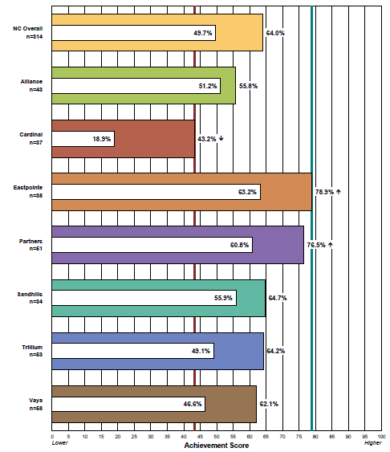
Overall Rating: Rating of Counseling or Treatment (Child Survey)
Low Benchmark = worst performing LME/MCO
High Benchmark = worst performing LME/MCO
White portion of bar represents proportions giving rating of 9 or 10
2020 NC CAHPS® 3.0 Child Medicaid ECHO® Report

Slide 37
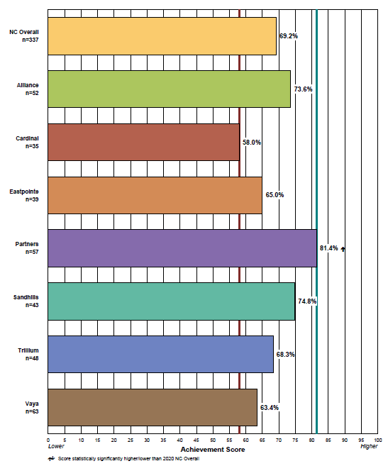
Getting Treatment Quickly (Child Survey)
Low Benchmark = worst performing LME/MCO
High Benchmark = worst performing LME/MCO
2020 NC CAHPS® 3.0 Child Medicaid ECHO® Report

Slide 38
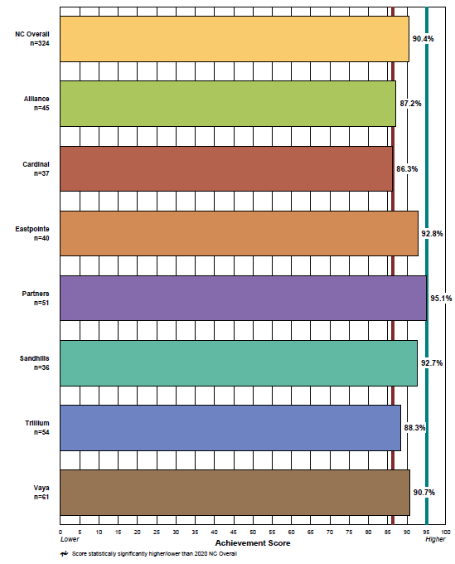
How Well Clinicians Communicate(Child Survey)
Low Benchmark = worst performing LME/MCO
High Benchmark = worst performing LME/MCO
2020 NC CAHPS® 3.0 Child Medicaid ECHO® Report

Slide 39
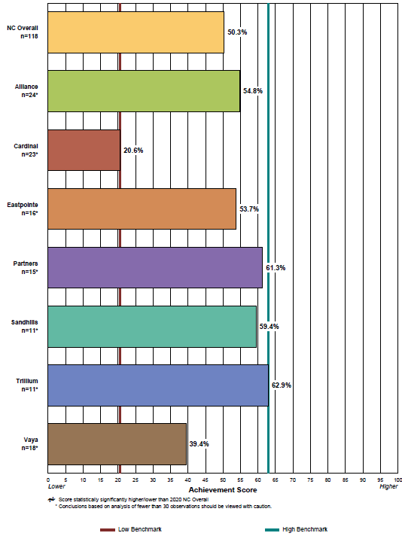
Getting Treatment and Information from the Plan (Child Survey)
Low Benchmark = worst performing LME/MCO
High Benchmark = worst performing LME/MCO
For some survey items, relatively small numbers of responses were collected. Conclusions based on analysis of fewer than 30 observations should be viewed with caution.
2020 NC CAHPS® 3.0 Child Medicaid ECHO® Report

Slide 40
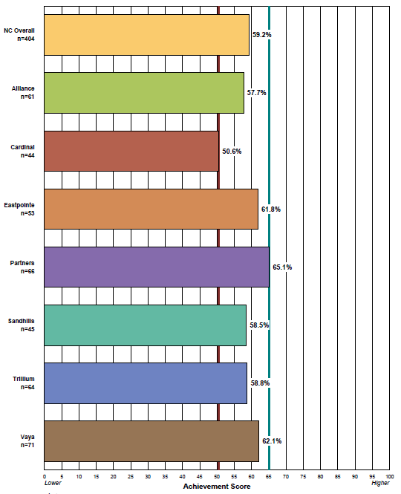
Perceived Improvement(Child Survey)
Low Benchmark = worst performing LME/MCO
High Benchmark = worst performing LME/MCO
2020 NC CAHPS® 3.0 Child Medicaid ECHO® Report

Slide 41
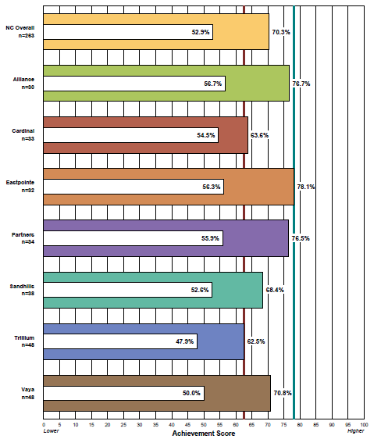
Overall Rating: Rating of Counseling or Treatment (Adult Survey)
Low Benchmark = worst performing LME/MCO
High Benchmark = worst performing LME/MCO
White portion of bar represents proportions giving rating of 9 or 10
2020 NC CAHPS® 3.0 Child Medicaid ECHO® Report

Slide 42
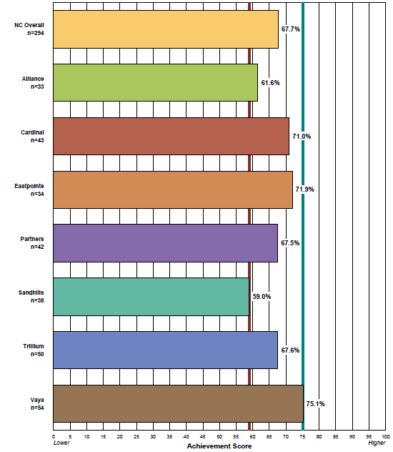
Getting Treatment Quickly (Adult Survey)
Low Benchmark = worst performing LME/MCO
High Benchmark = worst performing LME/MCO
2020 NC CAHPS® 3.0 Child Medicaid ECHO® Report

Slide 43
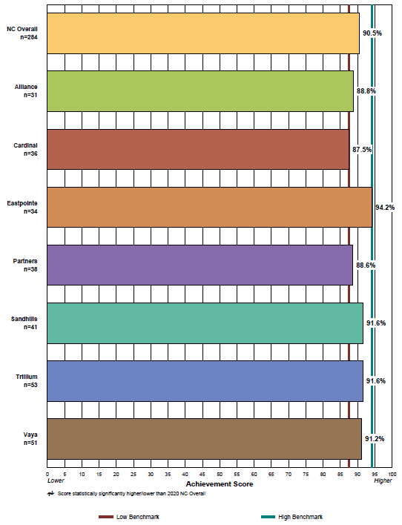
How Well Clinicians Communicate (Adult Survey)
Low Benchmark = worst performing LME/MCO
High Benchmark = worst performing LME/MCO
2020 NC CAHPS® 3.0 Child Medicaid ECHO® Report

Slide 44
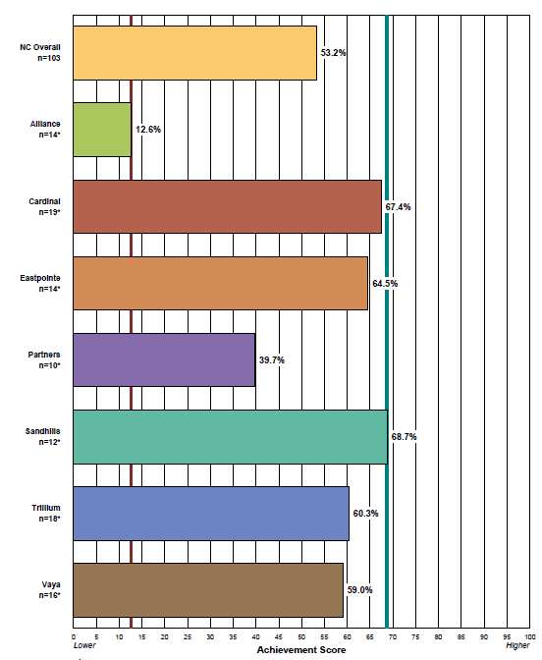
Getting Treatment and Information from the Plan (Adult Survey)
Low Benchmark = worst performing LME/MCO
High Benchmark = worst performing LME/MCO
For some survey items, relatively small numbers of responses were collected. Conclusions based on analysis of fewer than 30 observations should be viewed with caution.
2020 NC CAHPS® 3.0 Child Medicaid ECHO® Report

Slide 45
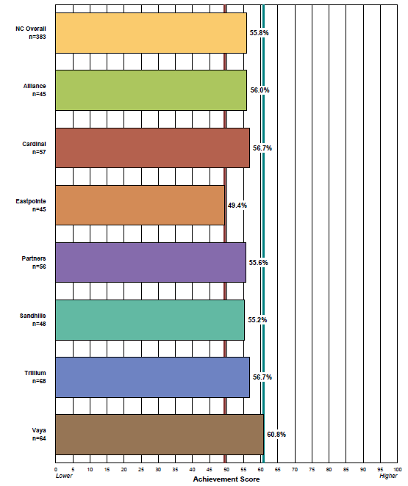
Perceived Improvement (Adult Survey)
Low Benchmark = worst performing LME/MCO
High Benchmark = worst performing LME/MCO
2020 NC CAHPS® 3.0 Child Medicaid ECHO® Report

Slide 46
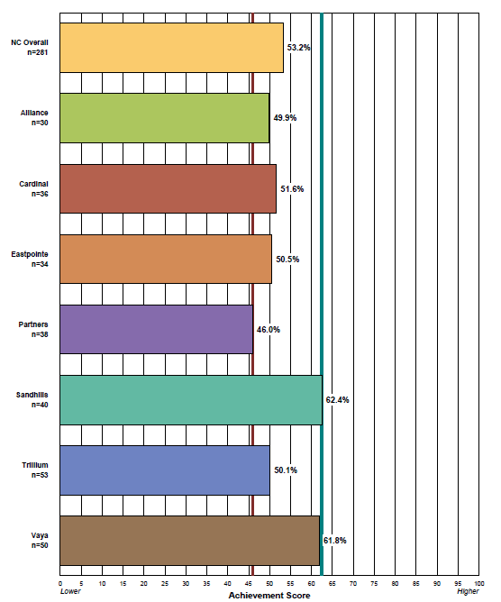
Information about Treatment Options(Adult Survey)
Low Benchmark = worst performing LME/MCO
High Benchmark = worst performing LME/MCO
2020 NC CAHPS® 3.0 Child Medicaid ECHO® Report

Slide 47
Questions?

Slide 48
LME-MCO Provider Satisfaction Surveys
Hope Newsome, MSW,
Quality Management Specialist
Division of Health Benefits
Quality and Health Populations

Slide 49
Provider Satisfaction Surveys
General Overview
  Per DHB contract, the Vendor (The Carolinas Center for Medical Excellence – CCME) will utilize the CMS protocol for conducting surveys and must use the Provider Satisfaction Survey created by DHB.
  The surveys must be stratified by Mental Health, Developmental Disabilities and Substance Abuse service providers for all seven (7) PIHPs.
  CCME will conduct annual Provider Satisfaction Survey for each of the PIHPs in a format pre-approved by DHB.
  CCME will provide a Provider Satisfaction Report to DHB annually.
  Quality and Population Health is now responsible for creating, monitoring and overseeing the Provider Satisfaction Survey as well as oversee all quality functions of the contract.
Notes:
c. agendas of upcoming meetings, posted far enough in advance to permit public
participation on issues that arise on the agenda,
d. information about accessing attendance/participation in monthly and quarterly
MCAC meetings, including options that make the meetings accessible to those
who cannot travel,
e. information about the public participation aspect of the MCAC meetings so that
the public will know how to prepare for efficient and effective participation in
those meetings,
f. access to documents that will be important in the meeting discussions, made
available prior to meetings, so that the public can have a more full and
meaningful understanding of what is transpiring in the meetings; and
g. timely posting of meeting minutes, so that the public can follow up in an
effective and efficient way on issues discussed in the meetings
-explains how a stakeholder can be considered for MCAC membership,
including sufficient detail to allow a stakeholder to apply for a membership,
b. identifies the term start and ending dates for all current MCAC members, and
c. states the ongoing responsibilities of and expectations upon MCAC members,
including attendance, participation on subcommittees if needed, and reasonable
responsiveness to community stakeholders
Please consider making these and other amendments to the plan in order
to create stakeholder participation in oversight and to strengthen
the oversight function of the ombudsman:
a. Provide that the ombudsman will communicate with the MCAC regarding
trends in PHP performance and enrollee concerns on a regular basis,
b. Provide that the ombudsman will provide proactive feedback to DHHS
regarding positive PHP/enrollee trends as well, so that they can be
acknowledged and leveraged for increased system effectiveness,
c. Provide for the ombudsman to copy the MCAC when it provides feedback to
DHHS, and that MCAC will make the copy available to the public on the website,
and
d. Provide the MCAC with periodic summaries of:
i. trends identified by the ombudsman, both positive and negative, in PHP
performance and enrollee concerns (and other areas, as may be added in this
role) to the MCAC regarding,
ii. feedback provided to DHHS by the ombudsman, and
iii. Updates
Commenters
Hospital (1) was faith division

Slide 50




Action Steps:
We requested input from several key stakeholders on the survey and QF (e.g. QMDF, LME-MCOs, CCME)
Developed survey incorporating feedback received.
Working collaboratively with CCME to administer survey.

Slide 51
Provider Satisfaction Survey Domains 2021
  Demographic
    How long have you been a provider
    How many Medicaid beneficiaries did you serve
    Provider type
    Services provided
    Primary Populations served
  Quality
    Accessibility of information, referral and scheduling
    LME-MCO response to provider needs
    Communications to network providers
    Trainings to meet needs of providers
    Where would they like more training/education
    Overall satisfaction with the LME/MCO
  Describe specific concerns/issues (open-ended questions)
    Communication with Providers and Members
    Customer Service Responsiveness
    Website
Notes:
c. agendas of upcoming meetings, posted far enough in advance to permit public
participation on issues that arise on the agenda,
d. information about accessing attendance/participation in monthly and quarterly
MCAC meetings, including options that make the meetings accessible to those
who cannot travel,
e. information about the public participation aspect of the MCAC meetings so that
the public will know how to prepare for efficient and effective participation in
those meetings,
f. access to documents that will be important in the meeting discussions, made
available prior to meetings, so that the public can have a more full and
meaningful understanding of what is transpiring in the meetings; and
g. timely posting of meeting minutes, so that the public can follow up in an
effective and efficient way on issues discussed in the meetings
-explains how a stakeholder can be considered for MCAC membership,
including sufficient detail to allow a stakeholder to apply for a membership,
b. identifies the term start and ending dates for all current MCAC members, and
c. states the ongoing responsibilities of and expectations upon MCAC members,
including attendance, participation on subcommittees if needed, and reasonable
responsiveness to community stakeholders
Please consider making these and other amendments to the plan in order
to create stakeholder participation in oversight and to strengthen
the oversight function of the ombudsman:
a. Provide that the ombudsman will communicate with the MCAC regarding
trends in PHP performance and enrollee concerns on a regular basis,
b. Provide that the ombudsman will provide proactive feedback to DHHS
regarding positive PHP/enrollee trends as well, so that they can be
acknowledged and leveraged for increased system effectiveness,
c. Provide for the ombudsman to copy the MCAC when it provides feedback to
DHHS, and that MCAC will make the copy available to the public on the website,
and
d. Provide the MCAC with periodic summaries of:
i. trends identified by the ombudsman, both positive and negative, in PHP
performance and enrollee concerns (and other areas, as may be added in this
role) to the MCAC regarding,
ii. feedback provided to DHHS by the ombudsman, and
iii. Updates
Commenters
Hospital (1) was faith division

Slide 52
Questions?

Slide 53
NC Department of Health and Human Services
Keeping Kids Well Campaign
1/21/21
Chris Weathington, Director, Practice Support, NC AHEC

Slide 54

Problem Summary
COVID-19 has led to a measurable decrease in pediatric preventative care across all populations. Disparities in rates across populations seen historically persist, especially with Latinx and Black children.
Under-utilization of well-child visits are missed opportunities to identify physical, developmental, and behavioral concerns – many of which can be managed or treated.
Missed vaccinations can eventually lead to potential community outbreaks of preventable disease during a busy COVID19 and influenza season. We don’t want another pandemic on top of a pandemic.
Need for AHEC and CCNC to help practices reduce care alerts or overdue well child checks to pre-COVID19 levels via 1:1 practice support assistance, webinars, media communications, printed resources, etc.

Slide 55
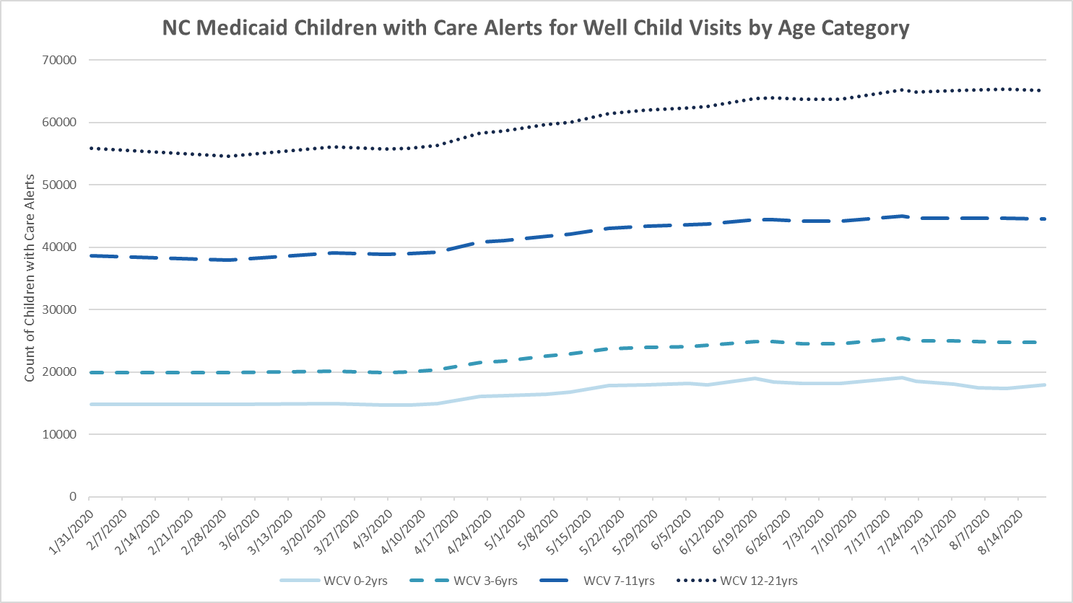
Care Alerts for Well Child Visits

Slide 56
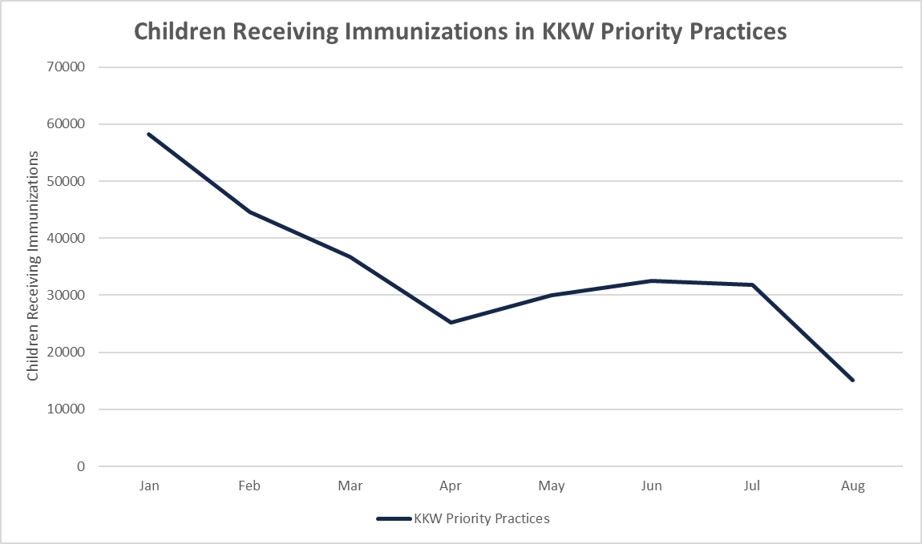
Children Receiving Immunizations

Slide 57
Recap of Keeping Kids Well Campaign
Project started August 3rd and will run through first half of 2021.
Informational webinar was given to provider community on 8/13 sharing trended claims data and an overview of the KKW campaign.
AHEC and CCNC co-branded website went live on August 3rd sharing information, resources and tools for practices and providers.
KKW campaign kick-off announcement was distributed to all professional DHB advisory group members and CCNC practices via email and social media.
AHEC and CCNC publicized efforts via traditional print and internet forums.
Practice support providing 1:1 coaching support to 160 independent and health system practice with 300 locations having more than 500 well child check are alerts.
Notes:
Chris

Slide 58
Recap of Keeping Kids Well Campaign
CCNC care management has been reaching out to parents and families with tailored messaging to Latinx and African-American families.
Local Health Departments are deploying care managers with active outreach to children in care management who are missing immunizations and well visits.
Notes:
Chris

Slide 59
Recap of Campaign Interventions
Use the EHR to generate a list of children who are behind on well childcare
Utilize the Internet and social media to reach parents and families
Utilize your staff and physical space to promote well child visits & immunizations
Partner with local school systems to get the message out about well childcare and immunizations
Remind families across your catchment area of the importance of well childcare and immunizations via local news outlets
Run a WCV/Immunization Promotion Month
Incorporate WCCs into acute care visits
Develop workflow to document immunizations that were received elsewhere
Implement group visits for well childcare (Post-COVID-19 pandemic)
Leverage CCNC care management with prioritized groups of children
Notes:
Jennifer

Slide 60
Coaching and practice performance evaluated against 3 process metrics
Measure 1: Total number and percent of practices for which there is at least one contact attempt to date.
Contact attempts = 100% (Target: 100%)
Measure 2: Total number and percent of practices for which there is at least one completed engagement (virtual meeting, telephone or email conversation).
Completed engagements = 87% (Target: 75%)
Measure 3: Total number and percent of practices with 1 or more planned or operationalized interventions to date.
Planned or operationalized interventions = 80% (Target: 70%).
Note that a practice may have more than one location.
Notes:
Jennifer

Slide 61
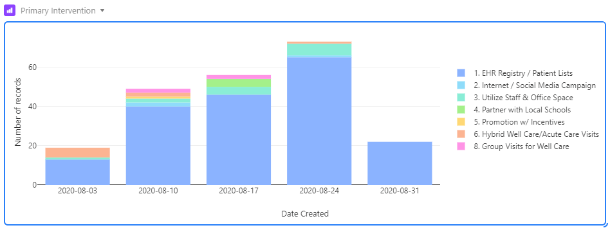
EHR Registry/Patient Lists is the most common intervention chosen by practices

Slide 62
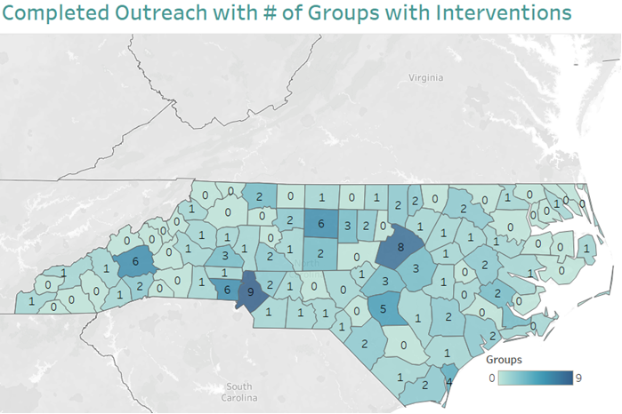
Practices with interventions is evenly distributed across the state with Mecklenburg, Wake, Buncombe, Gaston, Guilford and Cumberland Counties having 5 or more.

Slide 63
Additional Results
Based on Medicaid claims data (CCNC care alert reports), well child check care alerts have plateaued versus continued increase. Mixed results thus far with Latinx and Black children but there is improvement.
AHEC, CCNC and DHB partnered with Pfizer to distribute free pediatric immunization postcards to primary care practices. Cards are available in English/Spanish and targeting both small children and adolescents. Thus far, 170 practices applied and received over 120,000 postcards.
AHEC, CCNC and DPH partnered in December to distribute $175K ($5K per practice) to targeted KKW practices. Thus far, 20 practices in 17 counties received $100K in funding to implement targeted interventions (WCC or immunization clinics, work patient panels and contact parents for follow-up, patient education materials, etc.).

Slide 64
Questions?

Slide 65
Telehealth Evaluation—Updated
Sam Thompson, MSW
Senior Program Manager, Evaluation & Monitoring
January 21, 2021

Slide 66
Outline
There was an immense drop in the total volume of care delivered during the first few months of the Public Health Emergency.
A significant increase in telehealth and telephonic services (telemedicine) made up some of the gap created by the drop in in-person services.
Telemedicine uptake was particularly robust for behavioral health services.
The rate at which different demographic and geographic beneficiary subgroups participated in telemedicine varied.
The rate at which providers/practices participated in telemedicine varied.
Initial evidence suggests that telemedicine has replaced in-person services, to a significant extent, during the Public Health Emergency.

Slide 67
Telehealth, Telephonic, and In-person Claims Volume | 12/31/18 – 12/20/2020
Dramatic decrease in in-person visits at the outset of the Public Health Emergency
Steep increases in telemedicine during the same period
All visit types decrease with claims adjudication
Notes:
North Carolina reported its first case of coronavirus on March 3, 2020. To mitigate transmission, North Carolina’s governor instituted a stay-at-home order from March 27th to May 8th with significant social distancing measures continuing through the time of this writing. These milestones in the COVID-19 Public Health Emergency (PHE) precipitated a dramatic decrease in the volume of in-person care delivered to North Carolina Medicaid beneficiaries. By the week of April 19th, the midpoint of the stay at home order, in-person primary care claims were down 56.28% from the beginning of March. On March 8th North Carolina Medicaid instituted a broad array of telemedicine (telephonic and computer-based telehealth) policies to support social distancing and maintain continuity of care. Prior to this, the state supported almost no telemedicine, only reimbursing for remote behavioral health telehealth visits in a consultative model and only when the remote encounter was delivered at a local provider’s office.

Slide 68
% Telehealth¹ for Physical vs. Behavioral Health | 3/09/2020 – 12/13/2020
Compared to other types of care telemedicine made up a much larger proportion of behavioral health visits
Remote encounters that include both audio and video

Slide 69
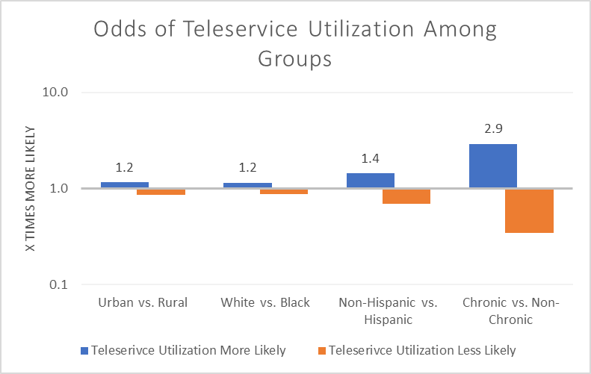
Teleservice Utilization Odds by Geography, Race and Disease Type
The COVID-19 diagnostic population may seek in-person care more readily.
The odds of teleservice utilization among:
Beneficiaries living in urban geographies is 1.2x greater than utilization odds among beneficiaries living in rural geographies
White beneficiaries is 1.2x greater than utilization odds among black beneficiaries
Non-Hispanic beneficiaries is 1.4x greater than utilization odds among Hispanic beneficiaries
Beneficiaries with a chronic disease is almost 3x greater than utilization odds among beneficiaries without a chronic disease

Slide 70
Beneficiary Survey Findings
Of respondents whose most recent visit was virtual individual therapy (n=145) 59% said that they would like to continue virtual therapy if given the option to return in person.¹
  Black or African American respondents were less likely to want to continue virtual individual therapy (44%, 24 of 54, p<.00001) compared to White respondents (73%, 48 of 66).¹
84% of respondents (n=186) reported no technical difficulties at their last virtual appointment.¹
When comparing self reported outcomes from February 2020 (before transition to telehealth) to April 2020 (transition to primary telehealth model), self reported outcomes remain similar.²
Intercept survey implemented by Carolina Outreach, a statewide behavioral health provider
Patient-reported outcomes survey implemented by Access Family Services, statewide behavioral health agency
Notes:
16% said that they would not like to continue; 25% said that they would continue under certain circumstances
Of those that participated in virtual group therapy, 44% said that they would like to continue virtual therapy if given the option to return in person
Distribution and response rate held across:
No progress
Some progress
Moderate progress
Substantial progress
DHB fielding Telehealth stratified CAHPS survey now

Slide 71
Using Teleservices to Close Care Gap
Primary care practices that adopted telemedicine at higher rates saw a much larger proportion of their patients during the first five months of the Public Health Emergency.

Slide 72
A Second Visit Was Less Likely After Teleservices
Notes:
A lower proportion of beneficiaries had a second primary care claim within 14 days after a primary care claim when the initial modality was telemedicine (14.4% compared to 16.3% for in-person services, chi-square = 172.9, p < 0.00001). Moreover, there tended to be more time between the initial visit and the second claim when the initial modality was telemedicine (figure 1).

Slide 73
Total Cost of Care in Two Weeks Following Primary Care Visit
Costs were about 25% higher for ABD when initial visit was telehealth

Slide 74
% Using Hospital Within Two Weeks of Primary Care Visit
Admissions were lowest for both ABD and non-ABD populations when initial visit was telehealth

Slide 75
PHP Onboarding Plans and 2021 Governance Calendar
Beth McDermott, Quality Management Specialist, Quality and Population Health, Division of Health Benefits
January 21, 2021

Slide 76
2021 PHP Readiness
Standard Plan (SP) and Tribal Option Onsite Readiness Review
  Review systems and processes to ensure SPs and Tribe meets contract requirements.
  Removal of portions of guides that are not applicable or do not need to be demonstrated by the Plans/Tribe.
PHP Deliverable review
  Quality Management and Improvement Program
  Quality Assurance and Performance Improvement
  Performance Improvement Plans
  Provider Support Plans
External Quality Review Organization (EQRO)
  Templates
  Reporting
  Monitoring/Oversight
  Measure Calculation

Slide 77
2021 Governance Calendar
2021
SFY Q1
Survey Results, Equity Assessment
SFY Q2
Independent Evaluations
SFY Q3
QAPIs/PIPs
SFY Q4
Quality Measures
Observation Period- July 1 to June 31
Review Period- July 1 to September 30
Observation Period- January 1 to December 31
Review Period- April 1 to June 31
Observation Period- November 1 to October 31
Review Period- October 1 to December 31
Observation Period- July 1 to June 31
Review Period- January 1 to March 31
Source: Quality Governance document

