Slide 1
MCAC
Update on Medicaid Transformation:
Quality Management & Improvement
Kelly Crosbie
Project Lead—Quality & Population Health
Jaimica Wilkins
Senior Program Analyst
March 16, 2018

Slide 2
Agenda
DHHS Quality Management
Quality Strategy
Quality Drivers and PHP Accountability
MCAC Quality Subcommittee

Slide 3
Quality Management in Managed Care
DHHS seeks to advance high-value care, improve population health, and engage and support providers through innovative, whole-person centered and well-coordinated system of care, which addresses both medical and non-medical drivers of health
1
North Carolina Medicaid Managed Care Quality Strategy
Medicaid Quality Management Structure and integrated Continuous Quality Improvement (CQI) processes
2
3
PHP Quality Performance and Accountability
DHHS Quality Goal: Develop a data-driven, outcomes-based continuous quality improvement process that focuses on rigorous outcome measurement against relevant targets and benchmarks, promotes equity, and appropriately rewards PHPs for advancing quality goals.

Slide 4
State Medicaid Managed Care Quality Strategy
States are required to implement a Quality Strategy to assess and improve the quality of managed care services offered within the state.
The Quality Strategy is “intended to serve as a blueprint or road map for states and their contracted health plans in assessing the quality of care beneficiaries receive, as well as for setting forth measurable goals and targets for improvement” (Medicaid.gov)
Source: State Quality Strategies. https://www.medicaid.gov/medicaid/quality-of-care/medicaid-managed-care/state-quality-strategy/index.html

Slide 5
State Medicaid Managed Care Quality Strategy
The State’s Quality Strategy must contain several federally required elements, and be reviewed by CMS.
The State’s Quality Strategy must include several elements related to:
The State’s goals and objectives for continuous quality improvement, along with the quality metrics that will be used to measure performance.
The interventions and performance improvement projects that will be implemented to improve access, quality, or timeliness of care for PHP enrollees including plans to reduce health disparities
Arrangements for annual external independent reviews of the quality outcomes, timeliness of, and access to, the services covered under each PHP
The State’s structure and operations standards, and the mechanisms by which the State will comply with certain federal requirements (e.g. network adequacy; transition of care, etc.)
States are required to:
Submit the initial Quality Strategy to CMS for review;
Submit regular reports on the implementation and effectiveness of the Quality Strategy, which may be met through the federally-required external quality review (EQR) process; and
Review and update the Quality Strategy at least every three years or upon a “significant change”.
Source: State Quality Strategies. https://www.medicaid.gov/medicaid/quality-of-care/medicaid-managed-care/state-quality-strategy/index.html

Slide 6
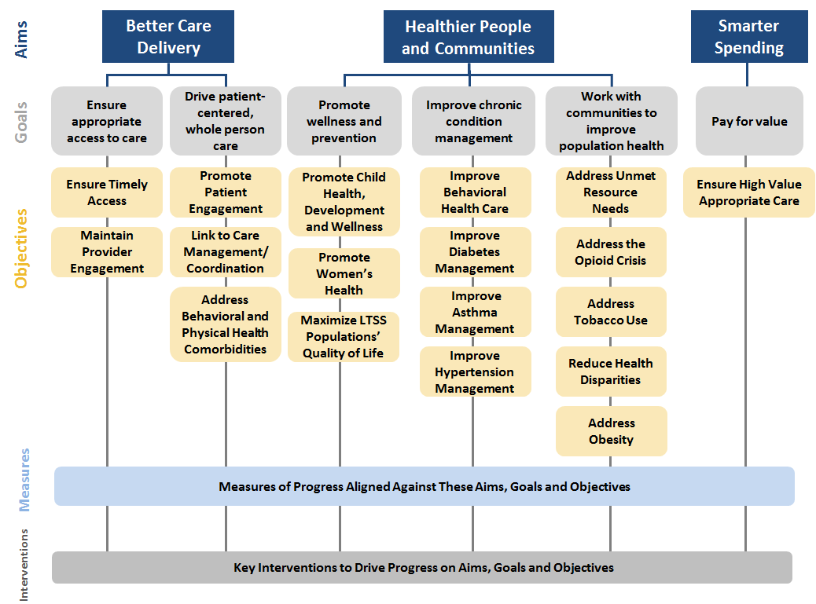
Overview of the Quality Framework
PHPs will be required to report a fairly expansive set of measures that allow the State to assess priorities and performance over time; the focused set of measures defined in the Quality Strategy Appendix A prioritize key opportunities for improvement in the near term.
Notes:
Aims are aligned with the CMS National Quality Strategy, with the Goals and Objectives aimed at driving improved and sustained population health outcomes.
Innovations to Drive Quality Improvement: The QS incorporates and aligns a series of interventions and innovations that address both medical and non medical drivers of health:
NC Opioid Action Plan/Strategy
SDOH
AMHs
BH Integration
VBP
CDC 6|18
Wforce, Provider Supports/Telemedicine
Accreditation
Disparities Reporting and Tracking

Slide 7
Summary of Primary Levers for Quality Performance
1
Quality Measure Reporting
2
Quality Baselining, Benchmarking, and Performance Target Development
3
Disparities Reporting and Tracking
4
Quality Assessment and Performance Improvement Programs (QAPIs)
PHPs must develop a QAPI aligned to NC DHHS goals, and annually approved by NC DHHS
Key components include internal-to-PHP processes for monitoring and correcting performance, conducting performance improvement projects, and addressing disparities in care
5
Value-Based Payment/Provider Incentives
PHPs are required to develop a provider incentive program for AMH Tier 3 providers; incentives must be based on AMH quality measure list (a subset of the measures used for Quality reporting)
PHPs are given flexibility to develop provider incentives – a tool for: (1) meeting NC DHHS-set minimums for payments attributed to alternative payment models; and (2) meeting NC DHHS-set quality targets
6
Cross-Cutting Quality Levers
Accountability for quality performance is layered into accreditation requirements, member auto-assignment processes, and provider credentialing decisions

Slide 8
Quality Measure Reporting Framework
There are three measure sets designed to baseline PHP performance, set future priorities, and hold PHPs accountable to achieve quality outcomes for their enrollees.
Quality Measures Aligned with National, State and PHP Reporting
Quality measures are used by the DHHS to baseline PHP performance and set priorities in future years; DHHS may also elect to report on these measures publicly
No measures require clinical data from EMRs/EHRs/HIE (will change, over time)*
Vision: Report on quality measures broadly in initial years, and streamline the measure set over time to priority areas
64
Measures
Priority Measures Aligned with DHHS Policies (“Appendix A” of the Quality Strategy)
Priority measures are aligned with the Quality Strategy and reflect NCIOM stakeholder input
Priority measures will :
Be tied to the State Quality Strategy, AMH performance incentive programs, and withholds
Be the minimum set of measures that are publicly reported
Vision: Leverage Priority Measures to Promote DHHS’ Key Quality Areas
33 Measures
Quality Withhold Measures*
Quality withhold measures are used to financially reward and hold PHPs accountable against a sub-set of measures included in the priority measure set
Quality withholds account for 30% of the total withholds in Year 1 and 60% in subsequent years
Quality measures are the only component of the measure universe where performance (as opposed to reporting) is tied to PHP financial outcomes.
Vision: Make annual updates and changes to Quality Withholds Measures based on assessment of PHP readiness to move from process measures to outcome and population health measures
6 Measures
* 1 measure- Hypertension- required for Accreditation requires a clinical component; Withholds related to areas outside of quality measures comprise the rest of the withhold program.
Notes:
The quality measure set contains:
Measures required for NCQA Health Plan Accreditation (Y1 reporting)
A select set of CMS Adult and Child Core Measures
Select measures based on DHHS priorities
Measures used include:
37 NCQA HEDIS
10 AHRQ CAHPS
1 Pharmacy Quality Alliance
1 CMS
1 CDC
2 US Office of Population Affairs (OPA)
1 American Dental Association (ADA)
10 measures reported by PHPs, DHHS
The priority measure set is a subset of the quality measures, and includes:
26 clinical quality measures (HEDIS/CAHPS/CDC/OPA/ PQA)
7 administrative and financial measures (reported by PHPs, DHHS
The draft withhold set of measures includes 5 HEDIS and 1 CAHPS measure:
(Intermediate Outcome Measure) Comprehensive Diabetes Care (HbA1c poor control >9.0%)
Asthma Medication Ratio (total rate)
Initiation and Engagement of Alcohol and Other Drug Dependence Treatment (both rates)
Medical Assistance with Smoking and Tobacco Cessation
Prenatal and Postpartum care (both rates)
Well-Child Visits in the Third, Fourth, Fifth, and Sixth years of Life

Slide 9
Quality Measurement: The Art of the Possible
DHHS Quality Goal: Develop a data-driven, outcomes-based continuous quality improvement process that focuses on rigorous outcome measurement against relevant targets and benchmarks, promotes equity, and appropriately rewards PHPs for advancing quality goals.
Now Through Launch | Years 1 – 2 Approach | Years 3 – 5 Approach
Establish Quality Vision and Set Expectations for Role of PHPs in Advancing Quality Finalize State Baselines and Set Quality Withhold Targets and Benchmarks Release Quality Strategy, Quality Measures and Quality Withhold Details | Collect Broad Set of Quality Measures for Baselining Adjust Quality Measures/ Withholds Annually Collect Process Measures Set statewide targets Reward Achievement Against Quality Withholds Integrate Disparities Tracking into PHP Reporting | Streamline Quality Measure Reporting Adjust Quality Measures/ Withholds Annually Advance Toward Outcomes Measurement Set Targets Against Stratified Data (e.g. Regional) Reward Achievement Against Quality Withholds Incorporate Disparities into Targets and Benchmarking (as feasible)
Improve Tools for Data Reporting/Collection and Risk Adjustment at State level; Refine CQI Process
Allow PHPs Time to Invest in Systems, Build Performance Improvement Programs and Establish Provider Relationships

Slide 10
Quality Management/Improvement Cycle
State-Led Transformation- Support PHPs and providers on engagement in and implementation of State-directed transformation initiatives and interventions noted in the Quality Strategy
Evaluate
PHP Compliance/Performance:
Withhold/Incent., Sanctions
CMS required reporting
PHP PIPs
Measure
416, CMS Core, HEDIS, CHIP, CAHPS
Measure
Quantitative and Qualitative Analysis of data, reporting
PHP monitoring reports/metrics
Quantitative and Qualitative Analysis of data, reporting
DHHS operational performance, QM metrics
Quality Management
Quality Strategy Priority Performance Measures
PHP monitoring
AMH performance measures
DHHS operational performance QI
OB performance measures
DHHS operational performance monitoring
Improve
Monitor
AMH designation
PHP QIP
DHHS- internal/operational quality improvement, Quality Strategy CQI revision
PHPs- Quality Strategy Aims, Goals and Objectives
Providers- Quality Strategy Aims, Goals and Objectives
Provider/AMH Monitoring
PHP PIPs
Metric indicates performance gap
Notes:
Two cycles operating simultaneously:
Management involves the measures, assessments, surveys, tools reporting and evaluation regarding the quality strategy, PHPs, and DHHS operations
Improvement includes quality CQI cycle, quality assessment and performance improvement plans monitoring for providers and PHPs, performance improvement targets, benchmarks, and withholds, and qualitative and quantitative data analysis

Slide 11
Next Steps
We welcome your comments/questions now; any additional feedback may be submitted to Kelly Crosbie (Kelly.Crosbie@dhhs.nc.gov).
Next Steps:
We will request input from several key stakeholders (e.g., the Medical Care Advisory Committee, Tribal)
The Quality Strategy and PHP Quality Performance and Accountability Paper will be released for public comment period
Following key stakeholder and public input, the Quality Strategy will be submitted for CMS review prior to finalization.

Slide 12
MCAC Quality Subcommittee

Slide 13
Quality Subcommittee Members
Provide guidance on processes to promote evidence-based medicine, coordination of care and quality of care for health and medical care services that may be covered by the NC Medicaid Program.
Review and advise on Quality Strategy (QS), Metrics, and Priorities
Review and advise NC DHHS on quality policies and recommend any needed changes
Discuss measure reporting and timeline
Discuss targeted quality initiatives (PIPs, approach for special populations and/or conditions)
Slot Represented | Proposed Individual | Company
MCAC | Kim Schwartz | Roanoke Chowan Community Health Ctr
MCAC | Linda Burhans
Board-certified physician internal medicine/family practice | Genie Komives | Duke Primary Care
Board-certified physician internal medicine/family practice | Robert L. Rich, Jr | Bladen Family Medicine
Board-certified physician pediatrics | Calvin Tomkins | Mission Health Partners
Board-certified physician pediatrics | Jason D. Higginson | Maynard Children's Hospital
Board-certified physician obstetrics and gynecology | OPEN
Behavioral health professional (or psychiatrist) | Charles “Ken” Dunham | Novant Health
Beneficiary | Aaron Ari Anderson

Slide 14
Quality Subcommittee Members cont.
Slot Represented | Proposed Individual | Company
Health Plan Association | Ken Lewis | NCHP
AHEC/Quality in the Field | Ann Lefebvre | NC AHEC
Hospital | Robert A. Eberle | Novant
Hospital | Chris DeRienzo | Mission Health
Hospital | Samuel Cykert | UNC School of Medicine
Pharmacy | Andy Bowen | NC Board of Pharmacy
Provider Associations | Michelle F. Jones | Board Member, NC Medical Society/ Wilmington Health Assoc.
Local Health Departments | Marianna TePaske Daly | Madison County Health Department
 | Peter Charvat | Johnston Health
Academic/University | Darren A. DeWalt | UNC Population Health
Academic/University | Jason Foltz | ECU Physicians
Crisis/Emergency | David Kammer | Wake Emergency
Primary MD | J. Thomas (Tommy) Newton | Clinton Medical Center
LME-MCO | Katherine Hobbs Knutson | Alliance Behavioral Healthcare

Slide 15
MCAC Quality Committee Meetings
Meeting Topics (TENT)
CQI/Meeting Cycle
April 2018 - 1st Meeting, Quality Strategy Overview, Charter and Role of Subcommittee
July 2018 – PHP Measure Set, Provider Survey, CAHPs Surveys
October 2018 - EQRO Functions & Planning
January 2019 – PHP Quality Reporting Cycle, EQRO Cycles, Planned Quality Reports (Utilization, Disparity, Access, etc.)

Slide 16
Questions?

