Slide 1
NC Department of Health and Human Services
Regional Trainings - Electronic Visit Verification (EVV) Implementation – State Plan PCS and Community Alternatives Programs (CAP)
NC DHB, Liberty Healthcare, & VieBridge, Inc.
November 17 – 19, 2020

Slide 2
Welcome

Slide 3
Agenda
EVV Background
EVV Implementation
EVV Policy Updates (State Plan PCS)
QiRePort Provider Interface Enhancements
EVV Policy/Program Updates (CAP/DA & CAP/C)
Next Steps

Slide 4
Background
Effective 1/1/21 Electronic Visit Verification (EVV) implementation
  Federally mandated for Personal Care Service Programs (PCS) visit verification entry – Section 12006 of the 21st Century Cures Act
  EVV offers a measure of accountability to help ensure that individuals who are authorized to receive services in fact receive them.
EVV Systems Must Verify
  Type of service performed
  Individual receiving the service
  Date of the service
  Location of service delivery
  Individual providing the service
  Time the service begins and ends

Slide 5
Background
All Services subject to EVV
State Plan PCS In Home Care Services Only – 99509 HA & HB
Community Alternatives Program for Disabled Adults (CAP/DA) –
  S5125, S5125 UN, S5135, S5135 UN, S5150
Community Alternatives Programs for Children (CAP/C) -
  S5125, S5150, T1004, T1019, T2027, and associated congregate codes
Innovations Waiver – Community Living and Supports and Supported Living
(b)(3) Services – Personal Care / Individual Supports, Transitional Living Skills, In Home Skill Building, Community Living and Supports, Supported Living – Periodic
Traumatic Brain Injury Waiver – Life Skills Training, In Home Intensive, and Personal Care
1115 Waiver Managed Care
Note: Adult Care Home Providers are not subject to the EVV requirement.

Slide 6
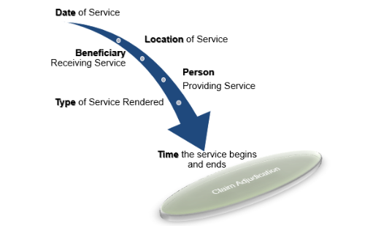
EVV Data is used to adjudicate claims

Slide 7


Background
EVV Technology – Providers will have the option of utilizing mobile app, Telephony, and Fixed Visit Verification Devices.

Slide 8
Background
OPEN VENDOR MODEL –
NC will utilize an open vendor model approach to EVV implementation – the open vendor model allows states to contract with a single EVV but allows providers and PHPs to utilize their own system.
Aggregator – The open vendor concept must be supported by an EVV aggregator.
The EVV Aggregator is a centralized database that collects, validates, & stores statewide EVV visit data transmitted by Third Party Alternate EVV Solutions.

Slide 9
OPEN VENDOR MODEL –
Sandata’s Data Aggregator will receive EVV data from the following locations:
Medicaid Providers using the State EVV system (Sandata)
Medicaid Providers using 3rd party/alternate EVV systems
Medicaid Fiscal Agents processing claims for consumer direction
LME/MCO Aggregated EVV data
PHP Aggregated EVV data

Slide 10
3rd party alternate EVV
Meeting held Thursday 11/12/2020
Presentation and Recording available on NC Medicaid EVV webpage
https://files.nc.gov/ncdma/documents/Providers/Programs_Services/EVV/NC-DHHS.Alternate-EVV-Provider-Overview.111220.pdf
https://register.gotowebinar.com/recording/739482453750215694
Alternate EVV Addendum – available on EVV webpage
https://files.nc.gov/ncdma/documents/Providers/Programs_Services/EVV/NC-DHB-altEVV-Addendum-v1.0--002-.pdf
medicaid.ncdhhs.gov/evv

Slide 11
EVV implementation
Claims Adjudication –
Providers will continue to submit claims to NCTracks for adjudication. No change to how prior approvals are transmitted to and how claims are submitted through NCTracks
Once claims are submitted, NCTracks will ensure an EVV validation file has been received from Sandata aggregator for date of service(s) prior to adjudicating the claim that also matches the PA limitation.

Slide 12
EVV Implementation
NC DHHS awarded Sandata Technologies, LLC the EVV contract on September 24, 2020.
January 1, 2021 – NC Medicaid will implement EVV
State Plan PCS, CAP/DA, CAP/C, Innovations, and TBI (LME/MCOs)
July 1, 2021 – Managed Care Implementation – PHPs will be required to implement EVV for its Members.

Slide 13
State Plan PCS Policy – EVV Updates

Slide 14
PCS Policy:3L Amended date - January 1, 2021
4.2.2 Medicaid Not Covered Specific Criteria
Medicaid shall not cover PCS when:
Providers subject to Electronic Visit Verification (EVV) have not enrolled with an EVV solution as required by Section 12006 1903(l) of the 21st Century Cures Act.
Note: Adult Care Home Providers are not subject to the EVV requirement

Slide 15
6.1.4 Requirements for State Plan PCS On-Line Service Plan
Provider organizations subject to EVV shall ensure that the service calendars are adjusted to reflect the monthly service authorization as needed.
Provider organizations subject to EVV shall adjust service calendars when Service Plan revisions are required.

Slide 16
7.4.2. Electronic Visit Verification Requirements (EVV) Minimum Requirements
Providers Subject to EVV must comply with the requirements listed below:
  Comply with Section 12006 1903 (l) of the 21st Century Cures Act and any subsequent amendments.
  Register with the State’s EVV solution or procure an alternative EVV solution.
  If provider selects alternative solution, the solution must be compliant with 21st Century Cures Act and all state requirements.

Slide 17
Cont.
  Provider agencies must have written documentation that they have informed beneficiaries of the EVV requirement.
  Provider agencies must complete all required EVV trainings prior to providing services.
  Provider agencies must train staff on use of EVV system selected and ensure continued training

Slide 18
Cont.
EVV visit verification validation components required by the 21st Century Cures act are listed below:
  Type of service performed;
  Individual receiving the service;
  Date of the Service;
  Location of Service delivery;
  Individual providing the service; and
  Time the service begins and ends.

Slide 19
QiRePort Provider Interface Enhancements
QiReport Provider Interface Enhancements explained in QiReport slides following will be effective January 1, 2021
The requirement to complete on-line service plan calendars (IHC Providers only) will start January 1, 2021 and will be completed for new requests, annuals, service plan revisions, change of status requests, etc. as they are due. Providers will not be required to complete service plan calendars for current beneficiaries prior to 1/1/2021.

Slide 20

QiRePort
Provider Interface Enhancements
PCS Provider Training
November 2020

Slide 21
System Enhancements
Online Service Plan Processing Updates
Online Service Plan Calendars – In-Home Care (IHC) Providers Only
Non-Assessment Based Authorizations
      Expedited Assessments
      Appeal Resolutions
        Change of Provider after Appeal Resolution
    EPSDT Short Term Increase
  Service Plan Revisions

Slide 22
Online Service Plan Processing Updates
The online service plan will generate AFTER the beneficiary (authorization) notification processes
  Service Plan Start and Projected End Dates will be determined with notification generation
IHC Providers will complete a monthly service calendar for the authorization period
Prior authorizations (PA) will generate only after the “typical week” service plan with tasks AND each monthly service calendar has been completed (IHC only)
Online service plans will generate for non-assessment based authorizations
  PAs will generate only after the service plan has been completed

Slide 23
Online Service Plan Calendars
IHC Providers

Slide 24
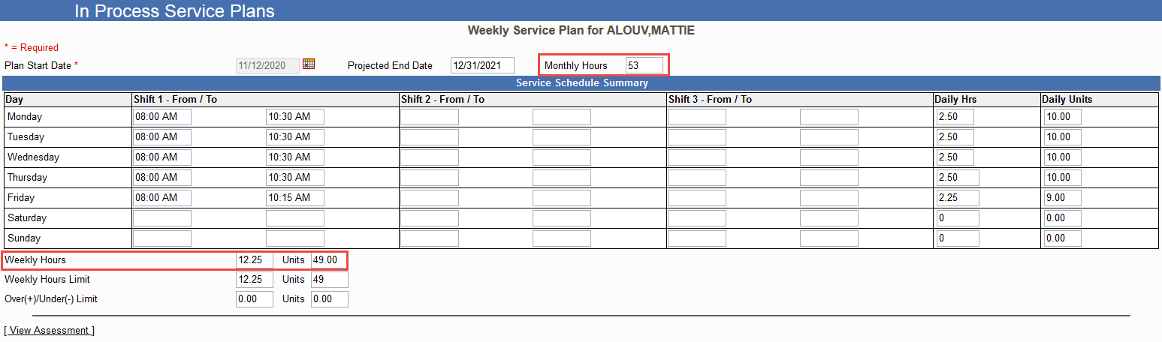
QiRePort will use the authorized Monthly Hours and Weekly Hours to determine the “Plan Monthly” hours based on the “typical week” entered on the plan

Slide 25
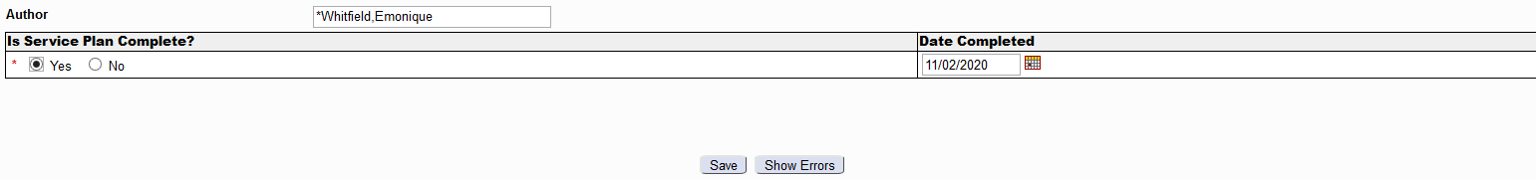

Save the service plan for system validations to process for Monthly Hour Allocation/Service Calendar generation to complete
The pop-up message notes that the Service Calendar schedule cannot exceed the Authorized Hours

Slide 26
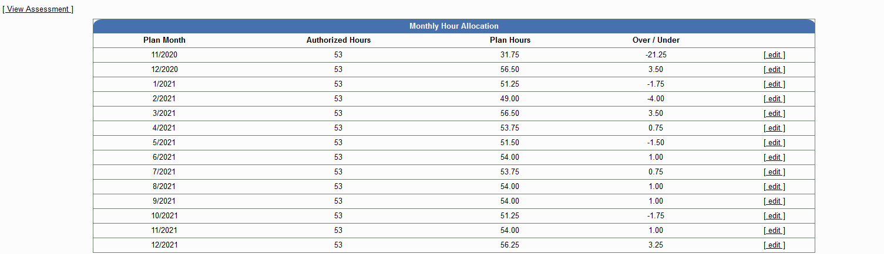
The Monthly Hour Allocation table generates with Service Calendars for each month of the authorization period
Selection of the [edit] hyperlink generates the Service Calendar for the Plan Month

Slide 27
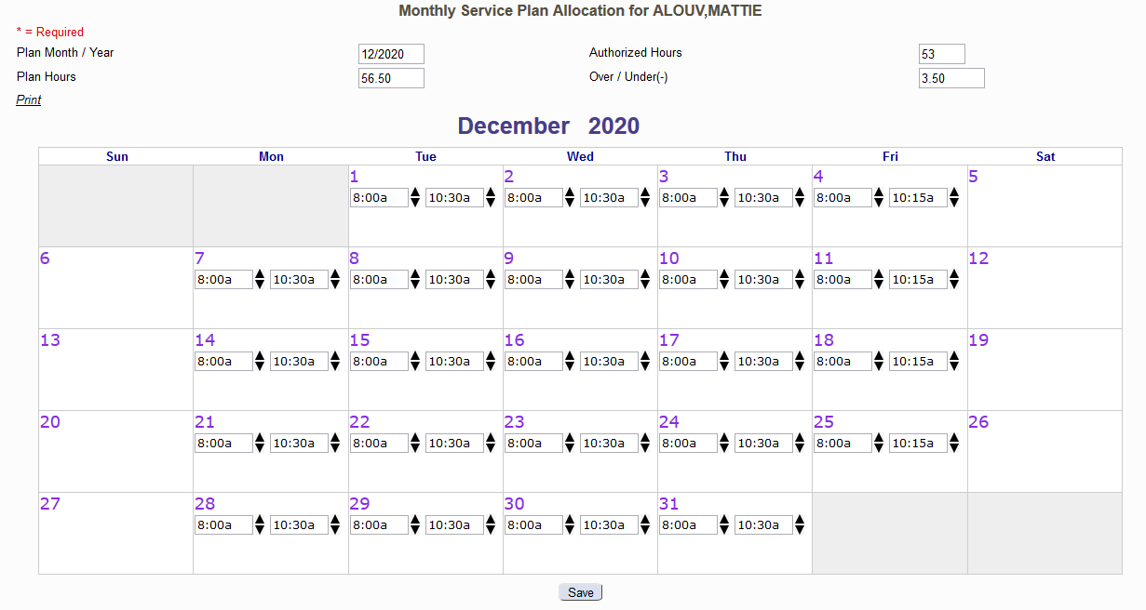

Slide 28
Service Calendar Edit
The Plan Hours must not exceed the Authorized Hours
    Plan Hours on a partial month cannot be increased
From/To Time can be edited in 15 minute increments by selecting the up/down arrows next to the times from the typical week
    The Plan Hours and Over/Under fields will adjust accordingly
  The Weekly Service Plan, Monthly Hour Allocation (service calendars) and PCS Tasks must be completed to mark the Online Service Plan complete
    PAs will generate the next business day after the plan is completed

Slide 29
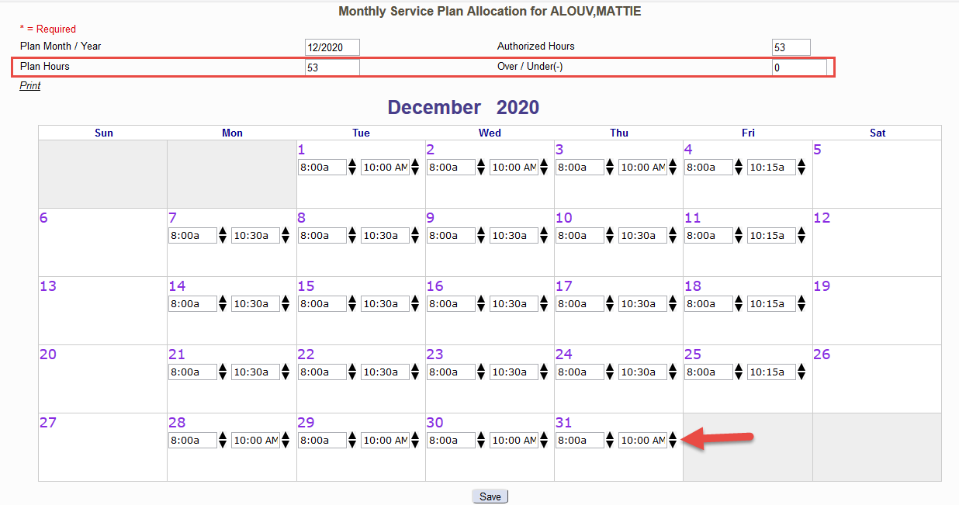

Slide 30
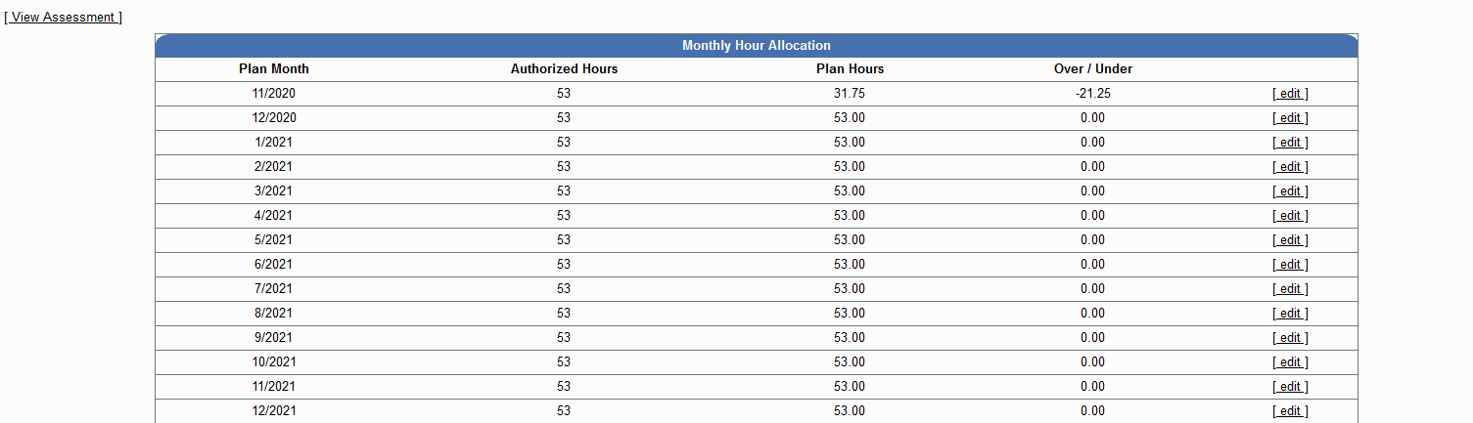
The Monthly Hour Allocation table will show all modified Service Calendars
The Plan Hours must NOT exceed the Authorized Hours
Note: Partial Month(s) will not be modified; services should be provided as the calendar specifies

Slide 31
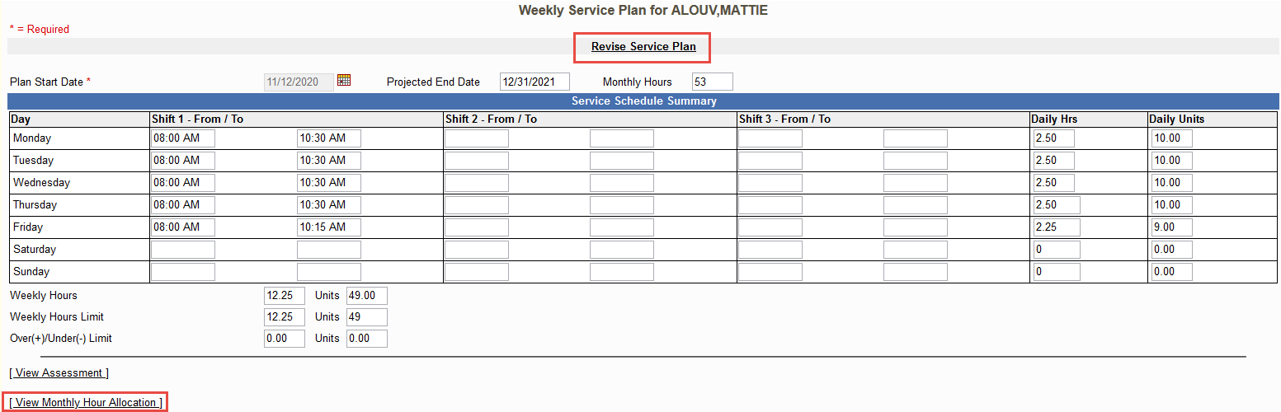
QiRePort will save the Service Plan if all validations for the Weekly Service Plan, Monthly Hour Allocation and PCS Tasks are met
Once the plan is complete, the “Revise Service Plan” and “View Monthly Hour Allocation” hyperlinks are available

Slide 32
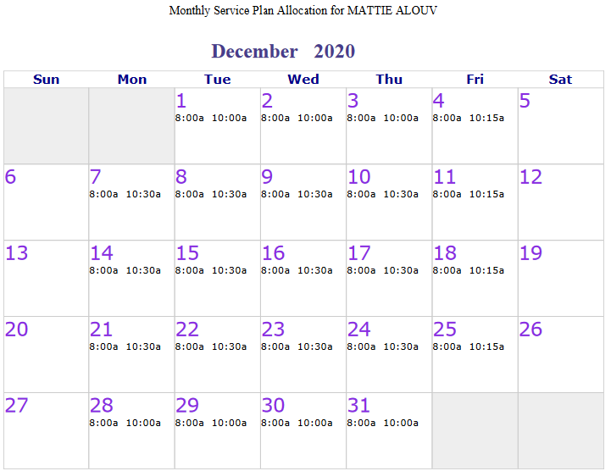
View Monthly Hour Allocation
Providers can print the Monthly Service Plan Allocation for each month to provide to the Aide and/or Beneficiary
The calendar will print in PDF format with the Time In/Out for each day services are to be provided

Slide 33
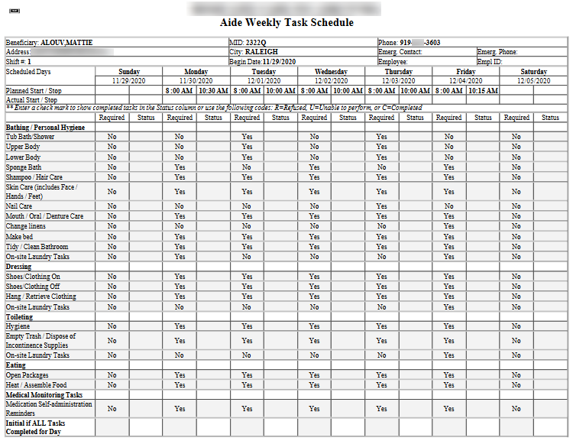
Aide Weekly Task Schedule
The Aide Task Sheet will print based on the times entered on the Monthly Service Plan Allocation using the Start Date specified
The task sheet will print in PDF format and the times will match the service calendar

Slide 34
Non-Assessment Based Authorizations
IHC & ACH Providers

Slide 35
Non-Assessment Based Authorizations
QiRePort will create an online service plan for authorizations that are not based on an independent assessment
    Includes IHC and ACH beneficiaries
  PAs will generate the next business day after the online service plan is completed

Slide 36
Expedited Assessments
The online service plan will generate after the beneficiary notification (authorization) based on the expedited assessment completed by the IAE
  Expedited service plans will follow the same process for completion.
All ADL/IADL Need/Tasks for qualifying ADLs will be included.
  Providers will determine the PCS Need Frequency for all selected tasks.

Slide 37
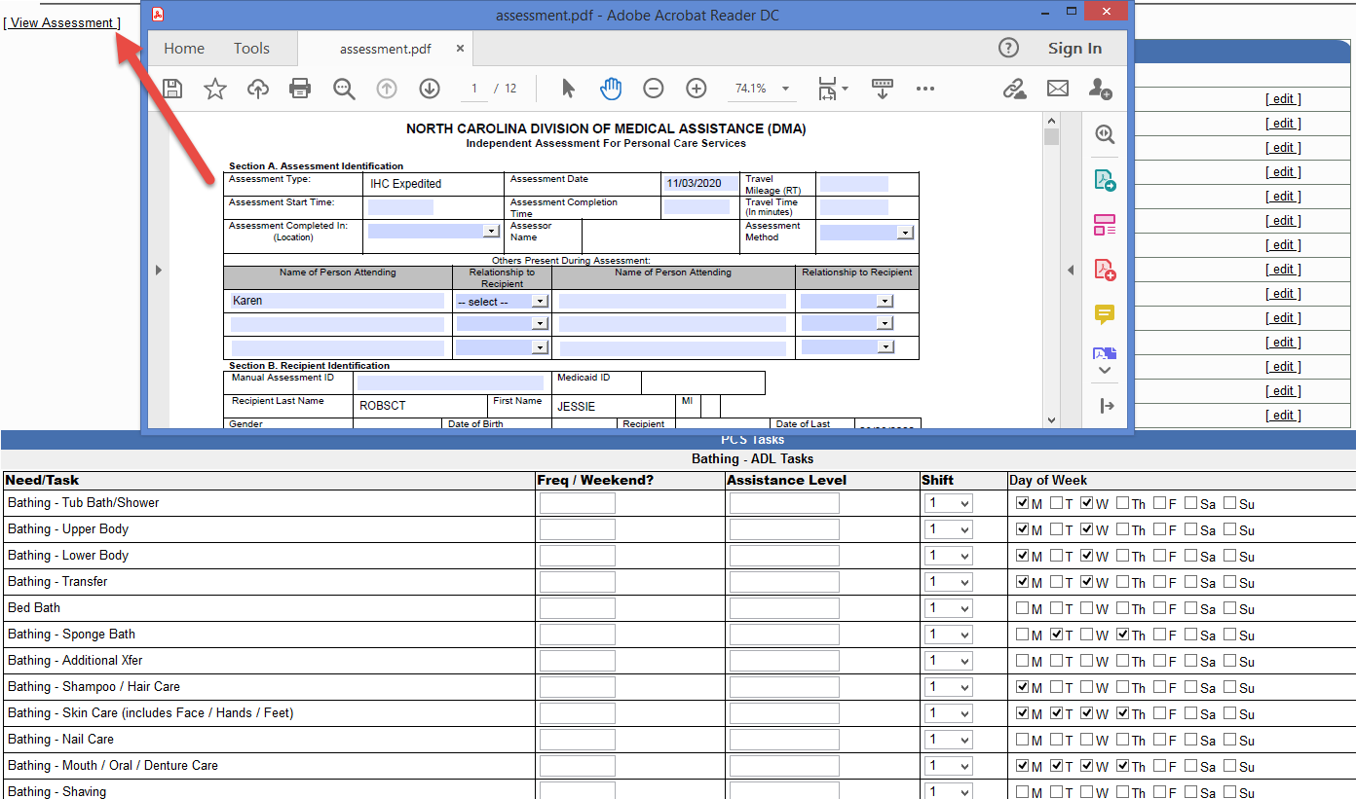

Slide 38
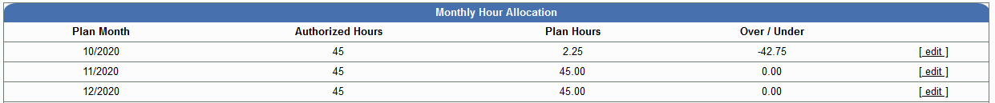
Expedited Service Calendars
Service calendars must be completed in order for the online service plan to be completed for provisional PAs to generate

Slide 39
Appeal Resolutions
QiRePort will create an online service plan for appeal resolutions that are not based on an independent assessment
    Mediation and Court Settlements
    Change of Provider after Settlements
  Online service plan completion is now required for PA generation for appeal resolutions
    PAs will generate the next business day after the online service plan is completed

Slide 40
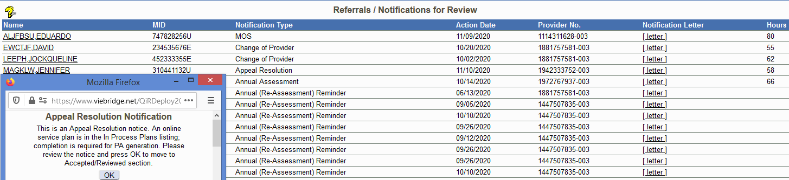

Slide 41
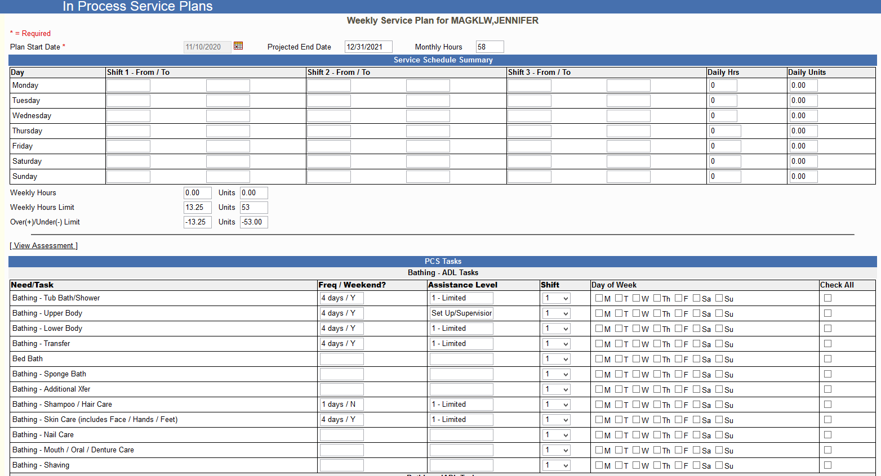
The online service plan is created using the appealed assessment

Slide 42
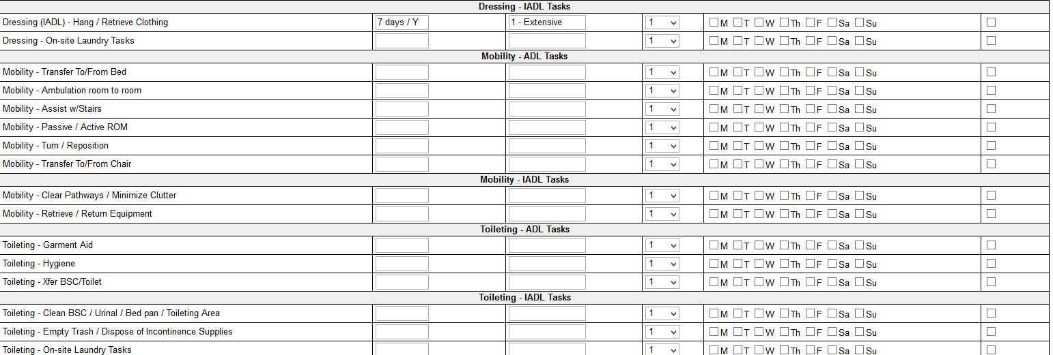
The plan will also include ADLs/Tasks that were “non-qualifying” on the assessment to allow the provider to add tasks if the resolution resulted in the need for additional assistance

Slide 43
EPSDT Short Term Increase (STI) Requests
QiRePort will create a Service Plan Revision when the beneficiary is awarded an STI authorization by the Medicaid Nurse
  The provider is notified on the Referrals for Review screen with the “Service Plan Revision Required” message
    Acknowledgement of the message will take the user to the Service Plan Revision for completion

Slide 44
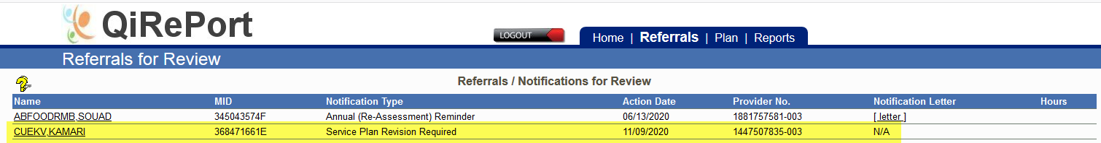

Acknowledgement of the message will open the Service Plan Revision

Slide 45
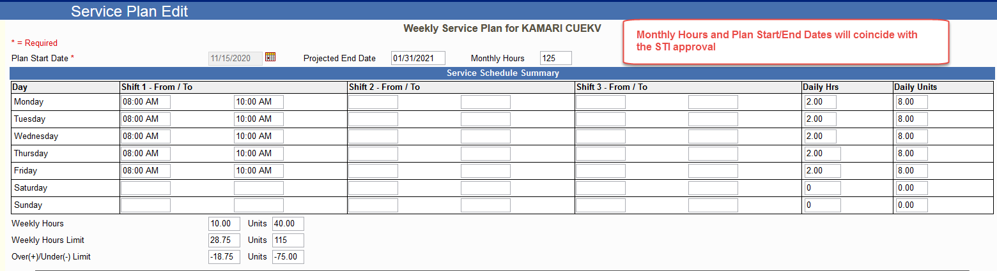

Slide 46
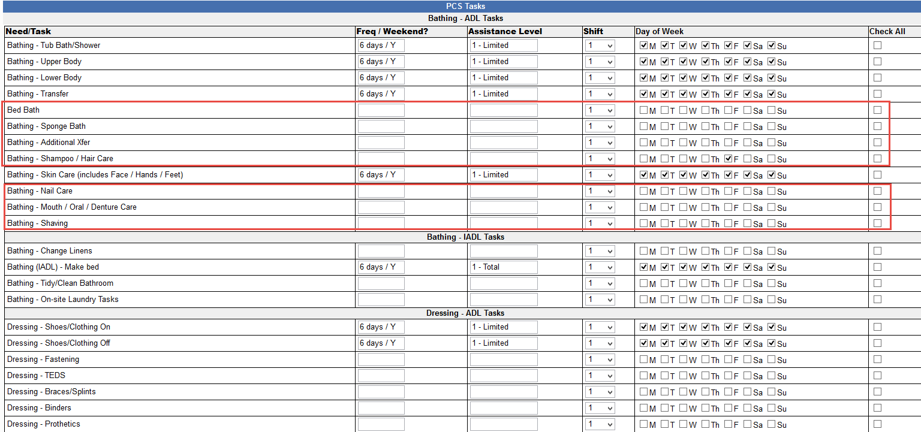
All PCS Tasks will be available for STI plan revisions

Slide 47
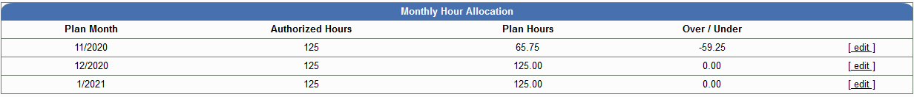
STI Plan Revision Service Calendars
Service calendars will be provided for the month(s) of the authorized STI only.

Slide 48
Service Plan Revisions
QiRePort will duplicate the current online service plan when the “Revise Service Plan” hyperlink is selected
  The Plan Start Date only can be modified
  The Monthly Hour Allocation table will display after the plan is saved.
    Service calendars will generate based on the Plan Start/Projected End Dates

Slide 49
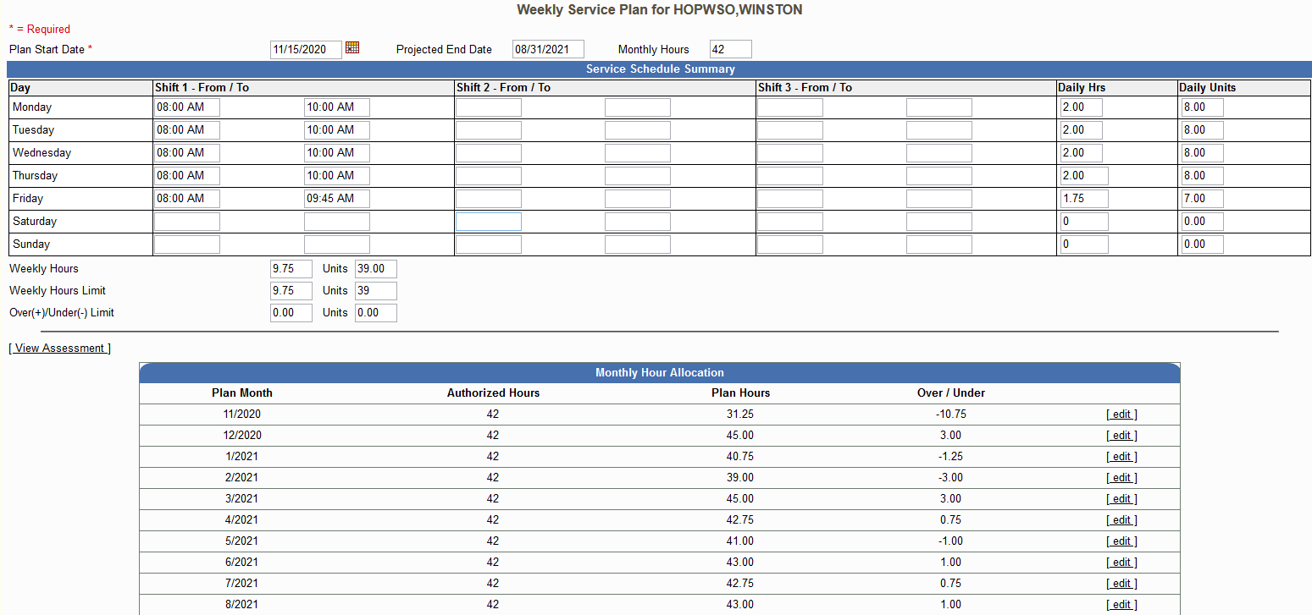

Slide 50

Need Assistance?
Website Help – Ask a Question from the QiRePort Home Page
  Type in your question and send
  Reminder: Do NOT include PHI
  Training Resources
    Online Instructions
    Training Videos/Webinars
QiRePort Support Center
  1-888-705-0970
Notes:
VieBridge Customer Support Representatives are available Monday – Friday 8:00 a.m. – 5:00 p.m.
You can send questions through the interface on the “Website Help – Ask a Question” box on the Home Page. Remember --- Do NOT include PHI
The Home Screen has Training Resources available to help you with system functionality and training – Online User Guides and Training Videos

Slide 51
Community Alternatives Programs (CAP) - Updates

Slide 52
CAP Policies: 3K-1 and 3K-2; proposed amended date, Jan. 1, 2021
Technical changes to include the EVV mandate were made to the CAP/C and CAP/DA Clinical Coverage Polices:
Section 5.0 – Requirements for and Limitation on Coverage
  The provider subject to the EVV requirements shall obtain an EVV confirmation before submitting claims for personal care-type services approved in this policy
Section 6.0 – Provider(s) Eligible to Bill for the Procedure, Product, or Service
  Providers(s) shall comply with Section 12006 1903(l) (Electronic Visit Verification, EVV) of the 21st Century Cures Act and any subsequent amendments to validate in-home visit(s) rendered for personal care type services approved in this policy.

Slide 53
CAP Policies: 3K-1 and 3K-2; proposed amended date, Jan. 1, 2021
Section 6.0 – Provider(s) Eligible to Bill for the Procedure, Product, or Service and Section 7.0 – Additional Requirements
  have written documentation that recipients of in-home aide and pediatric nurse aide services were informed of the EVV requirement;
  complete all required EVV trainings prior to providing in-home aide and pediatric nurse aide services;
  train staff on use of EVV system selected; and
  ensure administrator, essential personnel and staff within organization participates initial, annual and refresher training in EVV.

Slide 54
CAP Policies: 3K-1 and 3K-2; proposed amended date, Jan. 1, 2021
Section 7.19 - Use of Telephony and Other Automated Systems
  Providers subject to EVV shall comply with the EVV requirements. Those requirements are listed below:
  Register with the State’s EVV solution or procure an alternative EVV solution.
  A selected alternative solution must be compliant with 21st Century Cures Act and all state requirements; and
  Regular and routine training must be provided to staff on the use of the EVV system selected.

Slide 55
CAP Policies: 3K-1 and 3K-2; proposed amended date, Jan. 1, 2021
Attachment A- Claims Related Information
Provider(s) subject to the EVV requirements shall capture and verify seven (7) core in-home visit components, which are required under the 21st Century Cures Act to complete real-time electronic verification, tracking, and documentation. These core components are:
  Date of Service;
  Location of service delivery;
  Individual providing service;
  Type of services performed;
  Individual receiving service;
  Time service begins; and
  Time service ends.

Slide 56
CAP Policies: 3K-1 and 3K-2; proposed amended date, Jan. 1, 2021
Appendix B – Service Definition and Requirements
  is subject to the EVV requirements and the provider agency shall comply with Section 12006 1903(l) of the 21st Century Cures Act and any subsequent amendments, when applicable.
    CAP In-Home Aide
    Pediatric Nurse Aide
    Personal Care Assistance
    Respite services, excluding nurse respite
Appendix F: Glossary of Terms
  New EVV definition

Slide 57
Authorization of CAP HCBS
Using and understanding the CAP Service Authorization
  All but one EVV requirement is listed on the CAP service authorization (SA), name of the caregiver.
  The requirements listed below can be found on the SA:
    Date of Service;
    Location of service delivery;
    Individual providing service;
    Type of services performed;
    Individual receiving service;
    Time service begins; and
    Time service ends.
  Not an EVV requirement, but the task list can also be found on the SA

Slide 58
What’s Next????

Slide 59
Preparing for Implementation
1/1/2021 Go-Live, Providers who have selected the State’s Solution (Sandata) will complete scheduling of their aides in the Sandata Solutions. Providers should enter their schedules in accordance with the schedules completed in QiReport and e-CAP.
Aides will have the option of selecting aide tasks in the State’s solution during the visit. A compiled list of tasks from both PCS and CAP tasks will be included in the solution.
The Training Announcement for agencies who will use the State’s System will be available this week. Please visit the NC Medicaid EVV webpage under Provider Meetings and Trainings for updates. medicaid.ncdhhs.gov/evv

Slide 60
Completion of Provider Survey
North Carolina DHHS EVV Provider Agency Survey – State Plan PCS and Community Alternatives Program (CAP) Providers
https://www.surveymonkey.com/r/NCDHHS_AltEVV
Provider Trainings – Agencies using the State’s solution – Training announcement released this week and is scheduled to begin on 11/30/20. Training will be available for Agency Administrator(s) and Agency Staff/Caregivers

Slide 61
Third Party Alternate Solutions – All 3rd party alternate solutions – addendum and additional documents available on NC EVV webpage.
EVV Implementation – January 1, 2021

Slide 62
Program Contacts
Personal Care Services | Community Alternatives Programs (CAP/C and CAP/DA | Innovations and Traumatic Brain Injury
Cassandra McFadden, Community Programs Operations Manager Cassandra.mcfadden@dhhs.nc.gov | WRenia Bratts-Brown, Waiver Operations Manager, CAP Wrenia.bratts-brown@dhhs.nc.gov | Kenneth Bausell, IDD Manager Kenneth.Bausell@dhhs.nc.gov
EVV questions may be sent directly to Medicaid.evv@dhhs.nc.gov
Visit the NC Medicaid EVV webpage for updates on EVV medicaid.ncdhhs.gov/evv

Slide 63

Submit Questions via the chat option

