Slide 1
Understanding Your Medicaid Health Plan and Requests to Make Changes
November 6, 2019

Slide 2
Overview of Materials
Medicaid Changes in North Carolina
Notification of Your Medicaid Health Plan
Process to Request a Health Plan Review
Help Is Available to You

Slide 3
Medicaid Changes in North Carolina

Slide 4
Medicaid changes put YOU at the center of care
Physical Health
Intellectual/ Developmental Disabilities
Long Term Services & Supports
Pharmacy
Behavioral Health
Unmet Needs
(housing, food, transportation, violence and stress)

Slide 5
There will be two (2) ways to get Medicaid
NC Medicaid Managed Care
Name for new Medicaid program
NC Medicaid Direct
Offered by “health plans”
One health plan for most health services, including physical health, behavioral health, pharmacy
New name for current Medicaid fee-for-service program
Provides many of the same health services as in health plans
During the roll out of managed care, LME-MCOs will continue to provide some services for certain people in NC Medicaid Direct who are identified as having a mental illness, substance use disorder, I/DD, or TBI
Most people soon will get their Medicaid health care through a health plan
Every person who is eligible to get Medicaid will still get Medicaid

Slide 6
There will be three (3) types of Medicaid Managed Care health plans by 2021
Standard Plans
BH I/DD Tailored Plans
Standard Plans will cover:
Physical Health
Pharmacy
Behavioral Health
Most people with Medicaid will enroll in a Standard Plan.
BH I/DD Tailored Plans will cover:
Physical Health
Pharmacy
Behavioral Health
Also covers more intensive services for serious mental illnesses, severe substance use disorders, intellectual/ developmental disabilities (I/DDs), and traumatic brain injuries (TBIs)
Most people with significant health care needs for behavioral health, (I/DDs), or (TBIs), will enroll in a BH I/DD Tailored Plan.
Statewide Foster Care Plan
Children in foster care will be able to enroll in the Statewide Foster Care Plan
This plan will cover physical health, pharmacy, and behavioral health

Slide 7
These plans will start at different times
BH I/DD Tailored Plan
(July 2021)
Statewide Foster Care Plan
(TBD)
Standard Plan (February 2020)
Medicaid Managed Care Health Plans
2019 | 2020 | 2021
NC Medicaid Direct
Some people will not be eligible to enroll in a health plan; they will stay in NC Medicaid Direct.

Slide 8
Who is eligible for a BH I/DD Tailored Plan?
Not everyone is eligible to enroll in a BH I/DD Tailored Plan.
State law outlines who is eligible to enroll in a BH I/DD Tailored Plan.
People who need certain services to address needs for an intellectual/developmental disability (I/DD), traumatic brain injury, serious mental illness, serious emotional disturbance, or severe substance use disorder may be eligible to enroll in a BH I/DD Tailored Plan.

Slide 9
There is a process to determine your eligibility for a BH I/DD Tailored Plan
If you are determined eligible for a BH I/DD Tailored Plan, then you will stay in NC Medicaid Direct and your LME-MCO until BH I/DD Tailored Plans launch in 2021.
If you are enrolled in a Standard Plan but become eligible for a BH I/DD Tailored Plan at a later date, you will move to NC Medicaid Direct and then to a BH I/DD Tailored Plan in 2021.
NC Will Review Data
Claims & Services
Diagnosis
Waivers
NC Will Determine BH I/DD Tailored Plan Eligibility

Slide 10
Notification of Your Medicaid Health Plan

Slide 11
You may have recently received a letter from Medicaid
Notice letters were sent to most people who currently receive Medicaid
Beneficiaries received different types of letters, depending on their personal situation
Your letter tells you if you need to enroll in a health plan yet, or not
OPTION TO ENROLL
MIXED HOUSEHOLD
ENROLL

Slide 12
If you got a letter…
NC Medicaid has determined that you or someone in your household:
Must enroll in a Standard Plan OR
Has the option to enroll in a Standard Plan (i.e., is eligible for a BH I/DD Tailored Plan)
Reminder: Standard Plan Timeline
Enrollment is happening now and runs through December 13, 2019
Standard Plan coverage begins on February 1, 2020
Enrollment Ends
Coverage Begins

Slide 13
What if I did not get a letter?
If you did not get a letter, you will not enroll in a health plan right now
You will stay in NC Medicaid Direct and your LME-MCO for now
This is because NC Medicaid determined you are not eligible for the Standard Plan
Beginning in July 2021, you will either:
– Remain in NC Medicaid Direct OR
– Enroll in a BH I/DD Tailored Plan
This depends on if you are eligible for a BH I/DD Tailored Plan

Slide 14
If you got a letter telling you to enroll in a Standard Plan but…
Think you will be eligible for the BH I/DD Tailored Plan in the future and/or need a service only offered by LME-MCOs right now…
You can ask for an eligibility review:
“Request to Stay in NC Medicaid Direct & LME-MCO” form

Slide 15
Process to Request a Health Plan Review
Notes:
Substance abuse outpatient services? Pass through so they don’t need to submit a service auth.
Provider form with two check boxes at the top.

Slide 16
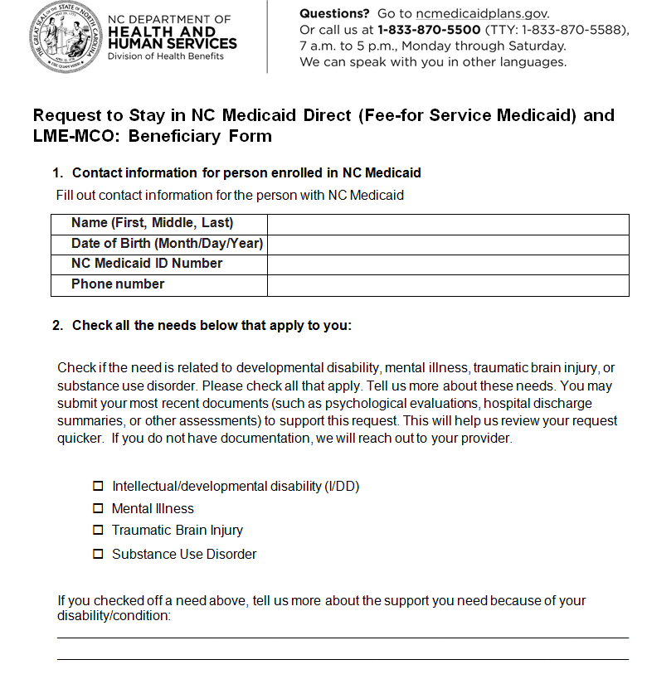
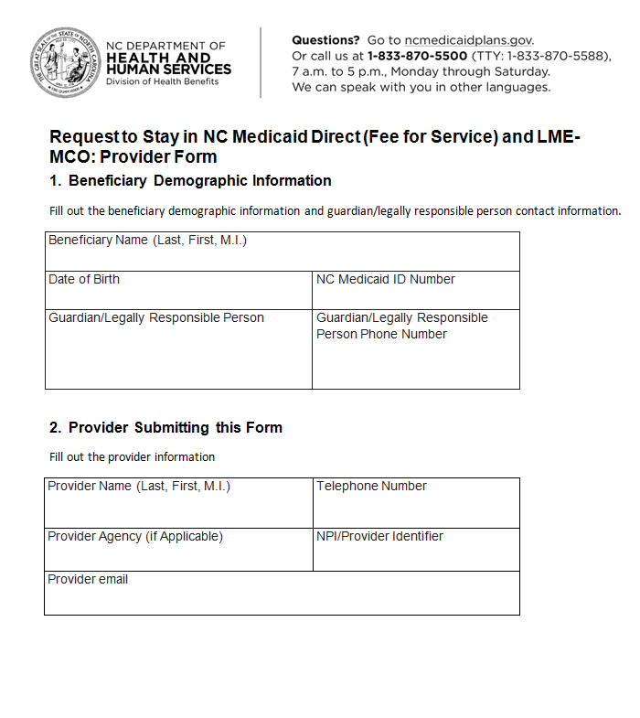
How do I request a health plan review?
There are two ways to request to stay in NC Medicaid Direct and LME-MCOs (and be considered for a BH I/DD Tailored Plan in 2021).
1. Beneficiary Form
2. Provider Form
To get these forms, you can:
Call 1-833-870-5500
Go to www.ncmedicaidplans.gov/learn/get-answers

Slide 17
Option 1: You or your legal guardian can submit the Beneficiary Form
Step 1
Step 2
Step 3
You or your legal guardian completes and submits the form to the Enrollment Broker.
You will explain why you think you will be eligible for a BH I/DD Tailored Plan in the future.
NC Medicaid will receive the form within 24 hours of submission.
NC Medicaid may contact your provider for more information.
NC Medicaid will determine if you are eligible for a BH I/DD Tailored Plan within 8 days. *
You will be notified of the decision and moved automatically if your request is approved.
*Timeline applies only after Managed Care launch in February 2020

Slide 18
Option 2: Your provider can submit the Provider Form on your behalf
Step 1
Step 2
Step 3
Your provider completes and submits the form to the Enrollment Broker on your behalf, with your or your legal guardian’s signature.
They will explain why they think you will be eligible for a BH I/DD Tailored Plan in the future.
NC Medicaid will receive the form within 24 hours of submission.
NC Medicaid will determine if you are eligible for a BH I/DD Tailored Plan within 5 days.*
You will be notified of the decision and moved automatically if your request is approved.
*Timeline applies only after Managed Care launch in February 2020

Slide 19
What if I need a service that is not covered by Standard Plans?
Your provider can request a transfer to NC Medicaid Direct and LME-MCO if you need a behavioral health or I/DD service that is not covered by Standard Plans.
Your Provider Works with You to Complete the Request
You and your provider discuss which services you need that are not available in your current plan.
You or Your Legal Guardian Sign the Request
You or your guardian confirm you want to immediately un-enroll from the Standard Plan.
NC Medicaid Reviews the Request and Transfers You
NC Medicaid reviews the request and, if approved, transfers you to your new plan within 1 business day.
Your Provider Submits the Request
Your provider submits the provider form* and a service authorization form to the Enrollment Broker, which will send to NC Medicaid within 24 hours.
*Reminder: That’s the form we mentioned on over the last few slides (16 & 18)!

Slide 20
Help Is Available to You

Slide 21
There’s an Enrollment Broker to help you navigate these changes
Many Convenient Ways to Contact
Trained specialists to help you understand your choice
Enrollment Services Website
Mobile App
Web Chat
Mail/Fax
Compassionate and understanding
Enrollment Specialist
TTY
Makes health information easy to understand
Help is FREE

Slide 22
Read your Medicaid letter and ask for help if you need it!
If you have any questions about Medicaid changes
Contact the Enrollment Broker
1-833-870-5500 (toll-free)
www.ncmedicaidplans.gov

Slide 23
Reminder: Opportunities to Engage
DHHS values input and feedback from stakeholders and will make sure stakeholders have the opportunity to connect through a number of venues and activities.
Ways to Participate
Regular webinars, conference calls, meetings, and conferences
Comments on periodic white papers, FAQs, and other publications
Regular updates to website: https://www.ncdhhs.gov/assistance/medicaid-transformation
DHHS Will Engage
Consumers, Families, Caregivers, and Consumer Representatives
Providers
Health Plans and LME-MCOs
Counties
General Public
Comments? Questions? Let’s hear from you!
Comments, questions, and feedback are all very welcome at
Medicaid.Transformation@dhhs.nc.gov

