Slide 1
NC DEPARTMENT OF HEALTH AND HUMAN SERVICES
Transition of Care Policy Overview and Introduction to Crossover Activities
3/11/2021
Trish Farnham, Senior Health Policy Analyst
In collaboration with Medicaid Transformation Team Members

Slide 2


North Carolina’s Vision for
Medicaid Transformation
North Carolina’s Vision for
Medicaid Transformation
“To improve the health of North Carolinians through an innovative, whole-person centered, and well-coordinated system of care that addresses both the medical and non-medical drivers of health.”
“To improve the health of North Carolinians through an innovative, whole-person centered, and well-coordinated system of care that addresses both the medical and non-medical drivers of health.”
Notes:
Slide attributes the graphic to the NC Medicaid Transformation Restart presentation. (Please click “See source document” and Visit Slide 2 of the original document to view the original graphic.)

Slide 3
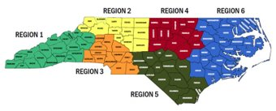
Moving to NC Medicaid Managed Care
Approximately 1.6 million of the current 2.5 million Medicaid beneficiaries will transition to NC Medicaid Managed Care​​
Beneficiaries will be able to choose from 5 Health Plans (aka “PHPs”)
  AmeriHealth Caritas
  Healthy Blue
  United HealthCare Community Plan
  WellCare
  Carolina Complete Health:
    Serving regions 3, 4, and 5
Eastern Band of Cherokee Indians (EBCI) Tribal Option
  Will manage the health care for North Carolina’s approximate 4,000 Tribal Medicaid beneficiaries primarily in Cherokee, Graham, Haywood, Jackson, and Swain counties
All health plans, all regions will go live on July 1, 2021

Slide 4
Overall Vision for Transition of Care Design
As beneficiaries move between delivery systems, the Department of Health and Human Services (Department or DHHS) intends to maintain continuity of care for each beneficiary and minimize the burden on providers during the transition.

Slide 5

The NC Transition of Care “Tridge:”
Processes established to guide transitions between Plans and Service Delivery Systems
Health Plan 1
Health Plan 2
Medicaid Direct/Tribal/LME-MCO
Enrolling
Disenrolling
Tailored Plan eligible
“Tridge” in Midland, Michigan: https://www.kuriositas.com/2012/01/tridge-michigans-three-way-bridge.html

Slide 6
Transition of Care: Two Distinct Phases
Crossover to MCL Transition of Care
One time crossover of beneficiaries eligible for NC Medicaid Managed Care on “Managed Care Implementation” or “Managed Care Launch” date (July 1, 2021)
Ongoing Transition of Care
Ongoing transition of care for beneficiaries moving between Health Plans, between Health Plan and Medicaid Direct.

Slide 7



A Note on Terminology
“Transition of Care,” “Care Transitions” and “Transitional Care Management” all have distinct meanings in the Policy.
“Transition of Care (TOC)” refers to the process in which beneficiaries’ healthcare coverage moves between delivery systems (e.g. FFS to managed care) or between health plans.
“Care transitions” refers to changes in beneficiaries’ care settings (e.g. inpatient to community-based setting). Expectations for AMHs surrounding transitional care management (care management during care transitions) have already been defined in the AMH Tier 3 requirements and are also reflected in the ToC Policy document.
A
B
Today’s focus
See AMH Provider Manual 2.0 . See also the AMH Training Page for more information on Transitional Care Management in AMH Tier 3.

Slide 8
Transition of Care Policy: Key Content
Transition of Care at Managed Care Launch ( “Crossover”)
“Crossover” refers to the Department’s conversion to a managed care service delivery system. Transition of Care at Crossover-specific requirements are time-limited and established in Appendix A of this Policy.
Ongoing Transition of Care
Processes related to supporting Members to transition between PHPs or between service delivery systems, including disenrollment.
Preliminary requirements for assisting Standard Plan PHP Members who may be eligible for Tailored Plans.
These preliminary requirements are included in Appendix B of this Policy.
Transitional Care Management Requirements
Today’s Focus

Slide 9
NC DHHS Transition of Care Policy: Development Context
Required by 42 CFR 438.62
Referenced in PHP Request for Proposal (RFP) and subsequent contracts.
Like all TOC work: Policy requirements are interdisciplinary.
TOC Policy requirements advance TOC contract requirements.
  Where applicable, integrates original RFP language and then updated to reflect contract amendment changes.
  Policy provides more specific guidance and framework for TOC practices referenced in contract.
Supplements to original RFP requirements include:
  Transition of care requirements for care managed populations and for disenrolling populations.
  Medicaid Managed Care Launch (MCL) specific requirements (aka Crossover).
  Preliminary guidance to PHPs on supporting Tailored Plan eligible members.
Initial TOC Policy Scope:
  TOC activities managed by the Health Plans.
  Related contracts with other partners/vendors amended to align.

Slide 10

NC DHHS Transition of Care Policy Outline
Background
Scope
Policy Statement:
  General Transition of Care Requirements
  TOC Requirements for Care Managed Members
  TOC Requirements for Members Disenrolling from
  NC Medicaid Managed Care
  TOC Requirements for Change in Provider
  Transitional Care Management
Definitions and Clarifications of Identified Terms
Compliance and Monitoring
References
Relevant Regulatory and Legislative Citations
Related Documents
Authority
Appendix A: Crossover Requirements
Appendix B: Supporting Members Who May Meet Tailored Plan Criteria
Forthcoming: Appendix C: Appeals during Transition of Care

Slide 11

Driving Design Priorities
Transition of Care Design
Resulting In
Facilitating Uninterrupted Service Coverage
Continuity of care protections related to service authorizations and provider continuity.
Supporting Continuity of Care through Data Transfer
Automated data transfer of prior authorizations, claims/encounter data and pharmacy lock-in data.
Clear and Organized Communication Between Entities
Communication protocols between health plans and with LME/MCOs, CCNC and other entities engaged with the transition.
Establishing Additional Safeguards for High Need Members
Rapid follow up at Launch, warm handoffs between entities and transfer of additional Member information.
Member and Provider Education
Transition of care-specific educational materials, webinars and call center scripting.
Notes:
Uninterrupted Service Coverage Details:
At MCL, required to honor medical PA for 90 days (or until end of auth period if shorter). Rx PAs honored for life of PA.
Ongoing: required to honor PAs for life of PA.
OON provider protections for transitioning members (OON providers parity with in-network for first 60 days after Launch; OON parity for transitioning members in ongoing course of treatment or with ongoing special condition.
100% rate floor during TOC episode
Data Transfer:
File transfers between NC TRACKS, PHPs, CCNC and LME/MCOs
Clear and Organized Communication
PHPs, LME-MCOs, CCNC establishing clear front doors for each other to facility “real person” coordination.
Additional Safeguards for High Need Members
High Need Members identified at Crossover require rapid follow up by PHP or AMHs to ensure service continuity.
PHPs expected to perform warm handoff when care managed member transitions if clinically warranted.
PHPS expected to facilitate warm handoff with CCNC or LME/MCOS for all members disenrolling due to Medicare eligibility, Foster care, or Tailored Plan eligibility (LME-MCO before TP launch)
Education
In addition to what’s listed, working with UM vendors to establish Launch related communication on their websites, will be developing “provider clearinghouse” on TOC website for additional information on PA submission and other TOC-related work.

Slide 12

Crossover: Open Prior Authorizations
Facilitating Uninterrupted Service Coverage
A prior authorization generated while member is in Medicaid Direct that is still in effect upon MCL is referred to as an “open prior authorization.”
Providers may continue submitting FFS prior authorization (PA) requests up through June 30, 2021.
Fee-for-service (FFS) Utilization Management Vendors and Behavioral Health Local Management Entities-Managed Care Organizations (LME/MCOs) will continue to receive PA requests up to 11:59 pre-MCL and process those requests per their standard processes and SLAs, even if processing continues beyond MCL. Accordingly, the PHP may receive additional FFS PAs on the incremental PA transfer file after MCL. The PHP shall honor these FFS PAs for the first 90 days after MCL, following the related requirements and protocols established for FFS PAs.
If an open prior authorization transfers to the PHP, it will be honored for at least 90 days, unless the authorization expires sooner.
To ensure continuity of care Members, the PHP must honor existing and active medical and behavioral health* prior authorizations (PAs) on file with the North Carolina Medicaid or NC Health Choice program for minimally the first ninety (90) days after implementation or until the expiration/completion of a PA, whichever occurs first.*
If PHP terminates or reduces an open authorization at 90 days, it must issue appeal rights.
If a transitioning member is under Maintenance of Service for service covered by PHP, PHP must continue services until the PHP reassess and either approves or issues its own adverse decision with appeal rights.
*Applies to BH PAs covered under the Health Plan’s benefit scope.
* Pharmacy Prior Authorizations are honored for life of PA
* PAs authorized after MCL will be honored for the life of the authorization if the member transitions to another PHP.

Slide 13
Crossover: Additional Authorization Considerations for BH Services
Facilitating Uninterrupted Service Coverage
Open PA for services covered by federal substance use disorder regulations is submitted directly to the PHP, will fall under Crossover Authorization protections.
For service authorizations managed by an LME/MCO and under the scope of 42 CFR Part 2 , the PHP shall deem authorizations submitted directly by impacted providers as covered under this requirement.
Unmanaged Visit Counts under CCP 8C will Reset to Zero at Launch.
Per the Standard- Plan contract, PHPs are required to adhere to Department’s Clinical Coverage Policy 8C, Outpatient Behavioral Health Services Provided by Direct-enrolled Providers. This policy states in relevant part: Outpatient behavioral health services coverage is limited to eight unmanaged outpatient visits for adults and 16 unmanaged outpatient visits for children per state fiscal year (inclusive of assessment and Psychological Testing codes). For Members who are authorized for services under this Clinical Coverage Policy at Managed Care Launch (MCL), the unmanaged visit count shall reset to zero. PHPs are otherwise required to adhere to Clinical Coverage Policy 8C, Outpatient Behavioral Health Services Provided by Direct-Enrolled Providers.
Stay Tuned:
NC DHHS and LME/MCOs will be hosting TOC training series for BH providers in April and May. Will be announced through LME/MCOs.

Slide 14
Crossover: Ensuring Provider Continuity
Facilitating Uninterrupted Service Coverage
Broader Context:
  PHPs operate open network and will seek to build as robust network as possible.
  Generally, PHPs assume financial responsibility for services with dates of service on or after July 1, 2021 for their members.*
For the first 60 days, out of network providers will be treating the same as in-network providers.
For the first sixty (60) days after MCL, PHPs are required to pay claims and authorize services for Medicaid eligible nonparticipating/out-of-network providers equal to that of in-network providers until the end of Episode of Care or the 60 days, whichever is less.
Statutory protections apply and in certain cases (e.g. cancer treatments), a member may remain with out of network provider longer.
If the Member has an Ongoing Special Condition or is under an Ongoing Course of Treatment, the PHP shall follow the timeframes provided in N.C. Gen. Stat. § 58-67-88(d), (e), (f), and (g).
*DRG impact: Medicaid Direct program will pay DRG-associated claims for Medicaid beneficiaries who are admitted to an acute care facility and eligible for full Medicaid FFS coverage prior to MCL but discharged after MCL.

Slide 15
Crossover: Non-Emergency Medical Transportation
Facilitating Uninterrupted Service Coverage
PHPs will begin accepting scheduling requests for NEMT appointment on or after July 1, 2021 on June 1, 2021.
In coordination with local DSSs, PHPs will receive direct list of high utilizers.
PHPs will report weekly updates on NEMT adherence at MCL.

Slide 16
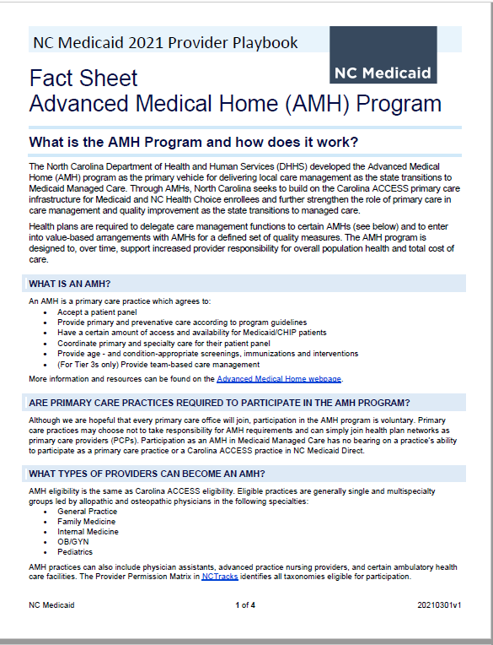
A Note about Advanced Medical Homes (AMHs)
Supporting Continuity of Care through Data Transfer
The North Carolina Department of Health and Human Services (DHHS) developed the Advanced Medical Home (AMH) program as the primary vehicle for delivering care management as the state transitions to Medicaid managed care.
Three Tiers of AMHs
Tier Three AMH will be provide care management.*
PHPs may also keep identified care management priority populations “in house.”
Transition of Care processes work to ensure effective coordination between PHPs and AMHs for transitioning members.
For more information: https://medicaid.ncdhhs.gov/transformation/advanced-medical-home
* In conjunction with CIN

Slide 17
Crossover: Data File Transfer
Supporting Continuity of Care through Data Transfer
State has coordinated data file transfer of member information important for informing PHP support to member and facilitating continuity of care:
  Claims/Encounter Data
  Prior Authorization Data
  Pharmacy Lock-In Data
  Current/past primary care provider (PCP) Assignment (“Assignment Files”)
  Care Plans/Transition Summary Sheet*
  PCS Assessments*
  High Need Member List*
PHPs are responsible for transferring applicable information to its Advanced Medical Home (AMH) network.
  Which members are enrolled.
  Information necessary to support effective care management by AMH Tier 3s.
* If applicable to the member.

Slide 18
Crossover: Summary of Data Flow
Supporting Continuity of Care through Data Transfer
Assignment Files
Claims Files (FFS+ LME MCO)
DHHS
NC Tracks
Prior Auth and Rx Lock In
DHHS “High Need Member List”
Assignment list or information via portal (Tiers 1 and 2)
Assignment files (Tier 3)
Claims files (Tier 3)
Pharmacy Lock-In (Tier 3)
Patient Risk List that includes information from DHHS “High Need Member List” (Tier 3)
Care Plans/Warm Handoff Summary Sheets (PHPs are required to make available to all AMHs/PCPs)
Behavioral Health Prior Auth Files
Health Plan
LME-MCOs
Transition Summaries/ Care Plans
Care Plans (for those in active CM)
CCNC
Personal Care Service Assessments
AMH Practice/CIN
Viebridge
18

Slide 19
Crossover: Safeguarding High Need Members
Establishing Additional Safeguards for High Need Members
Crossover Activities Customized Based on Service History, Vulnerability
All Transitioning Members:
Data Transfer:
Claims
Prior Authorization
Pharmacy Lock In Data
Care Plans or Assessments, if relevant
“High Need” Members:
High Need Members are transitioning Members whose service history indicates vulnerability to service disruption
All Transitioning Members
“High Need” Members
“Warm Handoff” Members (<2000 Members):
High Need Members who have been identified by Medicaid Direct “transition entities” (CCNC/LME-MCOs) or by the Health Plan as warranting a verbal briefing between transition entity and Health Plan
This group is identified on the DHHS “High Need Member List” and through a specific warm handoff/summary sheet process.
“Warm Handoff” Members

Slide 20
Crossover: “High Need” Member Defined
“High Need” Members
High-Need Member: Beneficiaries requiring time-sensitive, Member-specific follow up by the PHPs during Crossover. High Need Members include but are not limited to Members with open or recently closed PAs in the following services:
  High Need subset of Members receiving long-term services and supports.
    Members receiving or authorized to receive PDN services who have also experienced on or more ED visits or hospitalizations within 30 days of MCL.
    Members receiving or authorized to receive Home Health services who have also experienced one or more ED visits or hospitalizations within 30 days of MCL.
    Members who have received HIT services, with DOS within 30 days of MCL.
    Members who have been enrolled in a Nursing Facility for 30 calendar days or less at MCL. Members authorized for 80 or more hours a month of Personal Care Services or minors utilizing Personal Care Services.
  Members receiving crisis behavioral health services within six months of MCL;
  Members with Inborn Errors of Metabolism;
  Members identified by CCNC, an LME/MCO or the Department who have complex treatment circumstances or multiple service interventions and necessitate a Warm Handoff;
  Members who are experiencing a care transition from a High-Level Clinical Setting;
  Identified Standard Plan exempt Members who elected to enroll in Standard Plan;
  Members authorized for transplantation;
  Members authorized for out of state services; and
  Other high need Member or group of Members identified by the Department or the PHP.

Slide 21
Crossover: High Need Member Follow Up
“High Need” Members
PHPs provide expedited follow up after MCL with High Need Members to:
  Ensure identified services have continued without disruption;
  Initiate post MCL assessments that may be required to evaluate the Member's continuation of services after 90 days;
  Ensure uninterrupted access to NEMT.
PHPs provide High Need Member-level updates to the Department through weekly reporting.
State-sponsored supplemental oversight of member experience.

Slide 22
Crossover: Finalizing Essential Communication Pathways
Clear and Organized Communication Between Entities
Have established and will continue finalizing communication pathways among TOC entities for:
  Pre-MCL joint planning;
  Warm handoff protocols and schedules;
  Establishing issue identification and escalation protocols for:
    Data transfer
    Member dynamics
    TOC-related provider issues
As part of broader Medicaid Transformation oversight and governance, will hold “rapid cycle” pre and post MCL joint briefings within State team and with other TOC entities.
As part of broader Member and Provider Engagement strategies, TOC efforts will continue to solicit beneficiary and provider experience.
Example Only: NOT FINAL

Slide 23


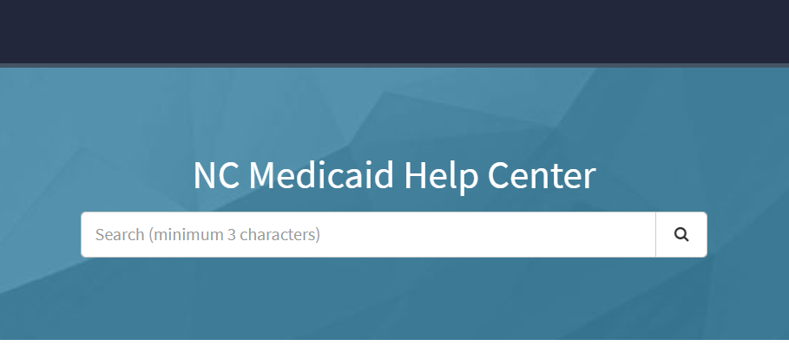
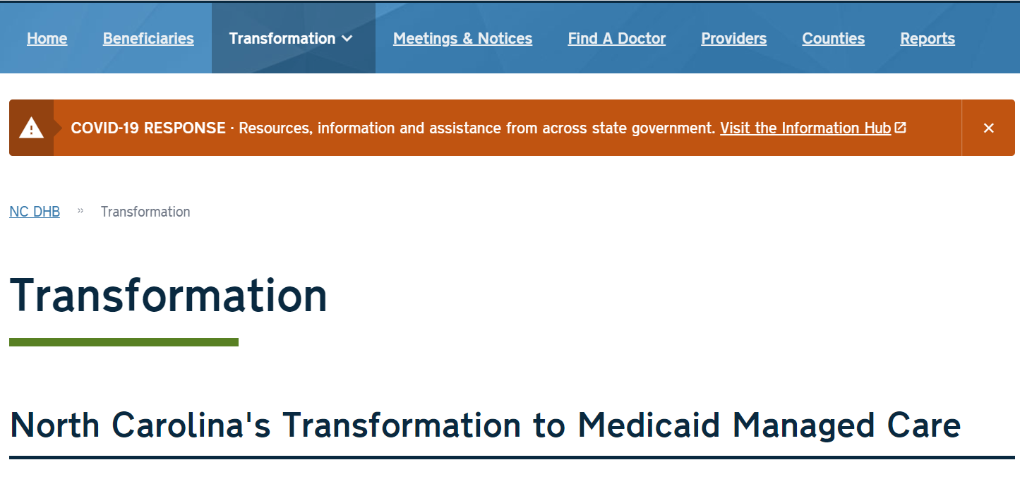
Crossover: Integration into Broader Education Efforts
Member and Provider Education
  Enrollment Broker at: ncmedicaidplans.gov
  NC Medicaid Beneficiary Portal
  NC Medicaid Help Center
  NCDHHS Transformation website (Including County & Provider Playbooks)
  Health Plan websites, handbooks and call center scripts

Slide 24
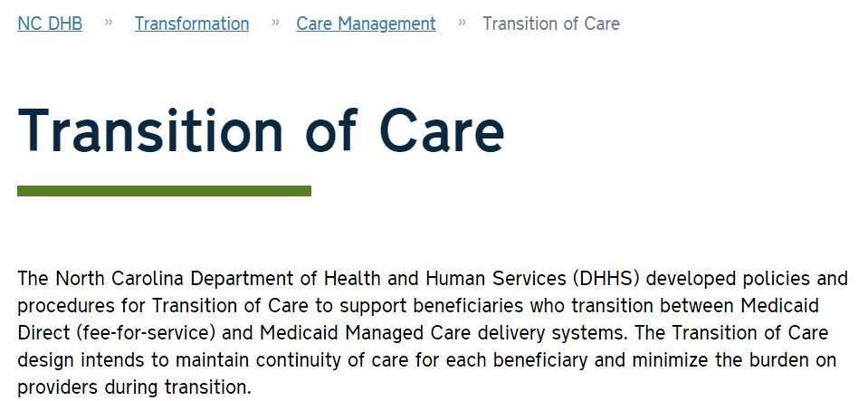

Crossover: Development of Transition of Care-Specific Resources
Member and Provider Education
NC DHHS Transition of Care Website:
Transition of Care Policy
Transition of Care Technical Specifications
PHP-specific Crossover Specific Guidance about Prior Authorization submission
General and PHP-specific Crossover Guidance to Members about “who to call.”
Disenrollment Protocols, as communicated on Transition of Care Policy.
Other materials as identified.
Links to other
https://medicaid.ncdhhs.gov/transformation/care-management/transition-care
Live and under continued development

Slide 25
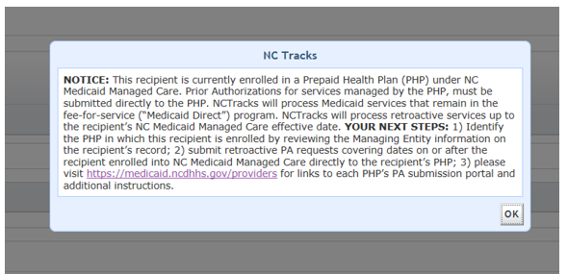
Crossover: Support to Providers Submitting PAs
Member and Provider Education
Prior to MCL, providers will be able to see a beneficiary’s upcoming Managed Care Status and PHP Assignment in NC Tracks.
  Function in development.
  To be in effect June, 2021
UM Vendors including NCTracks will have provider portal messages that direct providers to PHP if applicable.
PHP-specific PA submission instructions will be available on NC DHHS Transition of Care website

Slide 26
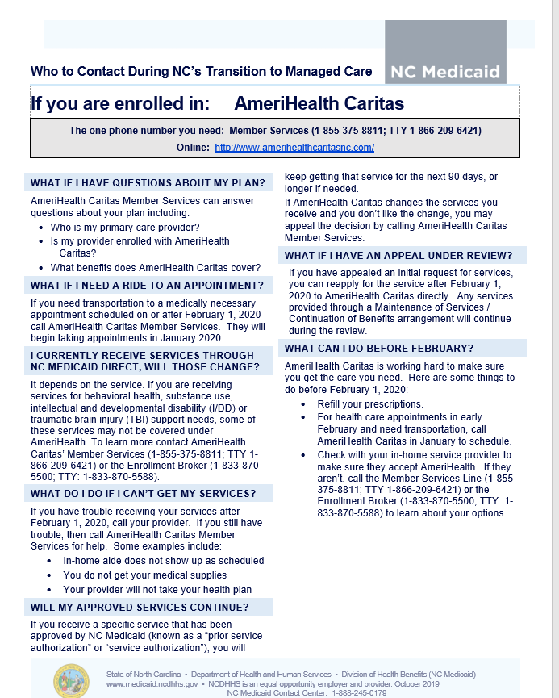
Crossover: Member-Facing Education/Supports
Member and Provider Education
Partnering with other Member support initiatives to develop member education tools including:
  Call center scripts
  Plan-specific “who to call” information
  Transition of Care education in other Member education materials.
SAMPLE and UNDER REVISION DO NOT USE

Slide 27
Today is the first in a series
Member and Provider Education
Please Look for Announcements on Transition of Care Education:
  Ongoing Transition of Care Member Protections
  Additional safeguards for transitioning members who are care managed or disenrolling from Standard Plan Option
  Continuity safeguards related to provider disenrollment
  Targeted education to AMHs, identified provider groups and other stakeholders

Slide 28
Questions?
Please submit in the Chat Option
Please email Medicaid.NCEngagement@dhhs.nc.gov

