Slide 1
NORTH CAROLINA DEPARTMENT OF HEALTH AND HUMAN SERVICES
Care Management for
Long Term Services and Supports
March 30, 2021

Slide 2
Care Management for Long Term Services and Supports
Agenda
Care Management in NC
Long Term Services and Supports in NC
Components of Care Management
    Care Needs Assessments
    Comprehensive Assessment
    Care Plans

Slide 3
Key Aspects of Care Management in NC Medicaid Managed Care
Everyone screened for Care Management through care needs screening.
Provided to identified “priority populations” including LTSS.
Team-based support and coordination driven by person centered care plan and identified goals.
Care Management
Members with high medical, behavioral or social needs should have access to a program of Care Management that includes the involvement of a multidisciplinary care team and the development of a written care plan.
Coordination of physical, behavioral and social services.
Includes transitional care management to assist through transitions.
Revised and Restated RFP 30-190029-DHB

Slide 4
NC Medicaid’s Care Management
“Priority Populations”
Individuals with Long Term Services and Support Needs
Individuals identified by PHP as at Rising Risk
Adults and children with Special Health Care Needs
Individuals with high unmet health-related resource needs
High-risk pregnant women
At-risk Children 0-5
Other priority populations identified by the PHP.
All members identified as needing LTSS or at risk of needing LTSS shall be categorized as part of priority population and shall receive care management if indicated
Revised and Restated RFP 30-190029-DHB

Slide 5
Definition of LTSS Care Management Priority Population
Individuals with Long Term Services and Support Needs
Members who are eligible for, currently use LTSS services or are at risk of requiring LTSS services are considered the LTSS Priority Population. This designation requires the health plan to outreach to every member meeting the criteria to engage in screening and, as appropriate, assessment and care planning activities.
The majority of LTSS service users have Medicaid eligibility in the Aged, Blind or Disabled (ABD) eligibility categories. The Department intends for health plans to identify and engage newly-enrolled ABD members to apply appropriate, pro-active care management interventions that will reduce or delay member dependence on formal LTSS services.
Not all priority population members will elect or qualify for care management. Participation in care management is not a requirement or criteria for receiving clinically indicated services the member may require.

Slide 6
Guiding Principles for LTSS Care Management
Guiding Principle I
Health plan Care Management policies and practices should align with and support the care process for members with LTSS needs.
Guiding Principle II
Health plan Care Management policies and practices are required to adopt a “whole-person” person centered approach in identifying and addressing a member’s physical, behavioral and psycho-social needs.
Guiding Principle III
Health plan Care Management policies and practices prioritize member self-determination and advance the goals of the American with Disabilities Act.

Slide 7
Guiding Principles for LTSS Care Management
Guiding Principle IV
Health plan Care Management policies and practices should recognize service dynamics specific to the LTSS population including:
  the use of state-sponsored programs
  the role of natural and informal supports in service delivery
  the impact of housing and living arrangements on access to and quality of services and supports
Guiding Principle V
Health plans Care Management policies and practices should recognize the time-sensitive, often urgent service needs that a member with LTSS service needs may require, particularly as the member transitions from the clinical care settings such as hospitals or nursing facilities back to the community. Further, Policies and practices should recognize the dynamic nature of LTSS beneficiary’s Care Management needs, with levels of engagement often fluctuating based on clinical condition, support availability and other member specific factors.

Slide 8
Guiding Principles for LTSS Care Management
Guiding Principle IV
Health plans Care Management policies and practices should recognize service dynamics specific to the LTSS population including:
  the use of state sponsored programs;
  the role of natural and informal supports in service delivery; and
  the impact of housing and living arrangements on access to and quality of services and supports
Guiding Principle V
Health plan Care Management policies and practices should recognize the time-sensitive, often urgent service needs a member with LTSS service needs may require, particularly as the member transitions from clinical care settings such as hospitals or nursing facilities back to the community. Further, policies and practices should recognize the dynamic nature of LTSS beneficiary’s care management needs, with levels of engagement often fluctuating based on clinical condition, support availability and other member specific factors.

Slide 9
Guiding Principles for LTSS Care Management
Guiding Principle VI
Health plan Care Management policies and practices should be sensitive to a member’s experience at times of transition that may result in significant changes in service delivery and support availability.
Guiding Principle VII
Care Management is voluntary and may not be required by all beneficiaries using LTSS services.
Guiding Principle VIII
Care Management may be time limited with the duration to reflect the member’s needs.

Slide 10
LTSS Specific Care Management Requirements
Comprehensive Assessment
Interim plan
Transitional Care/Care Transitions requirements
Include linkage to appropriate housing options
Revise a Member’s care plan
Change in circumstance
Revised and Restated RFP 30-190029-DHB

Slide 11
Facts about LTSS Care Management
Fact: LTSS members will have access to care management/coordination
Fact: Care Management will be comprehensive
  Integrate supports necessary to address social needs related to social determinants of health
  Integrate person-driven goals related to continuing education, employment, etc.
  Consider caregiving-related needs of unpaid caregivers
Fact: Most PHPs are keeping LTSS Care Management in-house
Light Touch Intensive

Slide 12
LTSS Care Management Process Overview Part I
New member enrolls in PHP and is identified on enrollment file PHP receives (e.g., the 834 file)
Screening may lead to comprehensive assessment
Screened within 90 days
LTSS Distinction: PHPs are required to expedite the screening process for newly-enrolled ABD members. Not every ABD member will require Care Management.
NOTE: PHPs indicate screenings for newly-enrolled ABD members will occur between days 1 and 5.
NOTE: PHPs indicating screenings for newly enrolled ABD members will occur between 1 and 5 days.

Slide 13
Factors Considered in Screening
The purpose of the Care Needs Screening is to provide the PHP with general information about the members’ health and to identify members with unmet health-related resource needs who may require a
Comprehensive Assessment, as defined by the contract, for Care
Management.
Chronic or acute conditions
Chronic pain
Behavioral Health needs
Medication
Other
Housing needs
Food insecurity
Transportation needs
Interpersonal safety
Revised and Restated RFP 30-190029-DHB

Slide 14
LTSS Care Management Process Overview Part II
LTSS Distinction Interim plan allowable if needed.
Pathways of Identification
Within 30 days
Screening
Response to provider/self-referral
Risk-scoring algorithm
CARE PLAN
ASSESSMENT
AMH+ or PHP conducts comprehensive assessment to confirm priority status
Within 30 days

Slide 15
Comprehensive Assessment Summary
Required for every member identified as High Priority Population
Comprehensive, person-centered and tailored to the member’s needs, following requirements specified in the contract.
Conducted in a location comfortable to the member.
Appropriate to member’s demographic/needs.
Meets timelines and routing requirements outlined in the contract.
May not delay provision of necessary services
Conducted annually, change in circumstance or at member’s request
ASSESSMENTAMH+ or PHP conducts comprehensive assessment to confirm priority status
Revised and Restated RFP 30-190029-DHB

Slide 16
What does a comprehensive assessment include?
Member’s immediate care needs
The Comprehensive Assessment shall be a person-centered assessment of a member’s health care, functional and accessibility needs; strengths and supports; goals; and other characteristics that will determine whether the member will receive care management and the member’s ongoing care plan and treatment.
Medications-prescribed and taken
Member’s immediate care needs
Member’s current services
Member’s current services
Unmet needs related to housing, transportation, food and toxic stress
Other state or local services uses
Ongoing special conditions that require a course of treatment
Usage of other state or local services
Physical and dental health conditions
Physical and dental health conditions
Factors indicating need or at imminent risk of requiring LTSS
Current and past mental health conditions and substance use disorders
Current and past mental health conditions and substance use disorders
Caregiving-related needs of member’s unpaid, informal caregiver
Additional optional assessment domains such as childhood trauma
Additional optional assessment domains such as childhood trauma
Revised and Restated RFP 30-190029-DHB

Slide 17
LTSS Care Management Process Overview Part III
Care Plan Executed
Ongoing Care Planning and Care Management
Reassessment

Slide 18
Care Planning Considerations
Care Planning:
Is informed by screening and assessment
Is individualized, person-centered and collaborative
Should not delay needed services
Should include specific requirements and follow timelines as outlined in RFP
A Care Plan:
Must include, at minimum, content outlined in the contract
Should be regularly updated, at minimum at points specified in contract
Documented and available to care team members, including AMH+/PCP
Revised and Restated RFP 30-190029-DHB

Slide 19
Closing Out Care Plan
Health plans must have Care Plan close-out policies and procedures, including member notification.
LTSS Continuity of Care Requirement
  If LTSS eligibility/LTSS high priority designation ends, and Care Management is no longer required
The Care Manager shall continue their role for a time specified by the circumstance and in the care plan.
Revised and Restated RFP 30-190029-DHB

Slide 20
A Note about Transitional Care Management
Broader than just LTSS Priority Population, but disproportionately impacts LTSS beneficiaries.
Health plans shall manage care transitions between clinical settings.
Health plans are required to develop transitional care management policies and procedures.
Must have methodology for identifying members at risk of readmissions/poor outcomes.
Health plans must have access to ADT file and establish processes for appropriate response to ADT alerts
Transitional Care Management specific functions apply to both care transitions and transitions of care between health plans/payment delivery systems.

Slide 21
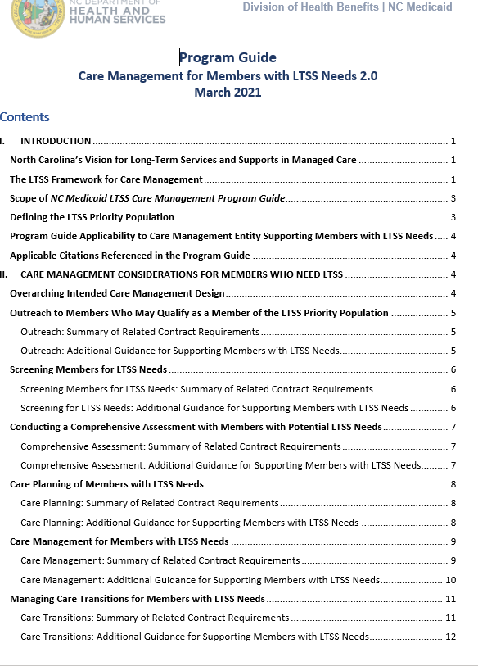
LTSS Program Guide
Key documents can be found on the NCDHHS Medicaid webpage
NCDHHS Care Management Webpage
April 2018*
March 2021*

Slide 22
Staying Current
For questions not covered please email: Vorinda.Guillory@dhhs.nc.gov

