Slide 1
NC Medicaid H.R.1 Public Outreach Presentation
This deck communicates important information about federal changes to Medicaid. It is designed to help people prepare for these changes, so that all eligible North Carolinians keep their Medicaid health coverage.
The presentation is:
Written with the goal of helping guide people on next steps.
Provides detailed notes and explanations for presenters to reference.
Meant to be shared with audiences with varying levels of knowledge.
A living document to be updated and refined as the new federal guidance is shared and feedback is gathered.
Available in both English and Spanish.
Designed for accessibility, therefore please do not change colors or add highlighting, etc. to the presentation. The deck has been formatted for the use of a screen reader.
Training is available for interested speakers.
Notes:
When presenting the NC Medicaid H.R.1, please use the slides that are most relevant to your audience. Do not feel as if you need to cover everything if it isn’t helpful information based on your understanding of the audience’s needs.

Slide 2

NC Medicaid
H.R. 1 Overview
Notes:
• Thank you for being here. We know Medicaid is incredibly important to people and families across North Carolina.
• Today, we’re going to talk about changes to Medicaid that are coming because of a new federal law.
• Some of these changes are complicated and we know they can be difficult for people in our state. Our goal today is to explain what we know as clearly as we can and, most importantly, help you and your community understand what you can do to prepare.
• As we go through this information, remember that some federal guidance is still being developed. We’ll be clear about what we know today and continue sharing updates as we learn more.
• Before we get into the changes, we want to start with why Medicaid matters so much to North Carolina.
• Then we’ll walk through what is changing, who may be affected and what people can do now to prepare.
• There is a lot of information here. You do not need to remember every detail today. We want you to leave knowing where to go for trusted information and what steps you can take to prepare.

Slide 3
Medicaid strengthens North Carolina
Medicaid provides affordable health coverage and access to doctors and prescriptions for more than 3 million children, older adults, people with disabilities and working North Carolinians – that is 1 in 4 North Carolinians.
    Rural communities rely on Medicaid. In many rural counties, Medicaid provides health coverage to more than half of the population. And Medicaid is a major source of funding for rural hospitals.
    Medicaid supports North Carolina’s businesses and workforce and brings billions of dollars into the state's economy.
    Medicaid makes people healthier. North Carolinians newly covered by Medicaid under expansion have filled more than 5 million prescriptions for conditions like heart disease, diabetes, seizures and other illnesses.
    Since Medicaid expanded, there has been a 29% decrease in overdoses.
Notes:
• Medicaid provides health coverage for more than 3 million North Carolinians. That’s about one out of every four people in our state.
• These are our neighbors, coworkers, children, older adults and people with disabilities. Medicaid helps people get prescriptions, see a doctor and get care when they need it.
• Medicaid is especially important in rural communities, where in some counties more than half of residents rely on Medicaid for health coverage.
• It also supports hospitals, health care providers, businesses and the workforce across our state.
• So, when we talk about changes to Medicaid, we’re talking about changes that can have a very real impact on people’s health, families and communities.

Slide 4
Federal law is changing who can get Medicaid health coverage
Despite Medicaid’s positive impact on people, communities and our State, changes are coming that will make it harder for some people to be covered.
  In 2025, Congress passed and the President signed a law that makes many changes to Medicaid.
  This law is referred to as the House Reconciliation Bill, H.R. 1, or the One Big Beautiful Bill.
  This presentation focuses on four big changes that will soon take place for people who have or are applying for health coverage through Medicaid.
    Many non-U.S. citizens will no longer be able to have Medicaid coverage.
    Most adults ages 19 through 64 will have to show they participated in an approved activity, like work, school or volunteering to be able to have health coverage through Medicaid.
    Most adults ages 19 through 64 will have to recertify (renew) their Medicaid every 6 months. That is a change from the current every 12 months.
    Changes to the length of retroactive coverage for all applying for Medicaid
Notes:
• In 2025, Congress passed and the President signed a new federal law that made significant changes to Medicaid. You may hear this law called H.R. 1, or the One Big Beautiful Bill.
• Because of this federal law, some people will lose Medicaid coverage, and many others will have new requirements they need to follow to keep their coverage.
• We know that can be concerning, especially for people who depend on Medicaid to get medications or ongoing health care.
• Today we’re focusing on four major changes: changes for many non-citizens, shorter retroactive coverage, new work and community engagement requirements and more frequent Medicaid renewals.
• These changes do not all begin at the same time. The first major change starts October 1, 2026. Other changes begin January 1, 2027.

Slide 5

Our commitment to you
The North Carolina Department of Health and Human Services and NC Medicaid are committed to getting you the information you need to know.
We are focused on helping people who are still eligible for Medicaid or applying for Medicaid understand the new federal rules
to keep or get health coverage through Medicaid.
We do not have all the answers from the federal government. We will tell you what we know, and what we don’t know. And we will update information when we have it.
Notes:
• There are still questions about how some parts of the federal law will work. We want to be transparent about that.
• NC Medicaid is committed to sharing what we know, being clear about what we don’t know yet and updating information as additional federal guidance becomes available.
• We also want to help people who remain eligible understand what they need to do so they do not lose coverage because they missed a letter, deadline or requirement.
• One of the most important things you can do is stay connected to NC Medicaid and your local Department of Social Services, or DSS as it’s known for short.

Slide 6

New Federal Rules for Non-citizens
Notes:
• The first changes we’re going to talk about affect people who are not U.S. citizens.
• These changes begin October 1, 2026.
• We recognize that immigration and health coverage can be very personal and sensitive topics. Our goal is to make sure people have clear, accurate information about what the federal law changes and where they can go for help.

Slide 7
Non-citizens are the first impacted
Beginning October 1, 2026, federal law will only allow the following non-citizens to have health coverage through Medicaid:
Lawful permanent residents (people with a green card)
Children up to age 19 and women who are pregnant or within 12 months postpartum (after birth), who are lawfully residing in the United States but do not have permanent immigration status
People with Cuban or Haitian entrant status
Citizens of the Freely Associated States (Micronesia, Marshall Islands or Palau) living in the U.S.
Notes:
• Beginning October 1, federal law significantly limits which non-U.S. citizens can have full Medicaid coverage.
• The groups listed here may still be eligible, as long as they also meet the other Medicaid eligibility requirements, such as income and age.
• This includes lawful permanent residents, or green card holders. Most green card holders also have to meet a five-year waiting period, although there are exceptions.
• It also includes lawfully residing children under age 19, women who are pregnant or within 12 months after pregnancy, people with Cuban or Haitian entrant status and citizens of Micronesia, the Marshall Islands or Palau living in the United States.
• If you are not sure whether your immigration status is included, please contact your local DSS. This is an area where we do not want people to guess.

Slide 8

What does it mean if you are no longer eligible for Medicaid?
Starting October 1, 2026, if you are a
non-citizen who is no longer eligible for Medicaid you:
Will lose Medicaid coverage, including the ability to go to the doctor, get prescriptions or receive mental health, dental and other services.
May qualify for Emergency Medicaid if the medical need is determined to meet the emergency criteria and the person meets all other factors of eligibility for Medicaid.
Notes:
• For people affected by this upcoming immigration eligibility change, losing Medicaid means losing full Medicaid health coverage. That can include coverage for doctor and dentist visits, prescriptions, mental health care and other services.
• We understand how significant that can be for someone who depends on Medicaid for regular care or medication.
• Some people may still qualify for Emergency Medicaid. Emergency Medicaid is much more limited than regular Medicaid and is meant to help cover qualifying emergency medical care.
• Emergency Medicaid is not a replacement for full health coverage, so we want people who are affected to understand what other options may be available.

Slide 9

What can you do if you lose Medicaid?
If your status has changed and you are now a lawful permanent resident (green card) holder, make sure your local Department of Social Services (DSS) has the correct information.
You can also get basic health care services at federally qualified health centers, rural health clinics and free and charitable clinics. Costs vary based on income. Learn more at ncdhhs.gov/divisions/office-rural-health/safety-net-resources​
Notes:
• If your immigration status has changed and you now have a green card, tell your local DSS. Make sure they have your current information so they can determine whether you are still eligible.
• If you lose Medicaid, there may also be other places to get coverage or lower-cost care. People with lawful immigration status may be able to find coverage or financial help through the Health Insurance Marketplace at HealthCare.gov.
• Federally Qualified Health Centers, rural health clinics and free or charitable clinics may also provide care at a reduced cost depending on income.
• If you receive a letter saying your Medicaid is ending and you believe the decision is wrong, the letter will explain your appeal rights.
• Most importantly, please don’t assume that there are no options available. Ask your local DSS or another trusted resource, like an NC Navigator, for help understanding your situation.

Slide 10
New Federal Requirements for Most Adults Ages
19 through 64
Notes:
• Now we’re going to spend some time on one of the biggest changes coming in January.
• Beginning January 1, 2027, many adults ages 19 through 64 will have new requirements to keep or get Medicaid.

Slide 11
Medicaid Expansion
H.R. 1 OVERVIEW
First - how do I know if I am enrolled under Medicaid expansion?
Medicaid expansion beneficiaries includes low-income adults ages 19 through 64, who are not pregnant, do not have a disability and get their health insurance through NC Medicaid.
People who earn up to 138% of the federal poverty level, which is about $21,610 per year for a single person, are considered low income.
Beneficiaries should ask their local Department of Social Services caseworker if they are not sure if they are enrolled under Medicaid expansion.
To find their local Department of Social Services, there is an online directory at dhhs.nc.gov/localdss or they can call the Medicaid Contact Center at 1-888-245-0179 (TTY Relay Services: Call 711) to find the DSS closest to them.
* More information on the 2026 Federal Poverty Limits can be found at medicaid.ncdhhs.gov/eligibility
Notes:
• Before we get into the upcoming changes, it is helpful to understand whether you are enrolled through Medicaid expansion, since some of the changes specifically affect this group.
• Medicaid expansion generally includes low-income adults ages 19 through 64 who are not pregnant, do not have a disability and get their health coverage through NC Medicaid.
• For context, people who earn up to 138% of the federal poverty level are considered low income for Medicaid expansion. In 2026, that is about $21,610 a year for one person.
• You do not need to figure this out on your own. If you are not sure whether you are enrolled through Medicaid expansion, contact your local Department of Social Services and ask your caseworker.
• You can find your local DSS at dhhs.nc.gov/localdss. You can also call the Medicaid Contact Center at 1-888-245-0179 for help finding the DSS office closest to you.
• The important takeaway is to confirm what type of Medicaid coverage you have so you can better understand which upcoming changes may apply to you.

Slide 12
Many adults will have new requirements
H.R. 1 OVERVIEW
Beginning January 1, 2027, most adults who have or apply for health
coverage through Medicaid will need to work or participate in approved activities.
These rules apply to adults who are ages 19 through 64 who:
Do not have a disability
Are not pregnant or eligible for postpartum coverage (12 months after a pregnancy ends)
Are not a parent, guardian, caretaker relative or family caregiver of a dependent child under age 14 or a person with a disability
Do not qualify for an exception or exclusion
Notes:
• The new federal law creates what is called a work and community engagement requirement.
• For many adults ages 19 through 64 without a disability, keeping Medicaid will mean meeting a monthly income requirement or participating in approved activities such as work, school or volunteering.
• But this does not apply to everyone between 19 and 64.
• People with disabilities, women who are pregnant or recently pregnant, certain parents and caregivers and several other groups do not have to meet the requirement.
• We’re going to walk through those groups next because it is important to understand whether the requirement actually applies to you before worrying about how to meet it.

Slide 13
Exceptions
H.R. 1 OVERVIEW
Exceptions include:
Children up to age 19
People who qualify for Medicare
People who get Supplemental Security Income (SSI) or Social Security Disability Insurance or (SSDI)
People who were incarcerated (in jail or prison) at some time during the last 3 months
Notes:
• There are a number of situations where someone does not need to meet the work and community engagement requirement.
• This includes people younger than 19 or older than 64, people who qualify for Medicare and people who receive SSI or SSDI.
• It also includes people who were released from jail or prison within the last three months.
• This is not the full list. We’re going to continue with additional groups on the next slides.

Slide 14
Exclusions
H.R. 1 OVERVIEW
Excluded individuals are not subject to work requirements and are
evaluated in month of application. This includes:
“Medically frail” – A person with special medical needs that significantly impact their
ability to comply with the work and community engagement requirement, including:
  Blind and Disabled​
  Have a Substance Use Disorder​
  Have a Disabling Mental Disorder
  Have a Serious or Complex Medical Condition​​
Participants in a drug addiction or alcohol treatment and rehabilitation program
Parents, guardians, caretaker relatives or family caregivers of a dependent child under age 14 or a person with a disability
  Have a physical, intellectual or developmental disability that impairs their ability to perform 1 or more activities of daily living​
Notes:
• There are also exclusions for people whose health, disability, caregiving responsibilities or other circumstances mean they do not have to meet this requirement.
• For example, this can include people with certain physical, intellectual or developmental disabilities, substance use disorders, disabling mental disorders or serious and complex medical conditions.
• Parents, guardians and certain family caregivers caring for a dependent child under 14 or a person with a disability also do not have to meet the requirement.
• Some details are still being worked out, particularly around which serious and complex medical conditions will qualify. More information about medical frailty will be shared in the coming weeks.
• If you believe your health or circumstances may exclude you from having to meet the new work and community requirement, make sure to keep documentation and talk with your local DSS. You do not have to figure this out on your own.

Slide 15
Exclusions Continued
H.R. 1 OVERVIEW
• Veterans with a total disability rating (100%)
• Members of a household receiving Supplemental Nutrition Assistance
Program (SNAP) and not exempt from SNAP work requirements
• People who already meet the work rules for Temporary Assistance for Needy Families (TANF)
American Indians, Alaska Natives or other members eligible for Indian Health Services (IHS)
Former foster care youth under age 26 and those currently in foster care
• Inmates of a public institution (prison or jail)
Notes:
• There are several additional groups who do not have to meet the requirement, including veterans with a 100% disability rating, people who already meet certain SNAP or Work First requirements and people who are pregnant or within 12 months after pregnancy.
• American Indians, Alaska Natives and other members eligible for Indian Health Services are also excluded.
• Current and certain former foster care youth are included as well.
• We know this is a long list. The important point is that many people will not have to meet the new work requirement.
• If you’re unsure whether one of these categories applies to you, contact your local DSS. Don’t guess.

Slide 16
Medical Frailty
H.R. 1 OVERVIEW
“Medically frail” means someone has a serious health condition that
significantly limits their ability to work.
NC Medicaid will first try to identify people automatically using health information it already has, such as diagnoses, services, medications and medical equipment.
Some people will qualify based on one condition or service. Others may qualify based on a combination of health needs.
If NC Medicaid identifies you as medically frail, you will not need to provide more information or meet the work and community engagement requirement.
If NC Medicaid does not have enough information, you or your health care provider can provide it. More details about how to submit information will be available later this year.
Notes:
• People who are medically frail do not have to meet the work and community engagement requirement. Medically frail means someone has a serious health condition that significantly limits their ability to work.
• To see if someone is medically frail, NC Medicaid will first try to identify people automatically. It will use health information it already has, such as diagnoses, medical services, medications and medical equipment. Some people will be identified based on one condition or service. Others may be identified based on a combination of health needs.
• If NC Medicaid can determine that you are medically frail from this information, you will not need to provide additional information. And you will not need to meet the work and community engagement requirement.
• Some people may need to provide information. If NC Medicaid does not have enough information to determine that you are medically frail, you or your health care provider can provide information about your health condition.
• NC Medicaid will provide more information later this year about how this process will work and how to submit information.

Slide 17
Work and Community Engagement Requirements
H.R. 1 OVERVIEW
To have health coverage through Medicaid, adults ages 19 through 64
who do not meet an exception or an exclusion, must:
Have a monthly income that is at least $580 (can include money from other people in your household, such as your husband or wife)
Work at a paid job, in-kind work or participate in a work training program
Volunteer in the community
Attend school at least half-time (usually 6 credit hours)
Be a seasonal worker whose average monthly income for the last 6 months is at least $580 (equal to the federal minimum wage)
These activities can be combined. They must add up to 80 hours for the month. To find out if an activity meets the requirements, contact your local Department of Social Services.
Notes:
• If none of those exceptions or exclusions apply to you, there are two basic ways to meet the requirement each month.
• One way is through income. You can meet the requirement if your household has at least $580 in countable income for the month.
• Importantly, that $580 does not necessarily have to come only from your own job. Certain income from a spouse, children or other people included on the same federal tax return may count.
• The other way is to complete 80 hours of approved activities during the month. That’s about 20 hours per week.
• You can combine different approved activities to reach 80 hours. For example, someone could combine work and volunteering.
• If you are not sure whether your income or an activity counts, contact your local DSS.

Slide 18
What counts as work?
H.R. 1 OVERVIEW
Work and Community Engagement Requirements
In addition to a paid job, the law allows:
Job Search. A supervised job search, a structured employment program where people look for jobs with support from a counselor or job search training. Job search activities conducted to meet unemployment insurance requirements also count. These hours must be less than half of the required 80 hours each month.
In-kind work. This is work where you are paid with something other than money. For example, a property manager who receives free rent in exchange for building duties can meet the 80-hour requirement.
Unpaid work. This is different from community service as it can benefit a private company or an individual. This includes internships, a trial work period and unpaid caregiving hours of a family caregiver, who does not meet the exclusion of parents, guardians, caretaker relatives or family caregivers of a dependent child under age 14 or of a person with a disability.
Notes:
• Work means more than a traditional paid job.
• Working for yourself can count. Certain unpaid work, internships, in-kind work and supervised job-search activities may also count.
• In-kind work means you receive something other than money in exchange for your work. One example would be receiving free rent in exchange for performing work on a property.
• Job searching can count for part of the requirement, but it cannot make up all 80 hours. It must be less than half of the required hours.
• Because people’s work situations can look very different, ask your local DSS if you are unsure whether something you do counts.

Slide 19
What counts as volunteering?
H.R. 1 OVERVIEW
Work and Community Engagement Requirements
The activity must be completed through a structured program under a
non-profit or public organization for the direct benefit of the community. This can be voluntary or court ordered.
What counts as education?
This includes college, career and technical education (CTE), high school and GED programs.
Enrollment is determined by the institution and continues through academic breaks.
  For example, an individual who graduates from high school in May, enrolls in community college mid-August and applies for Medicaid in July will satisfy the requirements because their status before their break was full-time high school enrollment and within the normal rhythm of school schedules.
Notes:
• Volunteering or community service can count when it is part of a structured program through a nonprofit or public organization and directly benefits the community.
• Education can also count. That includes college, career and technical education, high school and GED programs.
• You generally need to attend school at least half-time, which is often six credit hours.
• Regular school breaks can still count, so someone does not automatically stop meeting the requirement because school is out for a scheduled break.
• Again, if your situation is unusual or you aren’t sure, check with your local DSS rather than assuming an activity does or does not count.

Slide 20
How many hours do I need to work or take part in an approved activity?
H.R. 1 OVERVIEW
Work and Community Engagement Requirements
When you apply for Medicaid:
Starting January 1, 2027, adults ages 19 through 64 that apply for Medicaid may have to show proof they worked, went to school or volunteered for 80 hours each month of the 3 months before they applied for Medicaid.
For example, if you apply for Medicaid coverage on April 1, 2027, and you do not have an exception or exclusion, you must show that you completed 80 hours of approved activities in the months of January, February and March. If you do not show activities for all 3 months, you may not get health coverage through Medicaid.
Notes:
• The rules are particularly important if you are applying or reapplying for Medicaid.
• Beginning January 1, 2027, if the requirement applies to you, you will generally need to show that you met it during each of the three months immediately before you apply.
• So, if you apply in April, you will need to show that you met the requirement in January, February and March.
• That could mean completing 80 hours of approved activities or meeting the income requirement during each of those months.
• This is why we are encouraging people to start keeping records now. Pay stubs, timesheets, school records and volunteer logs may become important for you later on.

Slide 21
You will need to renew your Medicaid more often
H.R. 1 OVERVIEW
Work and Community Engagement Requirements
When you renew your Medicaid
Most adults ages 19 through 64 will need to recertify (renew) their Medicaid every 6 months instead of once a year – even if they meet an exception or exclusion.
When you renew your Medicaid, you may have to show proof you worked, went to school or volunteered for 80 hours for 3 of the 6 months of your certification period.
For example, if Mary’s certification period is from January to June, and she does not have an exception or exclusion, she must report her work, school or volunteer activities for 3 of those months to keep her Medicaid benefits for her next 6-month certification period. The months do not have to be in a row, she could report her 80 hours for the months of January, March and May
NOTE: This does not apply to American Indians, Alaska Natives or other members eligible for Indian Health Services (HIS)
Notes:
• Another major change is that most adults ages 19 through 64 will renew Medicaid every six months instead of once a year.
• When you renew, if the work and community engagement requirement applies to you, you will need to have met the requirement for three of the previous six months.
• Those three months do not have to be consecutive.
• This is different from applying or reapplying, when the requirement must be met for each of the three months immediately before applying.
• Even people who do not have to meet the work requirement will generally renew every six months, with an exception for American Indians, Alaska Natives and other members eligible for Indian Health Services, who continue to renew annually.

Slide 22
What do you need to do?
H.R. 1 OVERVIEW
Work and Community Engagement Requirements
If you are an adult ages 19 through 64:
Look at the NC Medicaid website to see if you meet an exception or exclusion.
If you do, you do not need to work, go to school or volunteer.
If you do not qualify for an exception or exclusion, save your pay stubs, school records and volunteer logs. You may need to share them with your local Department of Social Services.
Make sure your contact information is correct with your local Department of Social Services. If they need information, they will mail you a letter to let you know, so it is important to have your correct address on file!
Notes:
• There are things you can do now to make these changes easier to manage later.
• First, find out whether the new work and community engagement requirement applies to you. The NC Medicaid website walks through the different exceptions and exclusions.
• If you think an exception applies to you, start gathering documents that can help show that. If you will need to meet the requirement, start saving things like pay stubs, timesheets, school records and volunteer logs.
• Make sure your local DSS has your correct address and phone number. They will send important information to you by mail, and you don’t want to miss a notice because your address is out of date.
• Answer any letter from DSS as soon as you receive it. These letters often have deadlines and missing one can put your coverage at risk.
• We also encourage people to create an enhanced ePASS account. An enhanced account allows you to upload documents if DSS needs more documentation from you.

Slide 23
Keep your coverage
H.R. 1 OVERVIEW
Work and Community Engagement Requirements
If you do not meet an exception or exclusion from work and community engagement and you do not complete the 80 hours required for work, school or volunteer activities each month, you may lose full health coverage through Medicaid.
Notes:
• We want to be very clear about why all of this matters.
• If the work and community engagement requirement applies to you and you do not meet it, you may lose your full Medicaid benefits. That includes coverage for doctor and dentist visits, prescriptions and mental health care.
• We know losing health coverage can have a serious impact on someone’s life. That is why we are sharing this information before the requirement begins.
• If you are unsure whether the rule applies to you or how to meet it, please ask for help rather than guessing.
• And if you do receive a notice saying you are losing Medicaid and believe the decision is wrong, you have the right to appeal.

Slide 24
New Federal Rules for Retroactive Coverage
Notes:
• The next change affects people who are applying or reapplying for Medicaid.
• This change begins January 1, 2027, and changes how far back Medicaid may be able to help pay eligible medical bills.

Slide 25
When does Medicaid coverage begin?
The date Medicaid coverage begins depends on when you apply. Medicaid may be able to pay medical bills for care provided before you applied for Medicaid. This is called “retroactive coverage.”
Beginning in 2027, Medicaid will cover eligible care you received up to 1 month before you applied.
Most adults ages 19 through 64 who do not have a disability: Starting January 1, 2027, Medicaid will cover up to 1 month of health care costs incurred before you submit your application.* This used to be 3 months.
  For example, if you apply in March 2027 and you are eligible, Medicaid can pay bills for covered services from February 2027.
Children, adults 65 and older, and people with a disability: Starting January 1, 2027, Medicaid will cover up to 2 months of health care costs incurred before you submit your application.* This used to be 3 months.
  For example, if you apply in April 2027 and you are eligible, Medicaid can pay bills for covered services from February and March.
  * If eligible for Medicaid that month.
Notes:
• Today, Medicaid can sometimes pay eligible medical bills from before the date someone applies. This is called retroactive coverage.
• Beginning January 1, that period becomes shorter.
• For most adults ages 19 through 64 without a disability, Medicaid will cover eligible care received up to one month before the application instead of up to three months.
• For children, adults 65 and older and people with disabilities, that changes from up to three months to up to two months.
• One practical takeaway is not to wait to apply for Medicaid if you think you may be eligible. The amount of earlier care Medicaid may be able to cover will be more limited beginning in 2027.

Slide 26
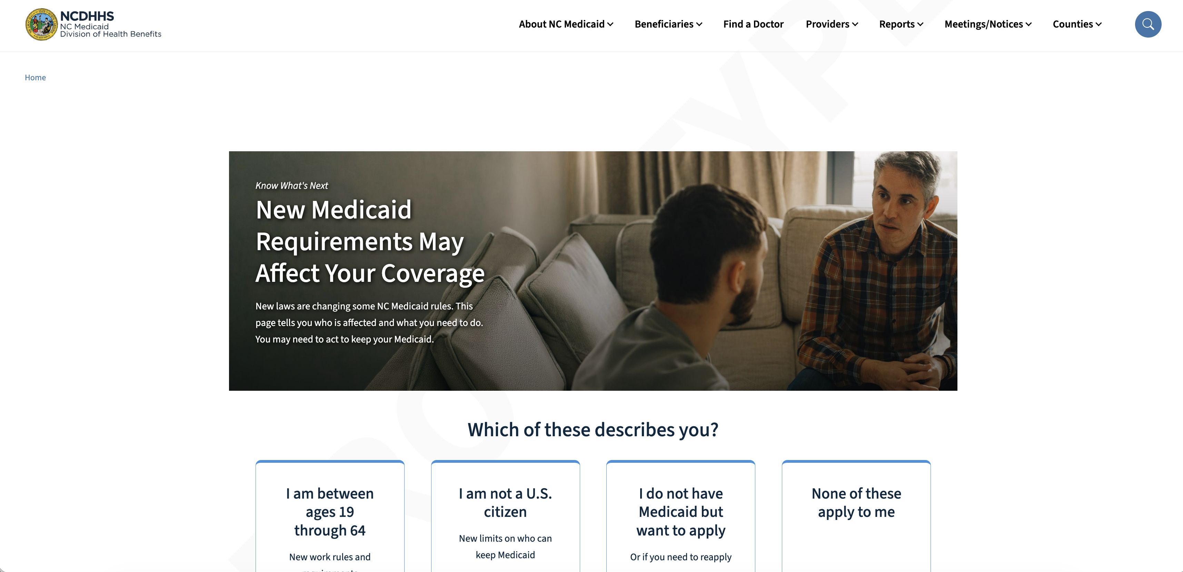
Additional Resources
Visit medicaid.nc.gov/changes.
Available in English and Spanish (medicaid.nc.gov/cambios)
Will be updated regularly with additional information
Note: Information may change with the Centers for Medicare & Medicaid final rule.
Notes:
• You do not need to memorize everything we covered today.
• The most important resource to remember is our website: medicaid.nc.gov/changes. The information is available in English and Spanish and will continue to be updated.
• Please rely on NC Medicaid, your local DSS and other trusted sources for information. There is a lot of information circulating about these changes and some of it may be incomplete or out of date.
• And remember the basics: keep your contact information current, read every letter you receive and respond by the deadline.

Slide 27
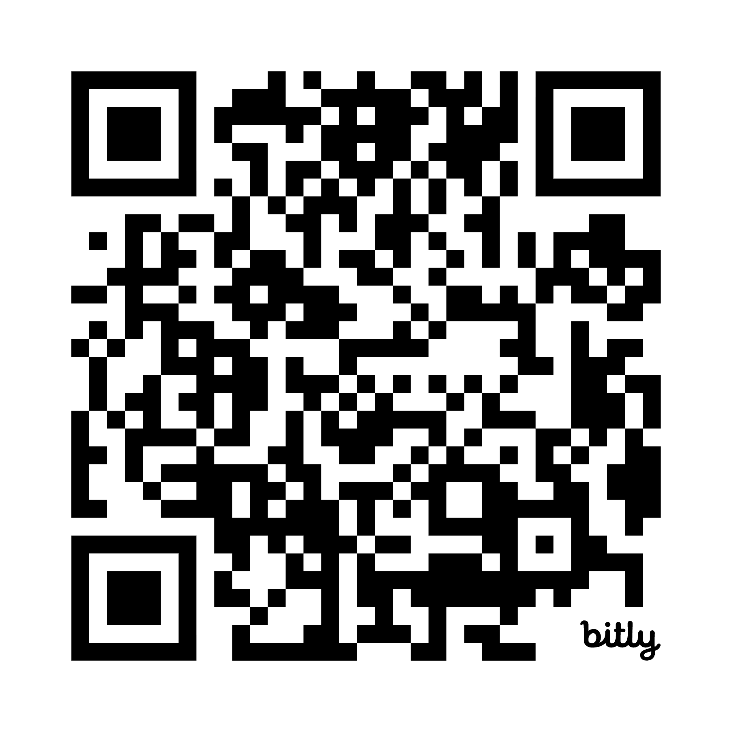
Thank you!
To fill out the Train the Train interest form, scan the QR code:
Notes:
• Thank you for taking the time to learn about these changes and for helping share this information with people in your community.
• We know this is a lot to take in, and we know some of these changes will be difficult for people and families.
• Our goal is to make sure people know what is coming, understand what applies to them and have as much time as possible to prepare.
• Please continue checking the NC Medicaid website as we get closer to these changes. Information will be updated as additional guidance becomes available.
• If you are interested in helping share this information in your community, you can use the QR code here to learn more about Train the Trainer opportunities.

