Slide 1
1915(i) services ESSENTIALS PRESENTATION
Launched April 3, 2025: Focused on Medicaid members with SMI, SUD, I/DD or TBI
Caregivers or beneficiaries, or community partners, advocates and navigators who are looking for greater detail around 1915(i) services under their Tailored Plan, NC Medicaid Direct or EBCI Tribal Option
AUDIENCE
This presentation communicates key information to North Carolinians about 1915(i) home and community-based services available under their eligible Medicaid health plan.
Intended for individuals who want to know more about 1915(i) services, what they need to do and/or for people who need a way to explain these home-based services.
The deck includes stock photos, posed by models, for illustrative purposes only.
Not intended to explain how the system or program works, but rather what's available for members.
Designed for people who do not know acronyms like PCP or LME.
4th - 6th grade reading level.
Presenters should: Use the slides that are most relevant and tailor every presentation.

Slide 2

1915(i)
Home and Community-Based Services
Last updated April 2025

Slide 3



What are
1915(i) services?
NC Medicaid 1915(i) services are free.
They help people live on their own at home or in their community.
They are for children and adults with:
serious mental health conditions
severe substance use disorders
intellectual or developmental disabilities
traumatic brain injuries

Slide 4

How 1915(i) services can help you
(or your loved one)
Help with daily activities (like bathing and eating)
Support with building skills for living at home or in the community (like cooking, shopping and staying safe)
Job coaching to find a job that is right for you
Breaks for you and your caregivers, including overnight or weekend help
Support with moving to your own place
Build self-help and problem-solving skills
Learn more at medicaid.ncdhhs.gov/1915i

Slide 5

Who is eligible for 1915(i) services?
You may be able to get 1915(i) services if you meet the following requirements:
You have an eligible condition
You have an eligible plan
You need support with activities at home or in the community because you have any of the following conditions:
  These NC Medicaid health plans offer 1915(i) services:
  Alliance Health
  Partners Health Management
  Trillium Health Resources
  Vaya Health
  Your plan is listed on your health plan ID card or welcome letter.
  Serious mental health condition
  Severe substance use disorder
  Intellectual or developmental disability
  Traumatic brain injury
Recipients of the NC Innovations Waiver or TBI Waiver are not eligible for 1915(i) services.

Slide 6

What if I have a different NC Medicaid health plan?
If you have an eligible condition, you can request to move to a Tailored Plan to get 1915(i) services.
Call the NC Medicaid Enrollment Broker
at 1-833-870-5500.
1915(i) services are only available with Tailored Plans, NC Medicaid Direct or the Eastern Band of Cherokee Indians Tribal Option.

Slide 7
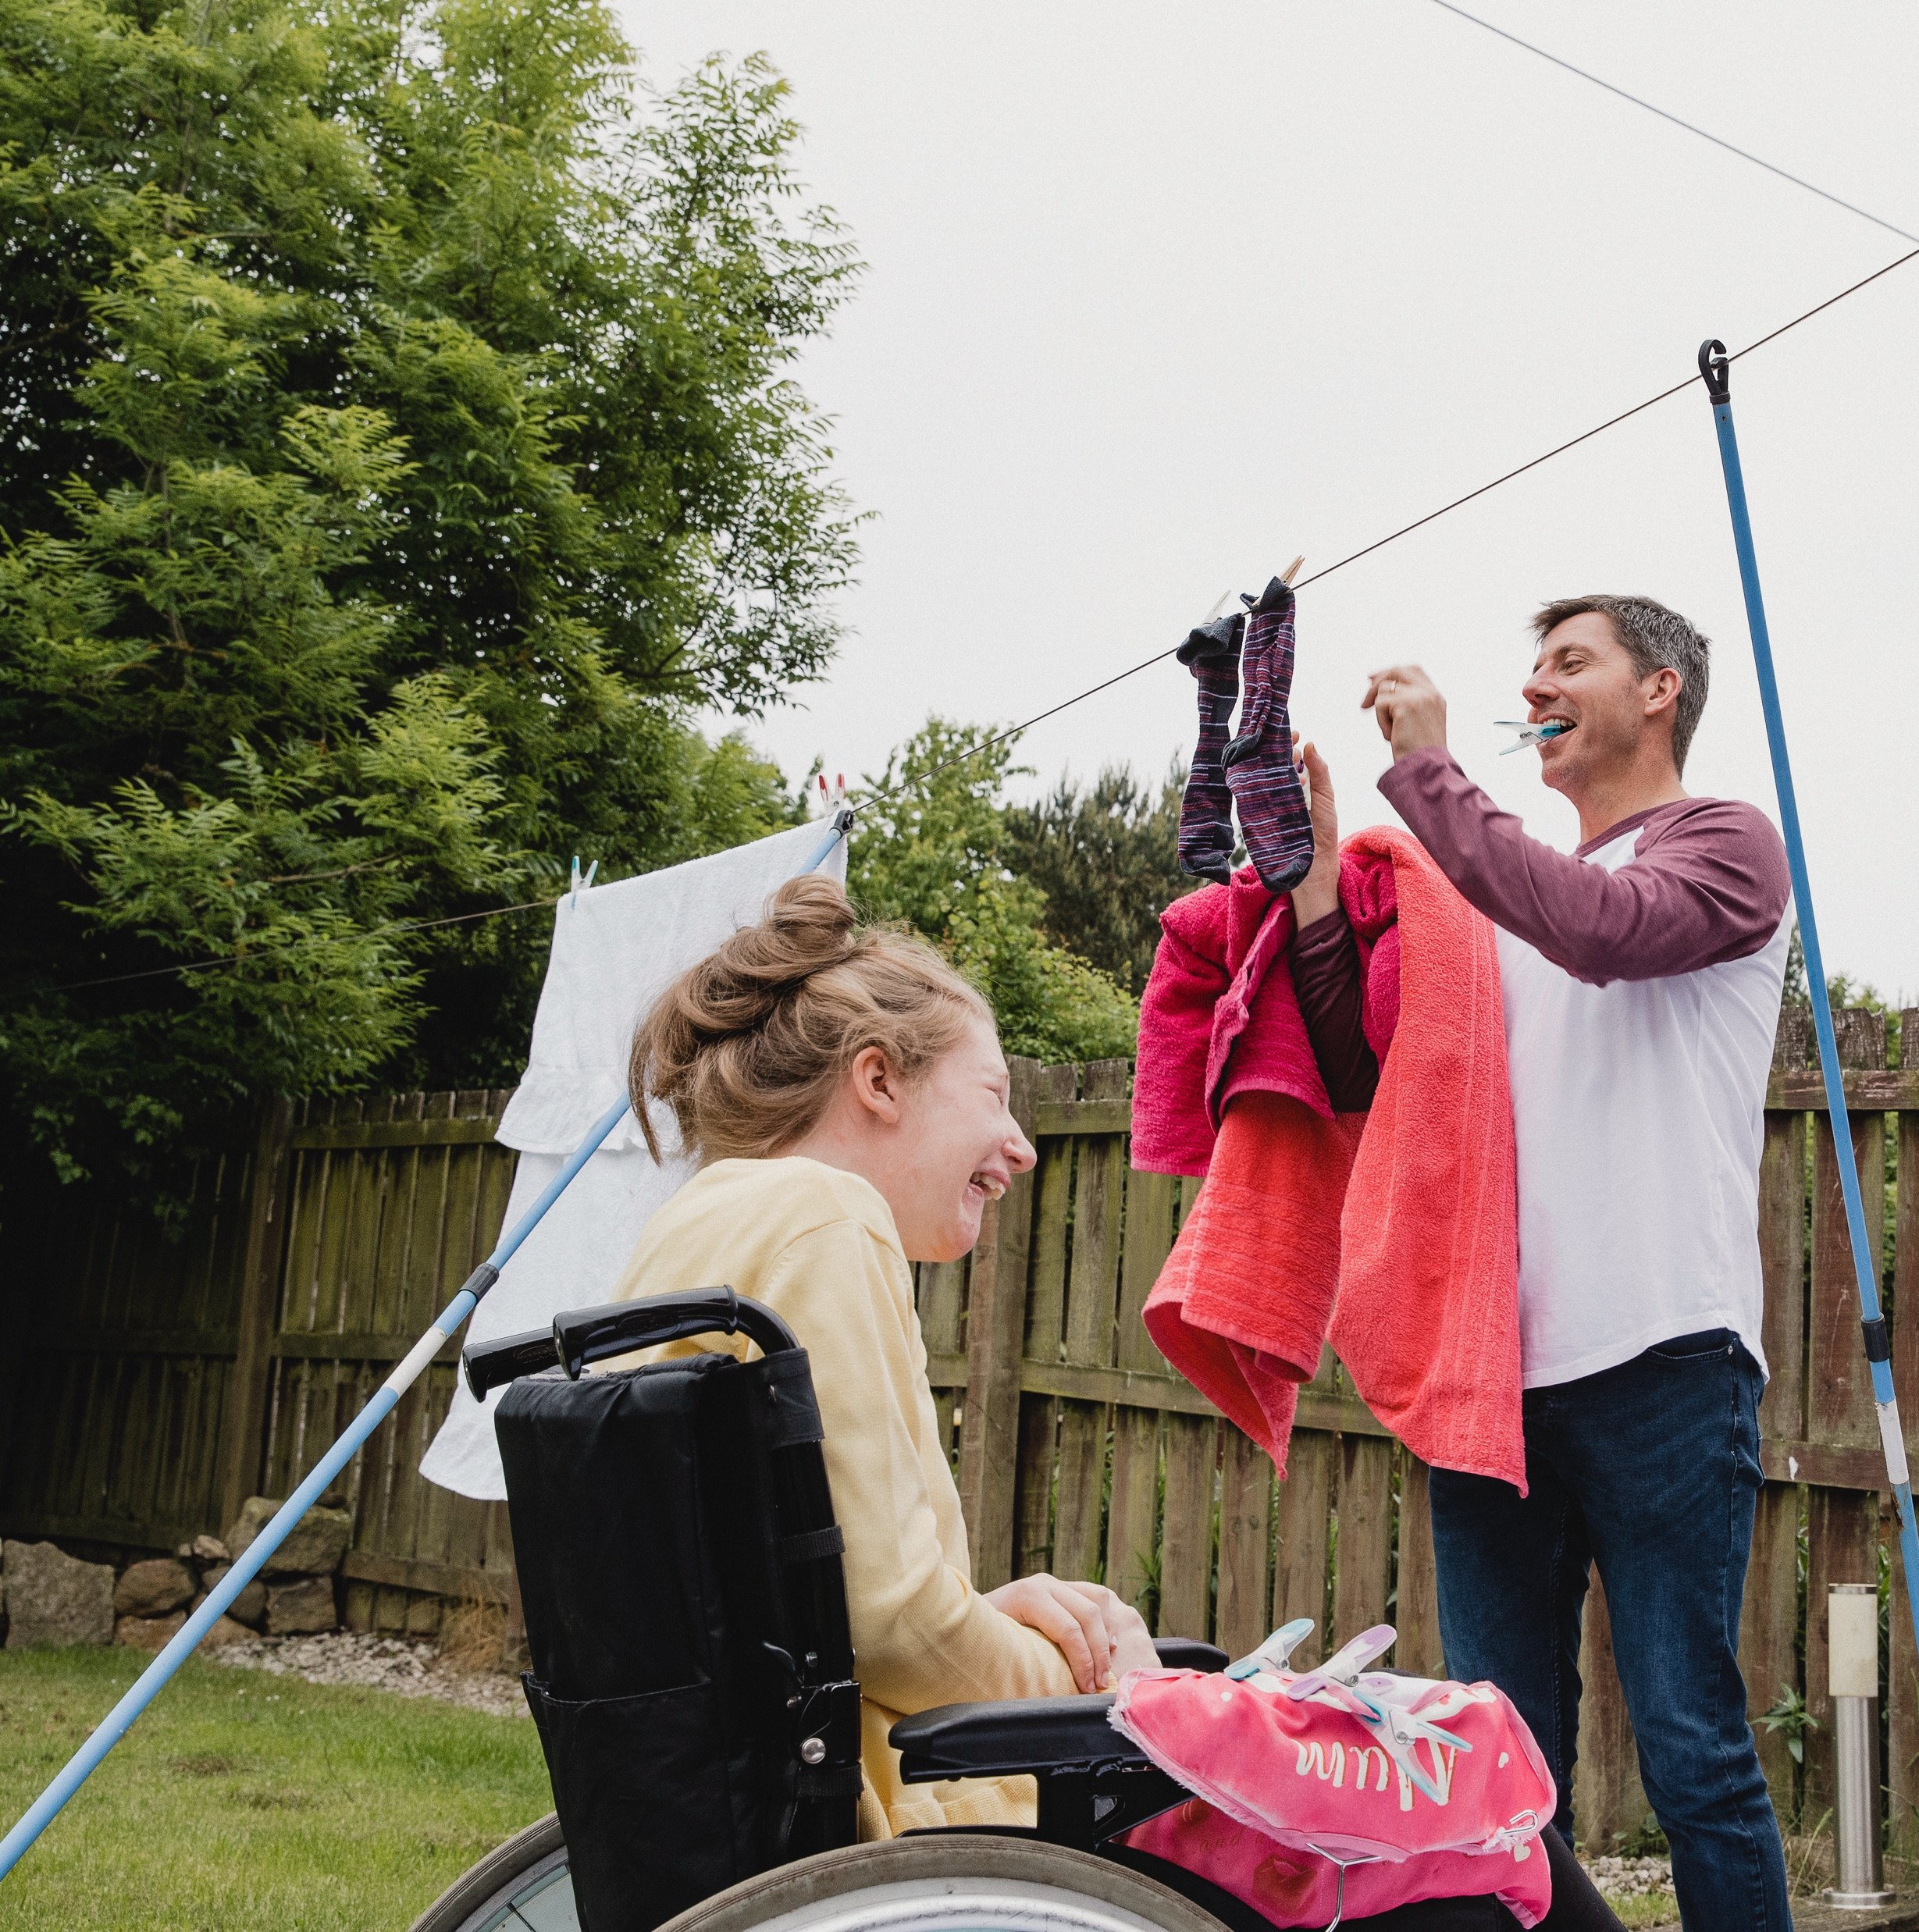
On the waitlist for Innovations Services?
You could get 1915(i) services while you wait!
  Get 1915(i) services 90 days after your assessment is approved. Other factors, like staff availability, may affect when services start.
  Your spot on the waitlist will not be affected.
You must have NC Medicaid to get 1915(i) services.
Medicaid.ncdhhs.gov/apply

Slide 8




How to get 1915(i) services
CALL AND ASK FOR 1915(i)
COMPLETE AN ASSESSMENT
Look for the phone number listed on your health plan ID card:
Alliance Health: 1-800-510-9132, TTY: 711 or 1-800-735-2962
Partners Health: 1-888-235-4673, TTY:711
Trillium Health: 1-877-685-2415, TTY: 711
Vaya Health: 1-800-962-9003, TTY: 711
Or contact your Tailored Care Manager or Care Coordinator if you have one.
A Care Manager will work with you to determine which services best meet your needs.
Get services within 90 days of approval, depending on staff availability.
To get updates on your application, call the number on your health plan ID card or your Tailored Care Manager.
Not sure which health plan you have? Call the NC Medicaid Enrollment Broker at 1-833-870-5500.

Slide 9
1915(i) Services
by condition

Slide 10




1915(i) Services for Mental Health
These 1915(i) services are for people with serious mental health conditions. These conditions can cause someone to need help with activities in their home and communities.
Examples can include bipolar disorder, schizophrenia or depression.
Skills for living in the community
Job
coaching
Breaks for you and your caregivers
Supports for moving to your own home
Individual and Transitional Support helps you build life skills to live independently in the community.
Individual Placement and Support helps you find and keep a job that's right for you.
Respite gives caregivers a break, while knowing that their loved one is cared for.
Community Transition gives you up to $5,000 in credit to help you move from an approved setting to your own home.

Slide 11

1915(i) Services for Intellectual/Developmental Disabilities
These 1915(i) services are for people with intellectual or developmental disabilities. These include teaching skills so people can live more independently and providing respite for caregivers (in or out of the home).
Examples include autism, Down syndrome or fetal alcohol spectrum disorder.
You could get 1915(i) services while waiting for the NC Innovations Waiver.
Skills and supports for living in your home
or community
Job
coaching
Breaks for you and your caregivers
Supports for moving to your own home
Community Living and Supports gives you a trained worker to help with daily activities and life skills.
Supported Employment helps you find and keep a job that's right for you.
Respite gives caregivers a break, while knowing that their loved one is cared for.
Community Transition gives you up to $5,000 in credit to help you move from an approved setting to your own home.

Slide 12
1915(i) Services for Substance Use
These 1915(i) services are for people with severe substance use disorders. These services include moving out of approved settings such as a state-operated health care facility, a foster or group home, a psychiatric residential treatment facility, a community intermediate care facility (ICF-IID) and to a private home or community.
Examples include misuse of alcohol, cocaine or opioids.
Skills for living in the community
Job
coaching
Breaks for you and your caregivers
Supports for moving to your own home
Individual and Transitional Support helps you build life skills to live independently in the community.
Individual Placement and Support helps you find and keep a job that's right for you.
Respite gives caregivers a break, while knowing their loved one is cared for.
Community Transition gives you up to $5,000 in credit to help you move from an approved setting to your own home.

Slide 13
1915(i) Services for Traumatic Brain Injury
These 1915(i) services are for people with traumatic brain injuries. This condition can cause someone to need help with activities in their home and communities. The types of skills taught depend on the person's own goals.
Examples include a brain injury due to a fall, car accident or sport injury.
Skills and supports for living in your home or community
Job
coaching
Breaks for you and your caregivers
Supports for moving to your own home
Community Living and Supports gives you a trained worker to help with daily activities and life skills.
Supported Employment
helps you find and keep a job that's right for you.
Respite gives caregivers a break, knowing their loved one is cared for.
Community Transition gives you up to $5,000 added to help you move from an approved setting to your own home.

Slide 14
What if I have a dual diagnosis?
A dual diagnosis means you have two conditions at the same time.
For example, you may have an intellectual or developmental disability and a serious mental health condition.
If you have a dual diagnosis, you may qualify for 1915(i) services for both diagnoses.
It does not matter which diagnosis is the primary diagnosis.

Slide 15
Get
1915(i) Services
Call your NC Medicaid health plan
Alliance Health: 1-800-510-9132, TTY: 711 or 1-800-735-2962
Partners Health Management: 1-888-235-4673, TTY: 711
Trillium Health Resources: 1-877-685-2415, TTY: 711
Vaya Health: 1-800-962-9003, TTY: 711
Or call your Care Manager if you have one.
Not sure which health plan you have?
Call the NC Medicaid Enrollment Broker at 1-833-870-5500.
Visit the website to learn more:
medicaid.nc.gov/1915i

