Slide 1
NC INNOVATIONS WAIVER ESSENTIALS PRESENTATION
INSTRUCTIONS FOR PRESENTERS:
Use this presentation to explain key information about the NC Innovations waiver to your community. Select the slides that are most relevant to tailor your presentation.
This presentation is:
Written in plain language at 4th - 6th grade reading level
Designed for an audience who may not know acronyms like "LME/MCO"
Meant to give enough relevant information for someone to take the next step
Not intended to explain every detail or how the system works
Using stock photos, posed by models, for illustrative purposes only

Slide 2



NC Innovations Waiver
Home and Community-Based Services for People with Intellectual or Developmental Disabilities
Last updated April 2025

Slide 3

What is the
NC Innovations waiver?
The NC Innovations waiver covers a full range of services
for people with intellectual or developmental disabilities.
Anyone can apply, regardless of age, insurance or income.

Slide 4

Intellectual or developmental disabilities may include:
Autism
Cerebral palsy
Down syndrome
Epilepsy
Fetal alcohol spectrum disorder
Intellectual disability
Traumatic brain injury (if the injury occurred before age 22)
And more

Slide 5

What can I get with the NC Innovations waiver?
The NC Innovations waiver is a program that covers home and community-based services.
Plus: With NC Medicaid, you can also get health and dental coverage and rides to appointments.

Slide 6

Why is it called a “waiver”?
The NC Innovations waiver is an NC Medicaid program, but it “waives” (does not consider) some of the usual Medicaid eligibility requirements, like the family's income.

Slide 7

NC Innovations Waiver:
Who It Is For

Slide 8
The NC Innovations waiver is for
North Carolinians of all ages who:
1
Have an intellectual or developmental disability or a related condition,
2
And need a lot of support, now and in the future.
Anyone can apply regardless of age, insurance or income.

Slide 9

Have an intellectual or developmental disability or a related condition
1
This may include:
  Autism
  Cerebral palsy
  Down syndrome
  Epilepsy
  Fetal alcohol spectrum disorder
  Traumatic brain injury (if the injury occurred before age 22)
  And more

Slide 10

And need a lot of support, now and in the future.
2
For instance, your loved one may need help to take care of themselves, like bathing or dressing. Or they may need help to live on their own, like cooking or working.
(The technical requirement is "meeting ICF-IID level of care," which means your loved one has needs similar to people placed in an intermediate care facility. You do not need to know if you meet this to apply.)

Slide 11
NC Innovations Waiver:
Services

Slide 12


Support at home
Supported Living
Get help with daily tasks in your home, like:
  Bathing
  Dressing
  Cooking
  Budgeting
  And more!
A trained worker helps you one-on-one based on your needs.
Support at home is also included in the
Community Living and Supports service.

Slide 13

Access to group homes
Residential Supports
Get help with daily activities while living in a structured care setting of your choice:
  Group home
  Alternative Family Living setting
A trained worker helps you one-on-one based on your needs.

Slide 14

Moving to your own home
Community Transition
Get help moving from an approved setting to your own home.
Approved settings include licensed facilities, foster homes, group homes, Alternative Family Living settings or even your family’s home.
This service covers expenses such as:
  Security deposits
  Household items
  Set-up fees for utilities

Slide 15

Community participation
Community Living and Supports
Get help with everyday activities, like grocery shopping and banking.
Community Networking
Meet and connect with new people through volunteering, finding hobbies, taking classes and more.
Day Supports
Attend a day program, like workshops and after-school programs.

Slide 16
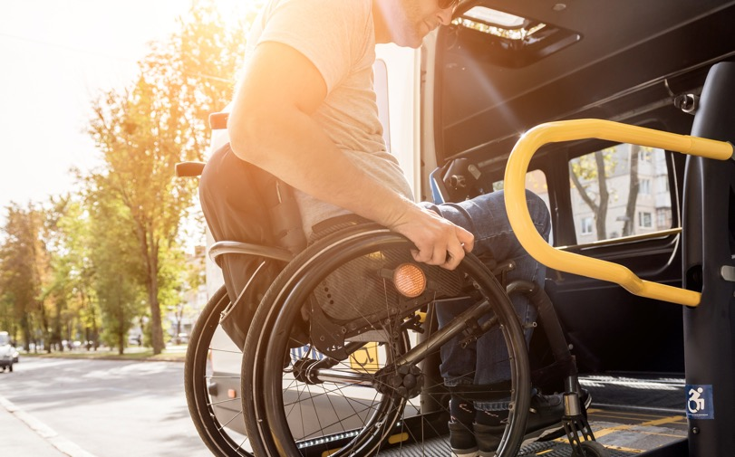
Equipment and modifications
Assistive Technology Equipment and Supplies
Communication devices, smart home technology, notetaking systems and more.
Home Modifications
Physical changes to your home, like making doorways bigger and installing ramps.
Vehicle Modifications
Physical changes to your car, like seating modifications and lifting devices.

Slide 17

Job coaching
Supported Employment
Find, get and keep a job that’s right for you. An employment specialist can help you with career counseling, resumes, interview practice and more.
Benefits Counseling
Get guidance on whether a job could affect your eligibility for benefit programs, like Supplemental Security Income (SSI) or Food and Nutrition Services.

Slide 18

Crisis services
Crisis Services
This service helps prevent institutional placement or hospitalization. For instance, this service could help you if you are at risk of losing your home or job.
Trained staff can help:
  Identify the type of help you need
  Connect you to agencies or psychologists
  Create a crisis plan

Slide 19

Caregiver support
Respite
Gives you and your caregivers a break, while knowing a loved one is cared for. This includes overnight, weekend or emergency care.
Specialized Consultations
Get advice and training from an expert in topics like supporting positive behaviors or improving social communication skills.
Natural Supports Education
Your family and friends can do trainings to learn how to support you. They will learn about I/DD, the best ways to support you and how to use any tools you might need.

Slide 20

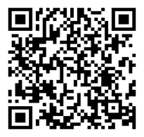
Someone to help navigate your health care
Tailored Care Managers
Tailored Care Managers are specially trained health care workers who know the system.
They help you navigate your health care, so you don’t have to do it all yourself. They can help:
  Understand your benefits, including NC Innovations waiver services
  Find doctors with openings
  Schedule rides
  Get supports for school or work
  And more!
Learn more about
Tailored Care Management

Slide 21

Plus: health coverage
Comprehensive health coverage through NC Medicaid:
  Primary care
  Specialists
  Behavioral health services
  Prescription drugs
  Dental services
  Hospital services
Did you know? Rides to Medicaid appointments are also covered!

Slide 22
NC Innovations Waiver:
How to Apply

Slide 23

We encourage you to apply as soon as you have a diagnosis, especially if services may be needed in the future.
When should I apply?

Slide 24
Anyone can apply regardless of age, insurance or income.
You do not have to have NC Medicaid to apply.
Even if you have private insurance, you may still apply.

Slide 25
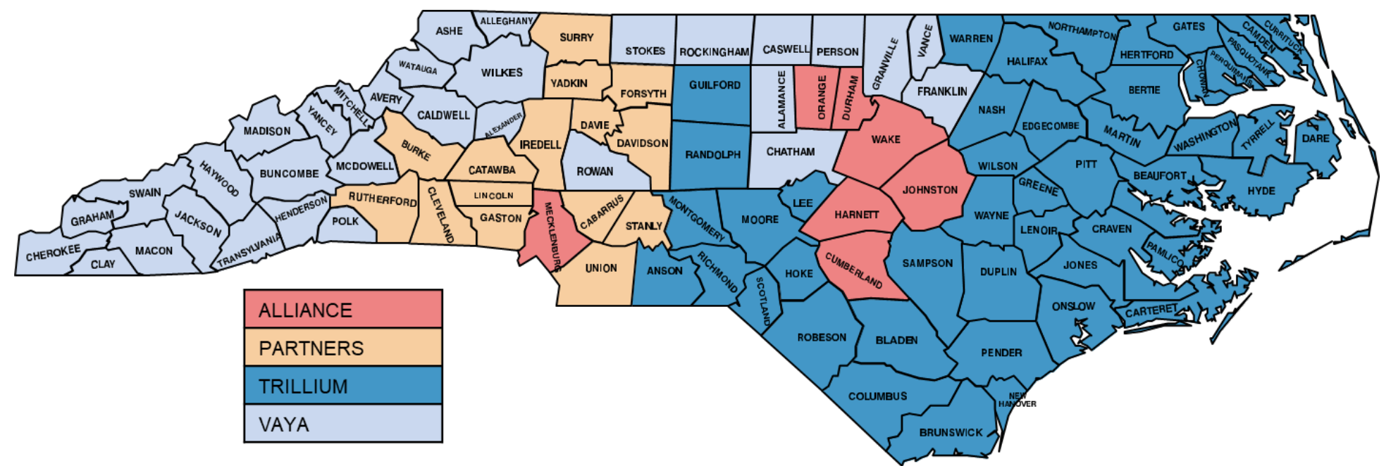
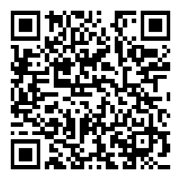
Find the LME/MCO that serves the county you live in.
Local Management Entity/Management Care Organizations (LME/MCOs) manage the NC Innovations waiver. To find yours, check this map:
1
Example:
If you live in Wake county, Alliance is your LME/MCO.
Not sure which one is yours? Call 1-855-262-1946

Slide 26




Call and ask to apply for the NC Innovations waiver.
2
Apply with your LME/MCO. The application used to be called the
"Registry of Unmet Needs application," and they may refer to it under that name.
1-800-510-9132
1-833-780-2587
1-877-685-2415
1-800-962-9003
Not sure who to call? Call 1-855-262-1946

Slide 27
The LME/MCO will guide you through the process.
3
Based on your specific situation, your LME/MCO may ask for supporting documentation, like medical records.
Follow the guidance provided by your LME/MCO.

Slide 28
After you apply
If additional documents are needed, you will be notified
by mail or phone.
Once your application is complete, you will get a
letter in a few weeks with a decision:
  If you are added to the waitlist: Be sure to save your acceptance letter. You may need to refer to it later.
  If you are denied: You can choose to appeal the decision. An appeal form will be included with the letter, or you can call your LME/MCO.

Slide 29
NC Innovations Waiver:
About the Waitlist

Slide 30
How the waitlist works
The North Carolina General Assembly decides how much to fund the NC Innovations waiver program.
Due to limited funding, there is a waitlist. It can take years before a waiver slot becomes available.
Each county has its own waitlist. Waitlists are managed by the LME/MCOs.
People who have been on the waitlist longest will usually be served first. Limited "reserve slots" are available for people who have extraordinary circumstances or emergencies.
Even though the list is long, we encourage you to apply, especially if services may be needed in the future.

Slide 31
Each LME/MCO manages their own waitlist
For questions about the waitlist, call your LME/MCO:
1-800-510-9132
1-833-780-2587
1-877-685-2415
1-800-962-9003
Not sure who to call? Call 1-855-262-1946
Note: They cannot predict anyone's exact wait time. NC Innovations waiver slot openings are dependent on many factors.

Slide 32
If you have extraordinary circumstances
A limited number of slots are reserved for those with extraordinary circumstances or emergencies. These are called "reserve slots."
If you have extraordinary circumstances:
Talk to your LME/MCO to see if you are eligible for a reserve slot, especially if your situation has changed since you first applied.

Slide 33
You will be contacted when a slot is available
Your LME/MCO will contact you by mail and phone when a slot is available.
Moved or changed phone numbers?
Tell your LME/MCO so you can be contacted about slot openings. They will also make sure you are on the correct waitlist for your county.

Slide 34
When a slot is available for you, here is what happens next:
You are notified.
Your LME/MCO will try to contact you 4 times by phone and mail. This is the same organization you called when you applied.
Eligibility is confirmed.
This process requires a psychological evaluation from a doctor or licensed psychologist completed within the last 3 years.
Someone is assigned to help you.
With your input, a Tailored Care Manager will create an Individual Support Plan to outline which services are needed.
Services begin.
After your Individual Support Plan is approved, services will begin within 45 calendar days.

Slide 35
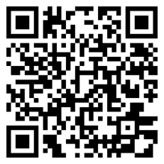
NEW! Get services while you wait
If you have NC Medicaid, you may be eligible to get similar services while you wait, such as help with daily activities.
Talk to your LME/MCO about 1915(i) services.
There is no waitlist for enrollment, and your spot on the NC Innovations waiver waitlist will not be affected.
Learn more
about 1915(i)
Did you know? NC Medicaid expanded coverage to more people in December 2023. You may be eligible for NC Medicaid now even if you were not before.

Slide 36
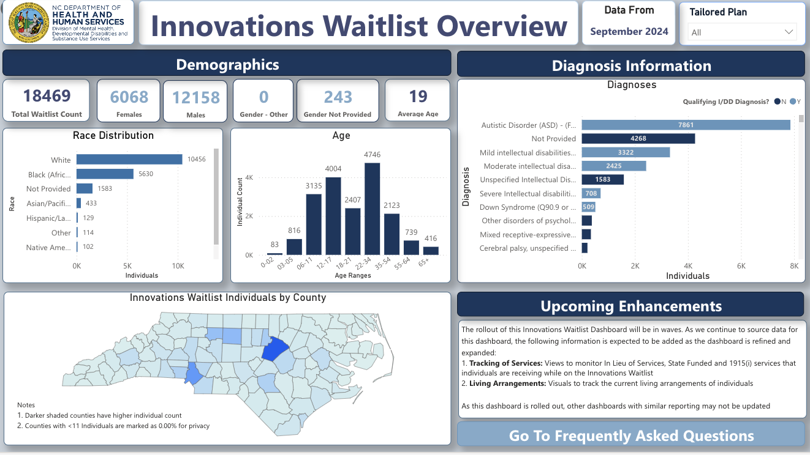
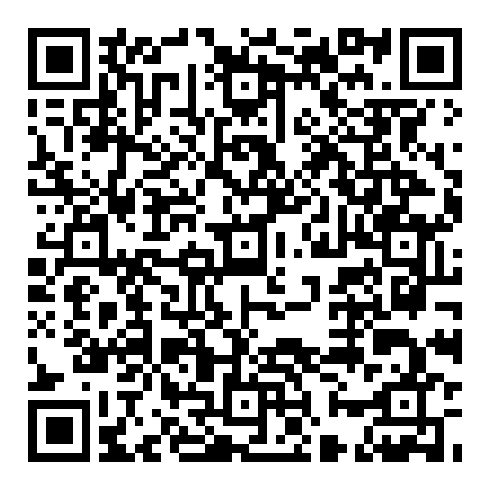
Innovations Waitlist Dashboard
To see how many people are on the waitlist,
visit the dashboard.
The dashboard gives more information about people on the
waitlist, such as
their gender, age
and diagnosis.

Slide 37
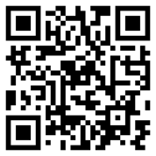
Secure your spot. Get on the waitlist.
Apply for the NC Innovations waiver today.
Call your LME/MCO
Alliance Health: 1-800-510-9132, TTY: 711 or 1-800-735-2962
Partners Health Management: 1-833-780-2587, TTY: 711
Trillium Health Resources: 1-877-685-2415, TTY: 711
Vaya Health: 1-800-962-9003, TTY: 711
Not sure who to call? Call 1-855-262-1946.
Learn more:
medicaid.nc.gov/innovations

