Slide 1
Overview of Tailored Plan Quality Strategy and Measures
DHB Quality and Health Outcomes CFT
January 2020

Slide 2
State Medicaid Managed Care Quality Strategy
States are required to implement a Quality Strategy to assess and improve the quality of managed care services offered within the state. North Carolina released a draft Quality Strategy in 2018, and is planning updates to take effect with the implementation of BH/I DD Tailored Plans.
The Quality Strategy is “intended to serve as a blueprint or road map for states and their contracted health plans in assessing the quality of care beneficiaries receive, as well as for setting forth measurable goals and targets for improvement” (Medicaid.gov)
Source: State Quality Strategies. https://www.medicaid.gov/medicaid/quality-of-care/medicaid-managed-care/state-quality-strategy/index.html

Slide 3
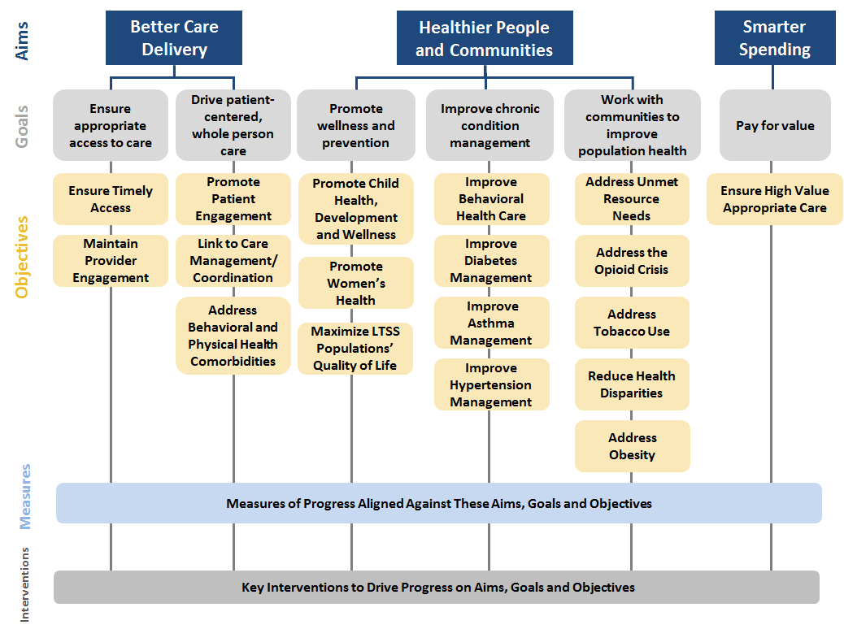
North Carolina Medicaid Quality Framework
The Quality Framework defines and drives the overall vision for advancing the quality of care provided to Medicaid beneficiaries in North Carolina.
Indicates objective is particularly relevant to BH/I DD Tailored Plans
Source: North Carolina Medicaid Managed Care Quality Strategy

Slide 4
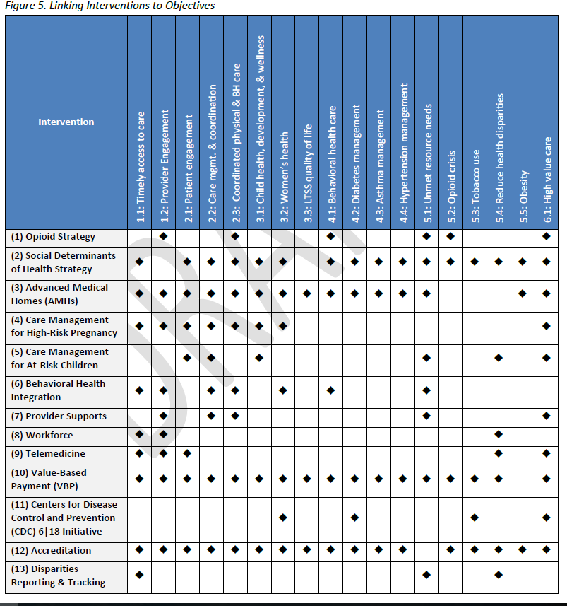
Interventions and Objectives

Slide 5
Summary of Primary Levers for Quality Performance
1
Quality Measure Reporting
2
Quality Baselining, Benchmarking, and Performance Target Development
3
Disparities Reporting and Tracking
4
Quality Assessment and Performance Improvement Programs (QAPIs)
  PHPs must develop a QAPI aligned to NC DHHS goals, and annually approved by NC DHHS
  Key components include internal-to-PHP processes for monitoring and correcting performance, conducting performance improvement projects, and addressing disparities in care
  PHPs are required to develop Performance Improvement Programs (PIPs), including a mandatory PIP on deinstitutionalization
5
Value-Based Payment/Provider Incentives
PHPs are required to meet annual targets for the percentage of medical expenditures in value-based arrangements
Starting in year 3 of managed care, all VBP arrangements counting towards targets must link payment to performance on quality metrics
6
External Quality Assurance Validation
  Accountability for quality performance is layered into accreditation requirements. The External Quality Review Organization (EQRO) will validate PHP measure reporting and validate PHP contract compliance.

Slide 6
North Carolina Medicaid Quality Measurement Approach
Quality Vision for Medicaid Transformation
Robust measure set and measure reporting that allow NC to track progress against quality priorities at a stratified level
Accountability for quality from Day 1
Immediate attention to maintaining and improving current measures of care, promoting health equity, and being transparent with quality results.
Other Factors Shaping Quality Approach
DHHS expects providers will require time to update documentation and coding processes for managed care environment
Public health priorities (particularly low birth weight) require new approach for managed care
Note: Legislative requirements prevent the use of withholds until Contract Year 3.

Slide 7
Overview: North Carolina Medicaid Quality Measures
PHPs will be required to report on a robust measure set, but must focus on narrower subset of measures reflecting DHHS priorities in contracting with providers. DHHS expects PHPs will incorporate these measures into their contracting and other engagement with practices.
PHPs must report all of these measures to DHHS annually (baseline & maintain)
Quality and Select Administrative Measures Aligned with National, State and PHP Reporting
68*
Measures
Priority Measures Aligned with DHHS Policies
DHHS will set benchmarks for performance. Measures used for QAPI and VBP contracts.
31*
Measures
Quality Withhold Measures
DHHS will hold PHPs financially accountable for these measures starting in Year 3 (July 2021) against targets.
6* Measures
Note: AMH performance incentive programs must be based on a subset of the priority measures.
*Pending

Slide 8
How the Department will assess PHP performance on quality metrics
PHPs will be given historical baselines for all measures for which comparable historical data are available at the state level.
DHHS will calculate benchmarks, representing optimal performance levels, for all Priority Measures.
  Help identify particularly high-performing PHPs
  Support PHPs’ quality improvement efforts
  NOT linked to financial accountability
PHPs will be held financially accountable for performance measured against a target for a smaller subset of measures beginning in the third contract year
  Targets will reflect a performance level that ensures meaningful improvement for North Carolina Medicaid enrollees
Benchmarks are meant to be aspirational in nature.
  Upon reviewing each year’s quality data, DHHS will determine whether to publish benchmarks as part of its public reporting.

Slide 9
Future Uses of Quality Withholds and Overall Quality Results
Beginning in the third year of managed care implementation, DHHS will measure PHPs’ performance against select withhold measures, for which PHPs will be financially accountable.
The withhold measures will be drawn from the Priority Measure set.
For withhold measures, DHHS will calculate withhold benchmarks, representing the level PHPs much achieve to receive some or all of their quality withhold amount.
Goals for withhold measure set:
  Maintaining a concise set (approximately 6-7 measures)
  Moving toward outcome measures, while ensuring data quality is sufficient to guide withholds

Slide 10
Quality Assurance and Performance Improvement (QAPI) Plan
PHPs are required to submit an annual QAPI plan, delineating their plans for performance improvement programs and other quality improvement efforts
Performance Measures
Quality Improvement Activities
Measures performance against state benchmarks
Measures stratified as directed by DHB
Measures of focus for performance/quality improvement (all measures less than DHB-target must be addressed in the QAPI).
PIP: no less than three (3) performance improvement projects as part of the annual Quality Assessment and Performance Improvement program, including a mandatory PIP on deinstitutionalization
Provider Support: provider supports that relate to each PIP or quality improvement effort
PHPs submit an annual QAPI and quarterly QAPI updates.

Slide 11
Performance Improvement Projects (PIP)
The PHP shall include no less than three (3) performance improvement projects as part of the annual Quality Assessment and Performance Improvement program
  1 - Non-clinical Performance Improvement Project
  2 - Clinical performance improvement projects
    Pregnancy Intendedness
    Tobacco Cessation
    Diabetes Prevention
    Birth outcomes
    Early childhood health and development
    Hypertension
    Behavioral Health Integration
    Mandatory PIP on deinstitutionalization
  Mandatory child PIP (if PHP performs below seventy-five percent (75%) for all child ESPDT measures)

Slide 12
Medicaid Quality: Public Reporting of Performance
Accreditation Progress and Results—DHHS will publish PHP progress toward receiving this accreditation, and will report the accreditor’s findings for each PHP during its accreditation process.
Annual Quality Measures at Plan Level/Report Cards—DHHS will share plan-level rates for the quality measures, to facilitate comparison among plans. Members and the public should have access to a reliable report on how PHPs are performing.
Health Equity Report—DHHS will assess disparities in care and outcomes and publish a report summarizing areas or care in which disparities have improved, persisted, or developed.
Provider Survey Results—DHHS, in partnership with a third party, will field a survey to providers assessing their satisfaction with the PHP(s) with which they have contracted. The Department will publish overall satisfaction rates and other findings from this survey.
Survey Results—DHHS, in partnership with a third party, will field surveys to assess patient experience in receiving care. The Department will publish overall ratings of plans, overall ratings of all care received and other findings from these surveys.
Network Accessibility Reports-- DHHS, in partnership with a third party, will evaluate network adequacy—a combination of provider availability, realized member utilization, and patient perception of availability. DHHS will publish PHP Access reports.

Slide 13
Tailored Plan Quality Measures
Sam Thompson
Senior Manager of Evaluation
Quality and Population Health
January 23rd, 2020

Slide 14
Survey and General Measures: Pediatric
Slide 1 of 2
NQF # | Measure Name | Steward | Frequency | SP List
 | Adolescent Well-Care Visit | NCQA | Annually | X
1388 | Annual Dental Visits* | NCQA | Annually | X
2 | Appropriate Testing for Children With Pharyngitis | NCQA | Interim and Annually | X
69 | Appropriate Treatment for Children With Upper Respiratory Infection | NCQA | Interim and Annually | X
Avoidable Pediatric Utilization* |  |  |  | X
 | PDI 14- Asthma Admission Rate | AHRQ | Annually | X
 | PDI 15- Diabetes Short-Term Complications Admission Rate | AHRQ | Annually | X
 | PDI 16- Gastroenteritis Admission Rate | AHRQ | Annually | X
 | PDI 18- Urinary Tract Infection Admission Rate | AHRQ | Annually | X
38 | Childhood Immunization Status (Combo 10)* | NCQA | Annually | X
2508 | Dental Sealants for 6-9 Year Old Children at Elevated Caries Risk | Dental Quality Alliance | Annually | X
108 | Follow-up For Children Prescribed ADHD Medication | NCQA | Annually | X

Slide 15
Survey and General Measures: Pediatric
Slide 2 of 2
NQF # | Measure Name | Steward | Frequency | SP List
1407 | Immunizations for Adolescents* | NCQA | Annually | X
2800 | Metabolic Monitoring for Children and Adolescents on Antipsychotics | NCQA | Annually | X
1334 | Percentage of Eligibles who Receive Dental Visits | The Child and Adolescent Health Monitoring Initiative | Annually | X
2803 | Tobacco Use and Help with Quitting Among Adolescents | NCQA | Annually | X
24 | Weight Assessment and Counseling for Nutrition and Physical Activity for Children/Adolescents | NCQA | Annually | X
1392 | Well-Child Visits in the First 15 Months of Life* | NCQA | Annually | X
1516 | Well-Child Visits in the Third, Fourth, Fifth, and Sixth Years of Life* |  |  | X
 | 0 Visits | NCQA | Annually
 | 1 Visit | NCQA | Annually
 | 2 Visits | NCQA | Annually
 | 3 Visits | NCQA | Annually
 | 4 Visits | NCQA | Annually

Slide 16
Survey and General Measures: Adult
Slide 1 of 4
NQF # | Measure Name | Steward | Frequency | SP List
 | Ambulatory Care: ED Visits | NCQA | Annually
 | Avoidable ED Utilization | TBD | Annually | X
58 | Avoidance of antibiotics in adults with bronchitis | NCQA | Annually | X
1879 | Adherence to Antipsychotic Medications for Individuals with Schizophrenia* | NCQA | Interim and Annually | X
 | Admission to an Institution from the Community | CMS | Annually
23 | Adult BMI Assessment | NCQA | Annually | X
105 | Antidepressant Medication Management | NCQA | Interim and Annually | X
1800 | Asthma Medication Ratio* | NCQA | Interim and Annually | X
Avoidable Inpatient Utilization* |  |  |  | X
 | PQI 01- Diabetes Short Term Complication Admission Rate | AHRQ | Annually
 | PQI 05- COPD or Asthma in Older Adults Admission Rate | AHRQ | Annually
 | PQI 08- Heart Failure Admission Rate | AHRQ | Annually
 | PQI 15- Asthma in Young Adults Admission Rate | AHRQ | Annually
2372 | Breast Cancer Screening | NCQA | Interim and Annually | X
32 | Cervical Cancer Screening* | NCQA | Annually | X
33 | Chlamydia Screening in Women* | NCQA | Annually | X

Slide 17
Survey and General Measures: Adult
Slide 2 of 4
NQF # | Measure Name | Steward | Frequency | SP List
Comprehensive Diabetes Care * |  |  |  | X
N/A | HbA1c control (<7.0%) for a selected population | NCQA | Interim and Annually | X
55 | Eye (Retinal) Exam | NCQA | Interim and Annually | X
57 | Hemoglobin A1c (HbA1c) Testing (HA1C)* | NCQA | Interim and Annually | X
59 | HbA1c Poor Control (>9.0%) | NCQA | Interim and Annually | X
61 | Blood Pressure Control (<140/90 mm Hg) | NCQA | Interim and Annually | X
62 | Medical Attention to Nephropathy | NCQA | Interim and Annually | X
63 | LDL-C screening | NCQA | Interim and Annually | X
64 | LDL-C control (<100 mg/dL | NCQA | Interim and Annually | X
575 | HbA1c Poor Control (>8.0%) | NCQA | Interim and Annually | X
3389 | Concurrent use of Prescription Opioids and Benzodiazepines* | PQA | Annually | X
3175 | Continuation of Pharmacotherapy for Opioid Use Disorder* | USC | Interim and Annually
18 | Controlling High Blood Pressure | NCQA | Interim and Annually | X
2607 | Diabetes Care for People with Serious Mental Illness: HbA1c Poor Control (>9%) | NCQA | Annually | X
1932 | Diabetes Screening for People with Schizophrenia or Bipolar Disorder who are Using Antipsychotic Medications | NCQA | Annually | X
39 | Flu Vaccinations for Adults | NCQA | Annually | X

Slide 18
Survey and General Measures: Adult
Slide 3 of 4
NQF # | Measure Name | Steward | Frequency | SP List
3488 | Follow-Up After Emergency Department Visit for Alcohol and Other Drug Abuse or Dependence | NCQA | Annually | X
576 | Follow-up After Hospitalization for Mental Illness* | NCQA | Interim and Annually | X
2082/ | HIV Viral Load Suppression (HVL-AD)* | HRSA | Annually
3210e
4 | Initiation/Engagement of Alcohol and Other Drug Dependence Treatment* | NCQA | Annually | X
1598 | Inpatient Utilization | CMS | Annually
27 | Medical Assistance with Smoking and Tobacco Use Cessation* | NCQA | Annually | X
1799 | Medication Management for People with Asthma | NCQA | Interim and Annually | X
 | National Core Indicators (NCI) Survey | NASDDDS and HSRI | Annually
 | NC TOPPS Required Service Reporting | NC DHHS | Annually and Interim
2856 | Pharmacotherapy Management of COPD Exacerbation | NCQA | Annually | X
1768 | Plan All Cause Readmission | NCQA | Annually | X
 | PQI 92: Chronic Conditions Composite | AHRQ | Annually
 | Rate of Screening for Unmet Resource Needs | NC DHHS | Annually | X
0418/ 0418e | Screening for Depression and Follow-up Plan | NCQA | Annually | X

Slide 19
Survey and General Measures: Adult
Slide 4 of 4
NQF # | Measure Name | Steward | Frequency | SP List
543 | Statin Therapy for Patients with Cardiovascular Disease | NCQA | Interim and Annually | X
547 | Statin Therapy for Patients with Diabetes | NCQA | Interim and Annually | X
1664 | SUB-3 Alcohol and Other Drug Use Disorder Treatment Provided or Offered at Discharge and SUB-3a Alcohol and Other Drug Use Disorder Treatment at Discharge | The Joint Commission | Annually | X
2597 | Substance Use Screening and Intervention Composite* | ASAM | Annually
2600 | Tobacco Use Screening and Follow-up for People with Serious Mental Illness or Alcohol or Other Drug Dependence* | NCQA | Annually
1604 | Total Cost of Care | TBD | Annually | X
52 | Use of Imaging Studies for Low Back Pain | NCQA | Annually | X
3400 | Use of Pharmacotherapy for Opioid Use Disorder | CMS | Annually
2940 | Use of Opioids at High Dosage in Persons Without Cancer | PQA | Annually | X
2950 | Use of Opioids from Multiple Providers in Persons Without Cancer* | PQA | Annually | X

Slide 20
Survey and General Measures: Maternal
NQF # | Measure Name | Steward | Frequency | SP List
2903 | Contraceptive Care: Most & Moderately Effective Methods* | US Office of Population Affairs | Annually | X
2904 | Contraceptive Care: Postpartum* | US Office of Population Affairs | Annually | X
NA | Percentage of Low Birthweight Births (Live Births Weighing Less than 2,500 Grams)* | NC DHHS | Annually | X
NA | Percentage of Pregnant Smokers Receiving Appropriate Screening/Treatment for Smoking | NC DHHS | Annually | X
1517 | Prenatal and Postpartum Care* | NCQA | Annually | X
 | Prenatal Depression Screening and Follow-up (PND) | NCQA | Annually | X
 | Postpartum Depression Screening and Follow-up | NCQA | Annually | X
 | Rate of Screening for Pregnancy Risk | NC DHHS | Annually | X

Slide 21
Survey and General Measures: Patient and Provider Satisfaction
Slide 1 of 1
NQF # | Measure Name | Steward | Frequency | SP List
6 | Coordination of Care* | AHRQ | Annually | X
6 | Customer Service* | AHRQ | Annually | X
6 | Getting Care Quickly* | AHRQ | Annually | X
6 | Getting Needed Care* | AHRQ | Annually | X
 | Provider satisfaction with health plan | NC DHHS | Annually | X
6 | Rating of all health care | AHRQ | Annually | X
6 | Rating of Health Plan | AHRQ | Annually | X
6 | Rating of personal doctor* | AHRQ | Annually | X

Slide 22
Additional Measure Sets
Acute Care Behavioral Health Utilization
Public Health Surveillance
CMS SUD Monitoring Protocol
Innovations Waiver
State-University Partnership Learning Network

