Slide 1
North Carolina Community Care Networks (N3CN): Medical Home Access and Emergency Department (ED) Utilization
May 2016

Slide 2
N3CN Responsibilities: Medical Home Access and ED Utilization
Medical Home Access
Maintain a network of medical home providers & create a care management infrastructure to manage target populations
Ensure that the Participating PCPs do the following:
Serve as medical home in which services are provided or coordinated and referrals are initiated and monitored.
Provide 24 hour contact for services and consultation or referrals
Automatic referral to ER is prohibited
See enrolled patients within clinically appropriate standards of appointment availability

Slide 3
N3CN ED Utilization Initiatives
Centralized Call Center
Telephonic outreach to patients who have had 2-6 non-emergent ED visits in the last 12 months
Educate patients on the use of the medical home
Educate on use of local urgent care facilities
Provides local resources for transportation, urgent care information, DSS numbers, and crisis lines
Telephonic outreach to Beneficiaries who are new to Medicaid in the past 30 days
Review Medicaid/CCNC benefits, medical home education
Encourage relationship with their PCP and to contact PCP before going to an ED
Educate on use of urgent care center as an alternative to ED use

Slide 4
N3CN ED Utilization Initiatives
ED Superutilizers
Analytics identify ED super-utilizers (more than 10 ED visits in prior year). Care managers provide care management activities:
Initial Comprehensive Health Assessment
Individualized care plan with specific goals and interventions
Linkage to medical home
Share data with the medical homes so they are aware of who their ED super-utilizers are, where they are going, why and when
Some networks have formal partnerships with hospital EDs, embed staff, share care plans, etc.

Slide 5
Risk-Adjusted ED Utilization in Mecklenburg County
ED utilization in Mecklenburg county has remained below the expected rate since the period YE December 2012
Expected utilization rates are calculated based on the clinical risk groups (CRGs) of the population from 2011 and 2012. The rate of expected utilization will fluctuate over time based on how the case mix (sickness) of the population changes.

Slide 6
Mecklenburg County ED Utilization compared to State
Mecklenburg County ED utilization rates are lower than the state:
58.47 visits per 1000 member months in Mecklenburg Co in YE December 2015
59.23 visits per 1000 member months for all of CCNC in YE December 2015

Slide 7
Mecklenburg ED Utilization Compared to Wake and Durham Counties
ED Utilization is slightly higher in Mecklenburg County as compared to Wake and Durham counties, though the expected rate is also higher
Durham County
Wake County
Notes:
Could say something here about the difference in demographics also. Easy comparison of member months.

Slide 8
Drilling Down and Analyzing: ED Data
Networks can analyze the clinical drivers of ED utilization while filtering for emergent vs. non-emergent
Networks can then work with practices to improve management of top diagnoses, such as respiratory diseases

Slide 9
Drilling Down and Analyzing: Non-Emergent ED Utilization and High Utilizers
Networks also drill into non- emergent ED visits and can easily identify patients with high utilization for outreach
Patients with 5 or more ED visits in last year

Slide 10
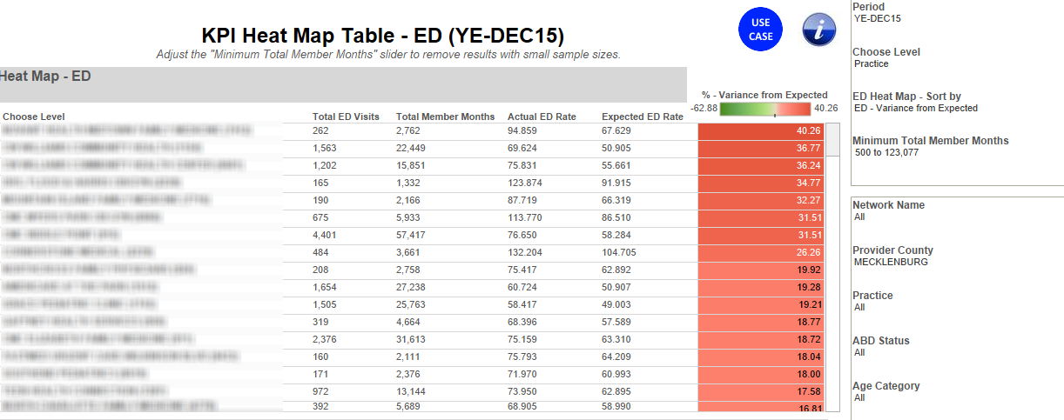
N3CN Initiatives: Identifying High-Opportunity Practices
Although a Network or County may have utilization below what is expected, Networks can drill down to identify practices with above expected utilization and implement quality improvement initiatives to reduce unnecessary ED visits.
Heat mapping allows Networks to quickly identify practices with the highest rates of above-expected utilization (variance from expected)

