Slide 1
Resolving North Carolina’s Direct Care Workforce Crisis Report to the NC Medical Care Advisory Committee
September 24, 2021
Kezia Scales, PhD, Director of Policy Research

Slide 2
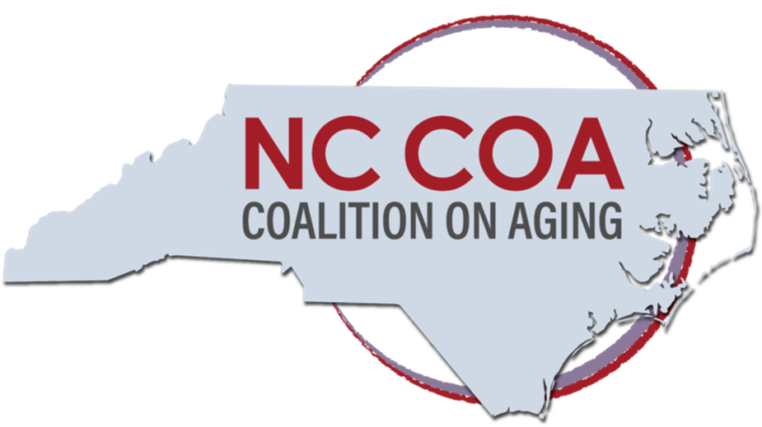
Background
In North Carolina, PHI is partnering with the North Carolina Coalition on Aging to lead the Essential Jobs, Essential Care™ initiative.
The approach: convene a broad base of stakeholders and an expert steering group to develop and implement a roadmap for advancing solutions to NC’s direct care workforce crisis.
Three broad issue areas:
Lifting workers out of poverty
Investing in workforce innovations
Improving data to strengthen the workforce
See: Scales, Kezia. 2021. “Now is the Time to Lift Up North Carolina’s Direct Care Workers.” PHI Newsroom, July 6, 2021. https://phinational.org/now-is-the-time-to-lift-up-north-carolinas-direct-care-workers/.

Slide 3
Profile of North Carolina’s Direct Care Workforce
116,600 frontline caregivers who support older adults and people with disabilities across care settings
A predominantly female (92%) and diverse workforce (62% people of color)
A rapidly growing workforce: nearly 21,000 new jobs expected 2018 to 2028 (and 186,200 total job openings in the same period)
PHI. “Workforce Data Center.” Accessed 9/7/21. https://phinational.org/policy-research/workforce-data-center/.

Slide 4
Direct care will add more new jobs than almost any other occupation in North Carolina in the next decade.
Projections Central. 2021. Long Term Occupational Projections, State Occupational Projections. http://www.projectionscentral.com/Projections/LongTerm

Slide 5
An Essential But Undervalued Workforce
Median hourly wage = $11.91
Median annual earnings = $18,200
Over half live in or near poverty (51%); 44% rely on public assistance; 32% lack affordable housing
20% have no health insurance; 25% rely on public coverage
Limited training and career development
High turnover and job vacancy rates across long-term care settings
PHI. “Workforce Data Center.” Accessed 9/7/21. https://phinational.org/policy-research/workforce-data-center; Campbell, Stephen, Angelina Del Rio Drake, Robert Espinoza, and Kezia Scales. 2021. Caring for the Future: The Power and Potential of America’s Direct Care Workforce. Bronx, NY: PHI. http://phinational.org/caringforthefuture/

Slide 6
PHI Resources:
New national data on the direct care workforce: https://phinational.org/resource/direct-care-workers-in-the-united-states-key-facts-2/
Detailed workforce analyses and recommendations for policy and practice: https://phinational.org/resource/caring-for-the-future-the-power-and-potential-of-americas-direct-care-workforce/
Recommendations for federal action: https://phinational.org/resource/federal-policy-priorities-for-the-direct-care-workforce/
And much more: www.PHInational.org

Slide 7
Kezia Scales, PhD Director of Policy Research kscales@PHInational.org
@KeziaScales

