Slide 1
Your Medicaid Health Care: Understanding the Changes and Available Support
If you experience technical difficulties during the WebEx session, please dial: 1-866-779-3239
Please note that this webinar is being recorded
Live closed captioning is available
Time permitting, we will be holding a Q&A session at the conclusion of today’s presentation.
You may ask an online question at any time throughout the presentation, using the Q&A text box
Q&A Text Box is located on the lower right hand side of the screen
Simply type in your question and click send
Make sure the “Send To” criteria is set to “ALL PANELISTS”
The recording and presentation will be available at the below website:
For more information on Medicaid Transformation, please visit:
https://www.ncdhhs.gov/assistance/medicaid-transformation

Slide 2
Your Medicaid Health Care: Understanding the Changes and Available Support
August 20, 2019
Updated September 24, 2019

Slide 3
Overview of Materials
Medicaid Changes in North Carolina
Understanding How the Medicaid Changes Impact You
Special Eligibility Scenarios
What To Do Next
Appendix

Slide 4
Medicaid Changes in North Carolina

Slide 5
Medicaid changes put YOU at the center of care
Physical Health
Leadership voiceover:
So, what does this mean for you?
Consumer are at the very center of the transformation goal, that care will be coordinated, etc.
Dave will likely have thoughts on what he’d like to discuss here
Intellectual/ Developmental Disabilities
Long Term Services & Supports
Pharmacy
Behavioral Health
Unmet Needs
(housing, food, transportation, violence and stress)

Slide 6
There is a lot of information out there…
NC Medicaid Direct?
PHP?
Health Plan?
Enrollment Broker?
Regions?
Leadership voiceover:
There is a lot of information out there on Medicaid changes… and it can be confusing.
This presentation might not answer every question you have. But we hope it will point you in the right direction, so that you will know who to ask for help.
LME/MCO?
BH I/DD Tailored Plan?
Managed Care?
Excluded?
Exempt?
Care Management?

Slide 7
Leadership voiceover
(pt. 1):
There will be two ways to get Medicaid health care.
One way is through “NC Medicaid Managed Care” health plans. This is our new way to get Medicaid.
Most – but not all – people will get care through “health plans.” There are a lot of different names for health plans. But what is important for you to know is that you will get most of your health care services – doctors visits, medicines, almost everything – from one plan.
Leadership voiceover
(pt. 2):
Another way is through “NC Medicaid Direct.” This is just a new name for our current Medicaid program. If you have Medicaid now, you have NC Medicaid Direct.
NC Medicaid Direct has all of the health care services available in the NC Medicaid Managed Care Health Plans, but sometimes, you’ll get physical health and BH services in different ways. NC Medicaid Direct also has some special services for people with an I/DD, TBI, MI, or SUD provided by LME-MCOs.
We want to reassure you that every person who is eligible to get Medicaid will still get Medicaid. The way you get it doesn’t affect that.
There will be two (2) ways to get Medicaid
NC Medicaid Managed Care
Name for new Medicaid program
NC Medicaid Direct
Offered by “health plans”*
One health plan for most health services, including physical health, behavioral health, pharmacy
New name for current Medicaid fee-for-service program
Provides many of the same health services as in health plans
LME-MCOs will continue to provide some services for people in NC Medicaid Direct who have a mental illness, substance use disorder, I/DD, or TBI; some of these services are not available in NC Medicaid Managed Care.
Most people soon will get their Medicaid health care through a health plan
Every person who is eligible to get Medicaid will still get Medicaid
*Current health plans are also known as “Standard Plans” or “prepaid health plans (PHPs).” In 2021, BH I/DD Tailored Plans will be added.

Slide 8
There’s an Enrollment Broker to help you navigate these changes
Talking points:
Before diving into specifics, we want to make sure you are aware of all the resources available to help with questions. We will come back to these but want to mention them upfront too
Talking points:
You can choose a plan without calling the enrollment broker. But they are here to help if you want it
You’ll see the contact information several times in this presentation
Many Convenient Ways to Contact
Trained specialists to help you make the right choice
Enrollment Services Website
Mobile App
Web Chat
Mail/Fax
Compassionate and understanding
Enrollment Specialist
TTY
Makes health information easy to understand
Help is FREE

Slide 9
Understanding How the Medicaid Changes Impact You

Slide 10
Leadership voiceover
(pt. 2)
Depending on what your letter says, you might not need to do anything you see on this page. Some people will stay in NC Medicaid Direct (what you have now) and some people will enroll in Health Plans over the next year.
Leadership voiceover
(pt. 1)
In June, letters were sent to many people who receive Medicaid health care to let them know about these changes. Your letter has information specific to you and your family about what the changes mean for you.
Some of your friends or neighbors might have received different letters. That’s okay! We are going to explain each type of letter today.
You may have recently received a letter from Medicaid
Notice letters were sent to most people who currently receive Medicaid
Everyone received a different type of letter, depending on their situation
Your letter tells you if you need to enroll in a health plan now, or not
OPTION TO ENROLL
MIXED HOUSEHOLD
ENROLL

Slide 11
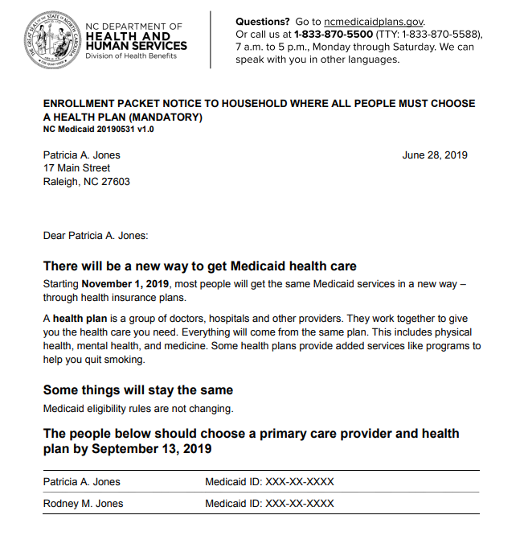
ENROLL: If you received this letter…
“Must Choose a Health Plan (Mandatory)”
You need to enroll in a health plan
by December 13
Talking Points:
#2 – There are a few things to think about when you are choosing a health plan.
For example, if you already have a doctor that you want to continue seeing, you should pick a plan that works with your doctor.
1
Choose a Primary Care Provider (PCP) – this is your main doctor or clinic.
NOTE: Some people received a letter saying the enrollment deadline is September. This deadline has been extended to DECEMBER 13.
2
Choose a Health Plan – each plan provides the same types of services but not all doctors work with each plan. Pick the plan that is best for you.
3
Call the Enrollment Broker if you need help or want to learn more about your options.

Slide 12
If you received a “mandatory” letter, choose a health plan by December 13
Regardless of when enrollment began, everyone with a “mandatory” letter must choose a health plan by December 13.
Open enrollment began in July
Ashe
Alleghany
Surry
Stokes
Rockingham
Warren
Northampton
Gates
Currituck
Caswell
Person
Granville
Vance
Halifax
Hertford
Camden
Watauga
Wilkes
Yadkin
Pasquotank
Avery
Forsyth
Guilford
Franklin
Bertie
Perquimans
Mitchell
Caldwell
Alex-
ander
Alamance
Orange
Durham
Chowan
Madison
Yancey
Davie
Nash
Edgecombe
Wash-
ington
Tyrrell
Buncombe
McDowell
Burke
Iredell
Davidson
Randolph
Chatham
Wake
Wilson
Martin
Dare
Swain
Haywood
Catawba
Rowan
Pitt
Beaufort
Graham
Jackson
Henderson
Rutherford
Lincoln
Cabarrus
Mont-
gomery
Lee
Harnett
Johnston
Wayne
Greene
Hyde
Cherokee
Macon
Tran-
sylvania
Polk
Cleveland
Gaston
Stanly
Moore
Lenoir
Craven
Clay
Mecklenburg
Pamlico
Union
Anson
Rich-
mond
Hoke
Cumberland
Sampson
Duplin
Jones
Scot-
land
Onslow
Carteret
Robeson
Bladen
Pender
Columbus
New Hanover
Important Dates
Open Enrollment Ends | December 13, 2019
Health Plan Starts | February 1, 2020
Brunswick
Open enrollment begins in October

Slide 13
What if I do not choose a health plan?
If you are required to choose a health plan (“mandatory”) …
Medicaid will choose a plan & PCP for you if you don’t choose by December 13, 2019

Slide 14
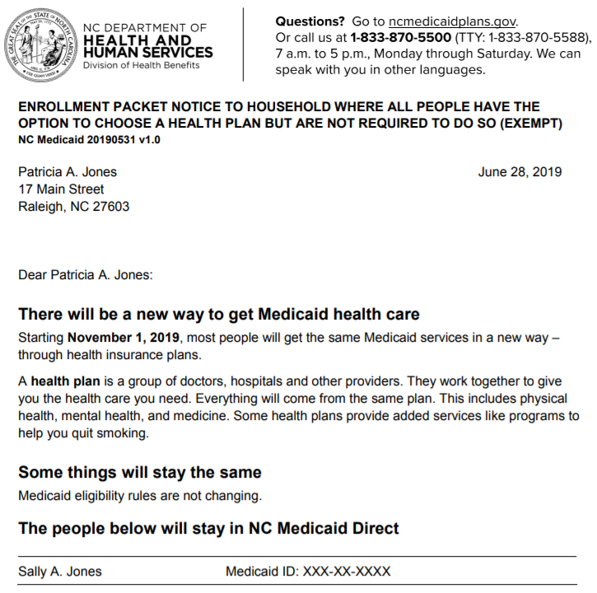
Talking Points:
If you are in this category, you do not need to do anything and will continue getting Medicaid the same way you do today.
You can move to a health plan if you want to. But remember – there are SOME services for behavioral health, I/DD, and TBI that are only available in NC Medicaid Direct via LME-MCOs, not a health plan.
If you aren’t sure about what to do, the best thing to do is to call the enrollment broker. They can help you understand your options.
OPTION TO ENROLL: If you got this letter…
You do not need to do anything
“May choose a health plan or stay in NC Medicaid Direct”
1
You are NOT required to do anything and you will get Medicaid the same way you do today.
NOTE: You do not need to choose a health plan.
However, you have the option to choose one – this deadline to has been extended to DECEMBER 13.
2
But, you have the option if you want to move to a health plan.*
3
Call the Enrollment Broker if you need help or want to learn more about your options.
*Reminder:
Some services for I/DD, TBI, serious mental illness and severe substance use disorders are only available if you stay in NC Medicaid Direct

Slide 15
What if I do not choose a health plan?
If you are not required to choose a health plan (“optional”)…
Nothing happens.
You will continue receiving services the same way that you do now.

Slide 16
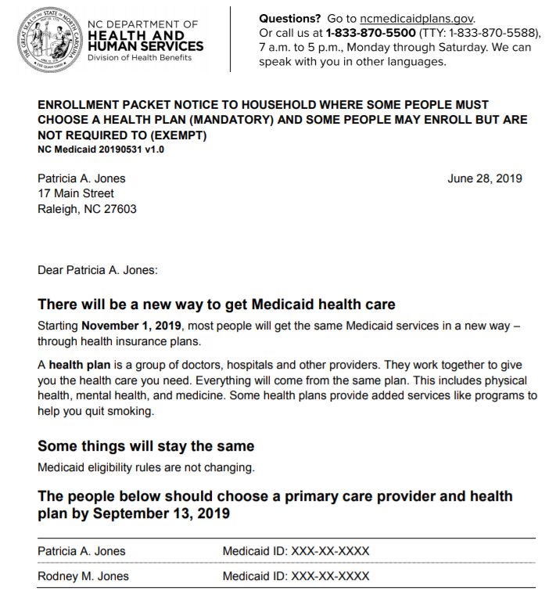
MIXED HOUSEHOLD: If you got this letter…
Only some people in your home need to choose a health plan
Voiceover:
If you want to keep your current doctor – also known as a primary care provider or “PCP” – you should check to make sure that the doctor works with the plan you want to enroll in. Remember – not all doctors work with every plan. If you choose a health plan that your doctor doesn’t work with, you will need to choose a new PCP so check to make sure your current doctor works with your health plan
1
Choose a Primary Care Provider (PCP) – this is your main doctor or clinic.
NOTE: Only some people in your home need to choose a health plan.
The deadline to choose a plan has been extended to DECEMBER 13.
2
Choose a Health Plan – each plan provides the same types of services but not all doctors work with each plan. Pick plan that is best for you.
3
Call the Enrollment Broker if you need help or want to learn more about your options.
NOTE: Each person who is enrolling can choose his/her own PCP and health plan

Slide 17
Reminder: What if I do not choose a health plan?
If you are not required to choose a health plan (“optional”) …
If you are required to choose a health plan (“mandatory”) …
Nothing happens.
You will continue receiving services the same way that you do now.
Medicaid will choose a plan & PCP for you if you don’t choose by December 13, 2019

Slide 18
What should I do if I think I got the wrong letter?
If you got a letter telling you to choose a health plan but think you should stay in NC Medicaid Direct:
Call the enrollment broker, and
Ask for this form:
Reminder:
Some services for people with an I/DD, serious mental illness, traumatic brain injury, or severe substance use disorder are only available in NC Medicaid Direct through LME/MCOs*
Request to Stay in NC Medicaid Direct &
LME-MCO: Beneficiary Form
Call the Enrollment Broker
1-833-870-5500
*Full list of these services available in the Appendix.

Slide 19
What if I do not get a letter?
Some people will not get letters.
Some people will not have the option to choose a health plan.
These people are either in a special group or need services that are only provided by NC Medicaid Direct and through LME/MCOs.
For example, someone who has Medicaid and Medicare cannot choose a health plan or PCP and will not receive a letter.
If you have questions about whether you are getting a letter, call the Enrollment Broker for help
Call the Enrollment Broker
1-833-870-5500

Slide 20
Special Eligibility Scenarios

Slide 21
What if I…
Receive Medicaid and Medicare…
Receive CAP/DA, CAP/C, or PACE…
Voiceover:
For almost all of these scenarios, if you got a letter telling you that you are required to enroll in a health plan, you should alert the enrollment broker
Am in a nursing facility…
Receive the TBI or Innovations Waiver…
Have a “deductible” or “spend down”…
Am in TCLI or live in a State IDD Center or ICF…
Get services from a LME/MCO…
Am in foster care…

Slide 22
If I have Medicaid and Medicare…
Voiceover:
If you got a mandatory letter, then you need to alert the Enrollment Broker
You are staying in NC Medicaid Direct and will have no changes to your Medicaid health care
You do not need to do anything.

Slide 23
If I am in a nursing facility…
You do not need
to do anything
You have lived in a nursing home for more than 90 days
You are most likely staying in NC Medicaid Direct and will have no changes to your Medicaid health care
You do not have Medicare
You have lived in a nursing home for less than 90 days
You are most likely enrolling in a health plan
You will enroll
in a health plan

Slide 24
If I have a “deductible” or “spend down”…
You are staying in NC Medicaid Direct and will have no changes to your Medicaid health care
You do not need to do anything.

Slide 25
If I am in foster care…
This includes youth in foster care, former foster youth in adoptive placements, and former foster youth up to age 26
You are staying in NC Medicaid Direct and will have no changes to your Medicaid health care
You do not need to do anything.

Slide 26
If I receive CAP/DA, CAP/C, or PACE services…
Talking Points:
If you have requested services but are waiting to receive CAP/DA, you will need to choose a plan
If you currently receive CAP/DA and CAP/C waiver services, you will not choose a health plan
There will be no changes to your waiver services
PACE members will not choose a heath plan
You are staying in NC Medicaid Direct and will have no changes to your Medicaid health care
You do not need to do anything.

Slide 27
If I receive Innovations or TBI waiver services…
Talking points:
If you are have requested Innovations or TBI waiver services but are waiting receive them, you do not need to do anything. However, you have the choice to move to a health plan if you want to and will not lose your spot on the waiver waitlist.
If you receive Innovations or TBI waiver services, you will not choose a health plan
There will be no changes to your waiver services
You are staying in NC Medicaid Direct and will have no changes to your Medicaid health care
You do not need to do anything.

Slide 28
If I am in TCLI or live in a State IDD or ICF…
Transitions to Community Living (TCLI) participants and State IDD or intermediate care facility (ICF) residents will not choose a health plan
It does not matter what other services you receive, you will not choose a health plan
You are staying in NC Medicaid Direct and will have no changes to your Medicaid health care
You do not need to do anything.

Slide 29
If I get services from a LME/MCO…
Some people who get services from their local management entity/managed care organization (LME/MCO) will choose a health plan, but some will not.
Some services for serious mental illness, severe substance use disorders, I/DD, or traumatic brain injuries are not available in the new health plans.
If you are unsure of what to do next or think you got the wrong letter, call the Enrollment Broker
Voiceover
People in ACTT, CST and/or PSR; those in child BH residential; those needing SAIOP or SUD residential; those with recurrent BH crises, those with IDD...will all stay in Medicaid Direct and not choose a health plan
Call the Enrollment Broker for help
1-833-870-5500

Slide 30
If I am not in these groups or am unsure…
If you are unsure about what to do next, the best thing to do is call the Enrollment Broker
The Enrollment Broker can tell you if you should enroll in a health plan, or not
The Enrollment Broker can help you choose a PCP and health plan that meets your needs
Call the Enrollment Broker for help
1-833-870-5500

Slide 31
What To Do Next

Slide 32
Read your Medicaid letter and ask for help if you need it!
If you have any questions about Medicaid changes or need help enrolling in a health plan…
Contact the Enrollment Broker
1-833-870-5500 (toll-free)
www.ncmedicaidplans.gov

Slide 33
Reminder: Opportunities to Engage
DHHS values input and feedback from stakeholders and will make sure stakeholders have the opportunity to connect through a number of venues and activities.
Ways to Participate
Regular webinars, conference calls, meetings, and conferences
Comments on periodic white papers, FAQs, and other publications
Regular updates to website: https://www.ncdhhs.gov/assistance/medicaid-transformation
DHHS Will Engage
Consumers, Families, Caregivers, and Consumer Representatives
Providers
Health Plans and LME/MCOs
Counties
General Public
Comments? Questions? Let’s hear from you!
Comments, questions, and feedback are all very welcome at
Medicaid.Transformation@dhhs.nc.gov

Slide 34
Appendix

Slide 35
Services only available in NC Medicaid Direct & LME/MCOs
Medicaid Services
Residential treatment facility services for children and adolescents
Child and adolescent day treatment services
Intensive in-home services
Multi-systemic therapy services (MST)
Psychiatric residential treatment facilities (PRTF)
Assertive community treatment (ACT)
Community support team (CST)
Psychosocial rehabilitation (PSR)
Substance abuse non-medical community residential treatment
Substance abuse medically monitored residential treatment
Substance Abuse Intensive Outpatient (SAIOP)
Substance Abuse Comprehensive Outpatient Treatment (SACOT)
Intermediate care facilities for individuals with intellectual disabilities (ICF/IID)
Innovations Waiver services*
Traumatic Brain Injury Waiver services*
State-Funded Behavioral Health and Intellectual and Developmental Disability Services
1915 (b)(3) Services
Respite
Supported Employment/Employment Specialist
Individual Support
One-time Transitional Costs
NC Innovations Waiver Services (funded by (b)(3)) (Deinstitutionalization Services)
Community Navigator
In-home Skill Building
Transitional Living Skills
Intensive Recovery Support
NOTE:
*Waiver services are only available to individuals enrolled in the waiver.

