Slide 1
TAILORED PLANS ESSENTIALS PRESENTATION
AUDIENCE
A caregiver or beneficiary looking for greater detail.
A stakeholder, advocate, or navigator.
This presentation communicates key information about Tailored Plans. It is:
Intended for individuals who want to know more about Tailored Plans.
Not intended to explain how the system or program works, but rather how it impacts people.
Designed for people who do not know acronyms like PCP or LME.
4th - 6th grade reading level.
Presenters should: Use the slides that are most relevant and tailor every presentation.

Slide 2
Tailored Plans
Essentials Presentation
Last updated June 2025

Slide 3
What is a
Tailored Plan?
Tailored Plans include services for people with more intense needs, including people with:
Tailored Plans are a kind of NC Medicaid Managed Care health plan. They cover services for mental health, severe substance use, I/DD, TBI needs and prescriptions in one plan.
Serious Mental Illness (SMI)
Severe Substance Use Disorders (SUD)
Intellectual/ Developmental Disabilities (I/DD)
Traumatic Brain Injuries (TBI)
Learn more at: Medicaid.NC.gov/Tailored-Plans

Slide 4
What is in the Welcome Packet?
If you are eligible for a Tailored Plan, you will get a Welcome Packet which includes:
Your new Tailored Plan ID card
Your Member Handbook
Your Primary Care Physician (PCP) is listed on your member ID card

Slide 5
Who runs Tailored Plans?
Tailored Plans in North Carolina are managed by four companies called Local Management Entities (LME).
Your LME will cover your behavioral health, physical health, and prescriptions.
Alliance Health
Partners Health Management
Trillium Health Resources
Vaya Total Care

Slide 6
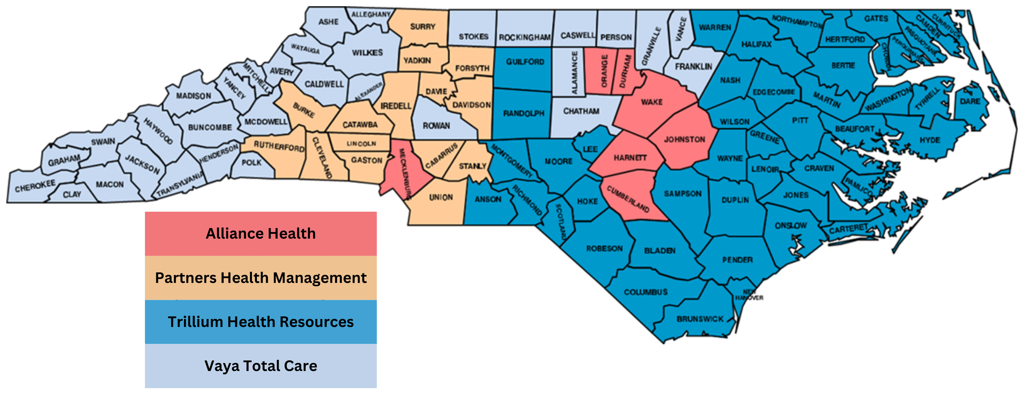
How will I know which Tailored Plan I am in?
There is only one Tailored Plan per county
Your Welcome Packet has information about which Tailored Plan you are in. Your plan is assigned based on the county where you get your Medicaid benefits.
Your assigned Tailored Plan
is based on the county that manages your Medicaid benefits. You cannot choose a different Tailored Plan.

Slide 7
How to find providers in your network
Call your Tailored Plan
Alliance Health 1-800-510-9132
Partners Health 1-888-235-4673
Trillium Health 1-877-685-2415
Vaya Total Care 1-800-962-9003
Providers (doctors and specialists) must accept your Tailored Plan
- not just Medicaid.
Search the directory
Look for your providers on the directory:
ncmedicaidplans.gov

Slide 8
Services Offered by Tailored Plans

Slide 9
How your Tailored Care Manager can help you
Tailored Care Managers help you get the care you need.
They help you manage your health and wellbeing – so you don’t have to do it all yourself.
Rides to appointments
Prescriptions and medical supplies
Doctors and specialists
Support with chronic conditions like diabetes
Housing resources
Hospital admissions, transfers, discharges
Support groups and community activities
Direct contact for all things Medicaid
Food and nutrition

Slide 10
Services offered by Tailored Plans If you opt out of Tailored Plans, these services are not paid for by other NC Medicaid Managed Care health plans.
Here are some examples:
Child and adolescent day treatment services
Intensive in-home services
Multi-systemic therapy services
Psychosocial rehabilitation
Residential treatment facility services
Community living and supports (specific to I/DD & TBI)
Supported employment (available to I/DD, TBI, and behavioral health)
Respite (specific to I/DD, TBI, serious emotional disturbance and severe SUD)
State-funded behavioral health, I/DD, and TBI services

Slide 11
Non-Emergency Medical Transportation (NEMT)
NC Medicaid's Tailored Plans Covers Free Rides to Medical and Mental Health Appointments
WHO IS ELIGIBLE?
People on NC Medicaid, including Tailored Plans, who need transportation assistance to travel to their medical appointments qualify to receive NEMT services. Accessible rides are available for members with mobility disabilities.
WHAT TRIPS ARE COVERED?
Visits to your Medicaid doctor or specialist
Trips to the pharmacy or for prescription pick-up
Mental health appointments
Substance abuse treatment

Slide 12
Continued... Non-Emergency Medical Transportation (NEMT)
NC Medicaid's Tailored Plans Covers Free Rides to Medical and Mental Health Appointments
HOW TO SCHEDULE NEMT RIDES?
Call your Tailored Plan to schedule NEMT rides.
Alliance Health 1-855-759-9600
Partners Health 1-833-577-2309
Trillium Health 1-877-685-2415
Vaya Total Care 1-888-621-2084
Request your ride at least 2 days before your appointment for best availability. This 2-day requirement does not apply in urgent pickups, like hospital discharges.

Slide 13
Continued... Non-Emergency Medical Transportation (NEMT)
TRAVEL-RELATED REIMBURSEMENTS
If you drive yourself to an appointment, or if a family member or friend gives you a ride, you might get money back for travel costs such as:
Gas vouchers
Food
Overnight or long-term lodging
Parking fees and tolls during transportation to health appointments
Transportation vouchers for taxi payments, ride-sharing services, or public transportation
Mileage reimbursements
Contact your Tailored Plan (Alliance, Trillium, Vaya Total Care, or Partners Health Management) to ensure your trip is covered and get more details.
Learn more at: Medicaid.NC.gov/NEMT

Slide 14
1915(i) Medicaid Home and Community-Based Services
NC Medicaid’s New 1915(i) Free Services Help You Live More Independently At Home
Tailored Plans include 1915(i) home and community-based services to help members and caregivers get the support they need.
WHO IS ELIGIBLE?
NC Medicaid members with:
serious mental illness,
severe substance use disorders,
traumatic brain injuries,
or intellectual/developmental disabilities.

Slide 15
1915(i) Medicaid Home and Community-Based Services
Continuation...
WHAT SERVICES ARE COVERED?
Respite​ Care: Breaks for caregivers, including overnight or weekend care
Supported Employment: Helps you find a job that's right for you
Individual Placement and Support Services: Job help for those with severe mental illness or substance use disorders
Individual and Transitional Support: Helps with housing, finances, etc.
Community Living and Support: Learn to perform daily activities, like bathing and dressing, and community aspect activities like grocery shopping and making friends
Community Transition: Helps you move from an institutional setting back to your community
Call your health plan or call your Tailored Care Manager or care coordinator (if you have one) to find the services you need.
Continuation...
Learn more at: Medicaid.NC.gov/1915i

Slide 16
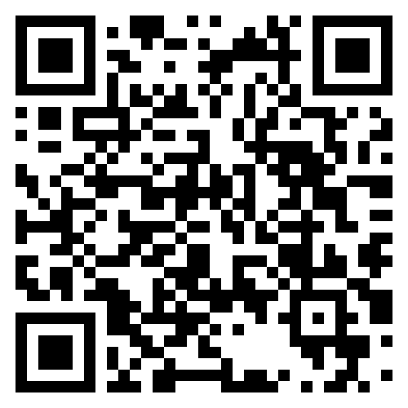
Call your Tailored Plan
Learn more about Tailored Plans.
Alliance Health: 1-800-510-9132, TTY: 711 or 1-800-735-2962
Partners Health Management: 1-888-235-4673, TTY: 711
Trillium Health Resources: 1-877-685-2415, TTY: 711
Vaya Health: 1-800-962-9003, TTY: 711
Not sure who to call? Call 1-833-870-5500.
For questions about eligibility:
Call the NC Medicaid Enrollment Broker at 1-833-870-5500.
Visit our website
medicaid.nc.gov/tailored-plans

